Slide 1


The Micro-credentials Characteristics Statement
9 June 2022

Slide 2
What is a “characteristics statement”?
Complements and contextualises the information provided in The Frameworks for Higher Education Qualifications of UK Degree-Awarding Bodies (the Qualifications Frameworks)
Provides more detail around distinctive features of particular types or levels of qualification and the implications and potential of these
Used by higher education providers in the design and development of new provision and review of existing provision

Slide 3
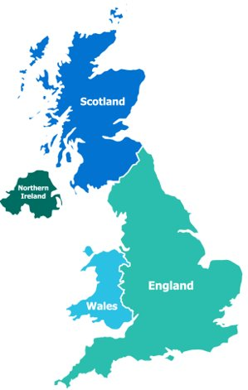
Imperatives
Must support practice in all four nations of the UK
Must enable – not restrict
Must be flexible
Must help protect the reputation of the sector

Slide 4

Definition
For the purposes of this Characteristics Statement and UK higher education, a micro-credential is:
credit-bearing against a recognised level of the Qualifications Frameworks;
subject to standard quality assurance mechanisms; and
not normally an award in its own right on the Qualifications Frameworks, although there are no upper or lower limits on the amount of credit that a micro-credential carries.

Slide 5

Characteristics Statement: sections
Definition
Context and Purposes of Micro-Credentials
Characteristics of the Learner
Admissions and Access, including Recognition of Prior Learning
Course Design, including Learning & Teaching and Assessment
Certification
Quality Management

Slide 6


Purposes of Micro-Credentials
Purposes
employment: upskilling, re-skilling, career migration
flexible pathways into and through higher education

Slide 7




Characteristics of the Learner
The design of micro-credentials and the support for learners engaging with them will need to take account of diverse needs and backgrounds. This could include:
extent of previous engagement with higher education opportunities;
support around needs associated with a disability;
the opportunities that the learners have to engage with the course around other commitments (both work and personal); and
challenges associated with geographical location in relation to the higher education provider and/or adequate access to the internet and digital devices.

Slide 8

Admissions and Access, including Recognition of Prior Learning
Key information and considerations:
What prior knowledge or skills are needed to succeed?
What are the on-course requirements?
What is the “offer” in terms of support and resources?
What are the future opportunities, both for employment and study?
Implications for policies on RPL and currency of credit

Slide 9

Pathways and “stackable” credits
Consortium approach
“Capstone” course

Slide 10

Quality Management
Key areas for consideration will be:
admissions decisions, and the role of Recognition of Prior Learning;
approaches to course design and approval that are agile and not overly-burdensome while still being robust;
swift confirmation of outcome and award following completion of assessment;
effective monitoring and review; and
student (or learner) engagement in quality management.

Slide 11




Implications for Students’ Associations
Representation; voting in elections; access to facilities, events and societies

Slide 12

What next?

