Slide 1
Strengthening our Global Learning Community: Resilience in Action
Dr Anne Tierney
a.tierney@hw.ac.uk
@goze01
Dr Rob Daley
r.a.daley@hw.ac.uk
@RD531
At QAA Enhancement Conference 2022: Resilient Learning Communities – Inclusive, Flexible and Accessible, 09/06/22

Slide 2
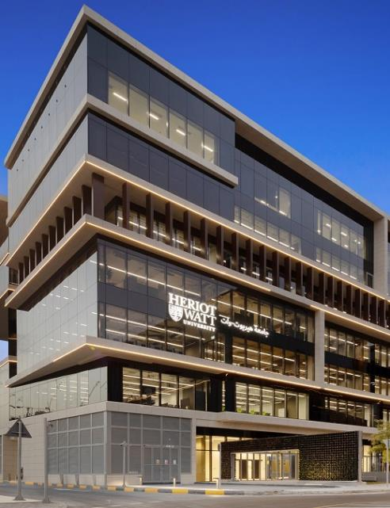
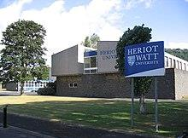
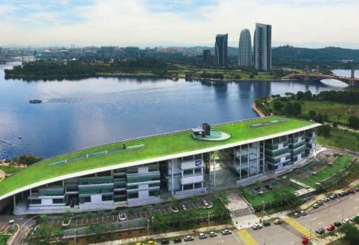
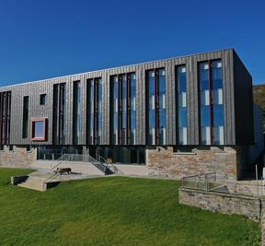
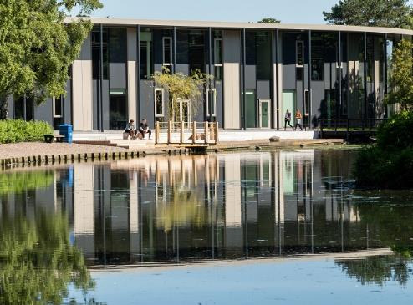
Heriot-Watt
Scotland’s Global University
Five campuses
Edinburgh
Borders
Orkney
Dubai
Malaysia
Learning & Teaching Academy

Slide 3
Student Numbers*
 | Dubai | Edinburgh | Malaysia | Orkney | Scottish Borders | ALP | IDL | Total
Foundation | 200 | None | 570 | None | None | None | None | 770
Undergraduate | 1910 | 6900 | 1525 | None | 615 | 455 | <5 | 11405
PGT | 1505 | 1470 | 245 | 20 | 30 | 3815 | 6620 | 13705
PGR | 35 | 970 | <5 | 10 | 20 | 0 | 395 | 1430
Total | 3650 | 9340 | 2340 | 30 | 665 | 4270 | 7015 | 27310
Full data available at https://www.hw.ac.uk/uk/services/docs/information-governance/AnnualStatistics2019-20.pdf

Slide 4
Our Enhancement Theme Approach
Focus on: “Strengthening our Global Learning Community:
Resilience in Action”
Action: “A collective effort to consider what our global learning community may look like by 2025 and how collaborative action can support staff and students across contexts and shape institutional process and practice.”
Outcome: HWU staff and students feel they belong to, and are inspired by, a global community that empowers them to flourish in their work and learning.

Slide 5
Our Enhancement Theme Approach
Overarching Themes
Resilient pedagogies
Resilient teaching teams
Student Action for Resilience
Local resilience, global change
Enabling resilience, Creating Connection
Approaches include
Institutionally commissioned work
Special Interest clusters
Focus on elements
Mini-projects

Slide 6
What are mini-projects?
Opportunity for individuals or small teams to realise an innovative project
Small scale funding (up to £1500) per project
£6000 from QAA Scotland plus top up funding from Schools (HWU)
Make a practical difference to student experience
Evaluation of project
Progress update and end of project report
Dissemination of project
Learning & Teaching Week presentation
Sharing Scholarship in Practice session
External dissemination
(Glassick, Huber & Maeroff, 1997; Felten, 2013)

Slide 7
Rationale for mini-projects
Encourages SoTL (Trigwell et al, 2000)
Informed: Familiarity with literature
Communication: Opportunity to disseminate internally and externally
Reflection: Opportunity to reflect in- and on-action (Schön, 1983)
Conception: Leads to a learner-centred view of teaching and learning (Tierney, 2017)
Carry out planned project with evaluation (Glassick, Huber & Maeroff, 1997; Felten, 2013)
Student-led projects
Professional services-led projects
Alumni, employers, local community involvement
Raises the profile of Teaching and Learning within the institution (Blackmore & Kandiko, 2011, p. 405; Tierney, 2016, p. 209)
Aligns with institutional strategy (HWU, Strategy 2025)
Empowers individuals to enact the strategy in positive and creative ways

Slide 8
Strategy 2025: Shaping Tomorrow Together
HWU Strategy, Shaping Tomorrow Together: https://strategy2025.hw.ac.uk/wp-content/uploads/2019/06/Strategy_2025.pdf

Slide 9
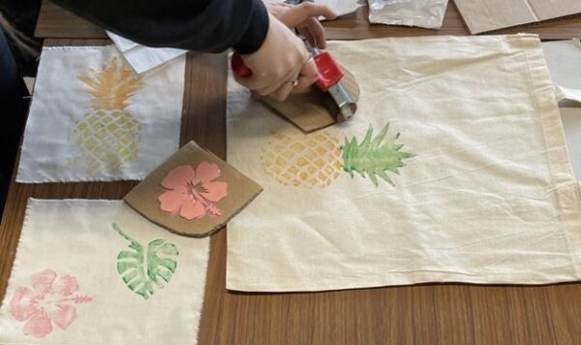
Connecting beyond our campuses
Lead | Project Title
George Jaramillo & Angela Cassidy | Knitted Tomographies: Material translations of place in Galashiels – Linking students with the community
Grace Smith | Textiles & Design Online Workshop – Student-designed workshop for schools

Slide 11
Impact of the projects
January 2021
19 project proposals
14 funded projects
September 2021
33 project proposals
12 funded projects
Category | January 2021 |  | September 2021
 | funded | total | funded | total
Edinburgh | 6 | 6 | 9(2) | 18
Malaysia | 5 | 9 | 1(2) | 13
Borders | 2 | 3 | 0 | 1
Dubai | 1 | 1 | (1) | 1
Academic staff (faculty) | 8 | 12 | 9 | 23
Technician | 1 | 2 | 0 | 1
Prof. Services | 3 | 3 | 3 | 7
Student | 2 | 2 | 0 | 2

Slide 12
Student engagement
Projects proposed and led by students
Minecraft server
Happiness Forum 2021
Student involvement in planning and execution of projects
Student podcasts
Digital learning
ePALS
Internal and external dissemination
HWU Learning and Teaching Week
QAA Internationalisation event
Improving University Teaching international conference 2022 and 2023

Slide 13
Take home message
Autonomy
Innovation
Creativity
Outward ripples
Intro to SoTL
Opportunity for dissemination
Sharing practice
Collaboration

Slide 14
Further Resources
HWU Strategy information https://strategy2025.hw.ac.uk/wp-content/uploads/2019/06/Strategy_2025.pdf
HWU Enhancement Theme Work: see https://lta.hw.ac.uk/strategic-projects/

Slide 15
References
Blackmore, P., & Kandiko, C. B. (2011). Motivation in academic life: A prestige economy. Research in Post-Compulsory Education, 16(4), 399–411.
Felten, P. (2013). Principles of Good Practice in SoTL. Teaching Learning Inquiry: The ISSOTL Journal, 1(1). http://tlijournal.com/tli/index.php/TLI/article/view/39
Glassick, C. E., Huber, M. T., & Maeroff, G. I. (1997). Scholarship assessed: Evaluation of the professoriate. Jossey-Bass.
Schön, D. (1983). The reflective practitioner -how professionals think in action. Basic Books.
Tierney, A. M. (2016). ‘More than just a Teaching Fellow’: The impact of REF and implications of TEF on life science Teaching-Focused Academics in UK HEIs [Doctoral Thesis, Durham University]. http://etheses.dur.ac.uk/11826/
Tierney, A. M. (2017). Threshold Concepts in Academic Practice: Engagement with the Scholarship of Teaching and Learning. Practice and Evidence of the Scholarship of Teaching and Learning in Higher Education, 12(2), 165–184.
Trigwell, K., Martin, E., Benjamin, J., & Prosser, M. (2000). Scholarship of Teaching: A model. Higher Education Research & Development, 19(2), 155–168.

