Slide 1
Student-Led Project: Promoting the Equity of the Student Learning Experience Enhancement Themes Conference Thursday 9th June 2022
Ondrej Kucerak
Vice President Education
Aberdeen University Students’ Association
Megan Brown
Development Consultant
sparqs

Slide 2
Student-Led Project (SLP)
Partnership working between QAA Scotland and sparqs.
Activity led by a Steering Group – chaired by the Enhancement Themes Student Lead.
Each year, the SLP chooses a new topic to focus on under the wider Enhancement Theme.

Slide 3
Student-Led Project Steering Group 2021-22
Damilola Adesanya, President Education & Welfare, RGU Students’ Union
Calum Brown, VP Education, University of Stirling Students’ Union
Mia Clarke, VP Education, Glasgow University Students’ Representative Council
Heather Innes, VP Higher Education, Highlands & Islands Students’ Association
Ondrej Kucerak, VP Education, Aberdeen University Students’ Association
Zechariah Laari, VP Academia, Dundee University Students’ Association
Amy McLuckie, Co-President, SRUCSA
Kevin Miguim, VP Education SAUWS
Viki Soper, Access Participation and Success Officer, OU in Scotland
Supported by sparqs (Patrycja Mitrut and Megan Brown) and QAA Scotland (Demelza Curnow and Caroline Turnbull).

Slide 4
This year’s theme: Promoting the Equity of the Student Learning Experience
HEIs in Scotland are currently reflecting on learning from the pandemic, in order to continue to develop approaches that maximise the benefits of a more blended environment.
Universities and students’ associations are working collaboratively to build a student experience that supports all students however and wherever they learn and to support the diverse needs of their student populations.
This year’s project has considered how students and staff can support equity for diverse student communities to allow students to get maximum benefit from their learning opportunities.

Slide 5
Outcomes of the project:
1
2
3
Identifying and raising awareness of the barriers to students in accessing equity of learning and teaching and how these can be mitigated against.
Promoting examples of good practice in equitable learning and teaching practices.
Preparing and equipping class reps to raise equity issues where they arise and effectively represent all students.

Slide 6
The outputs of the project:
A piece of desk-based research to collate a set of key existing theory, practice and resources related to equity in L&T
A suite of case studies related to equitable learning and teaching practices.
A ‘Top Tips’ resource on how to break down barriers related to equitable learning and teaching.
A workshop that explores how students’ associations and institutions can develop course rep systems that represent diverse groups of students.
An introductory guide for student reps that outlines the key issues around equity in a L&T environment.

Slide 7
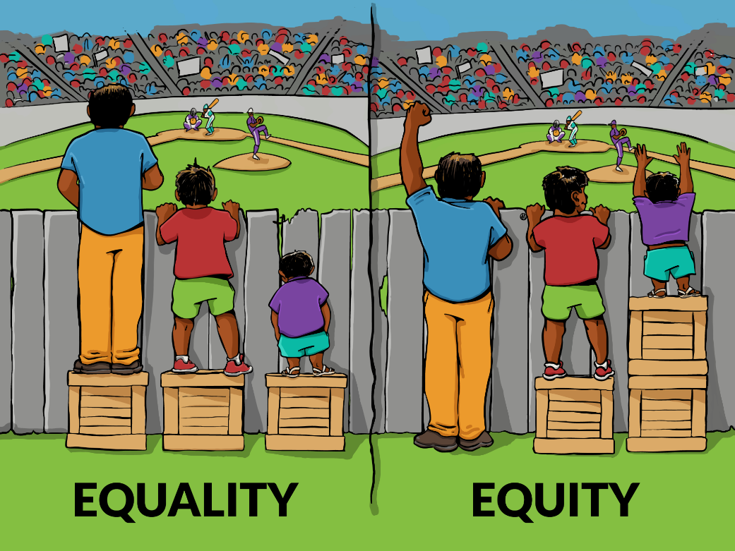
Equality vs Equity

Slide 8
Why does this matter?
“Education plays a key role in determining how you spend your adult life – a higher level of education means higher earnings, better health, and a longer life. By the same token, the long-term social and financial costs of educational failure are high. Those without the skills to participate socially and economically generate higher costs for health, income support, child welfare and social security systems. So a fair and inclusive system that makes the advantages of education available to all is one of the most powerful levers to make society more equitable.”
Organisation for Economic Co-Operation Policy Brief

Slide 9
Desk-based Research
To provide a solid grounding for sector colleagues interested in exploring the topic, the project team undertook desk research exploring key existing theory, practice and research relating to equity in learning and teaching.
The team identified 5 themes which emerged in the research:
Pedagogy
Accessibility
Digital technologies
Datafication of education
Equality, diversity and inclusion

Slide 10
Top Tips resource and case studies
A set of ‘top tips’ focused on ‘breaking down barriers’ related to equitable learning and teaching.
Organised under the same themes as the desk research.
Small suite of case studies to be published later this month.
“Continue to decolonise your curriculum and ensure that your practice is enacted in partnership with diverse groups.”
“Be honest about your own digital skills to your students. Encourage a culture of working together.”
“Don’t overload the virtual learning environment with resources, use it to generate discussion and asynchronous engagement.”

Slide 11
Workshop – Supporting Student Reps to Engage with Issues of Equity
This took place yesterday!
This workshop explored with attendees the roles institutions and students’ associations can have in supporting student reps and rep systems to effectively engage with issues of equity.
How can we create and support student rep systems that effectively capture the views of our diverse student population?
What opportunities are there to engage with issues of equity throughout the whole of the rep journey?
What can we learn from existing practice where students and students’ associations have supported reps to engage with issues of equity, or made more equitable rep systems?

Slide 12
Rep Guide to Equity in Learning and Teaching
During the pandemic, pedagogical practices have changed. Institutions now need to make changes about what to keep, and reps have a key part to play in these decision-making conversations.
Designed to give reps an informed view of what we’ve learned from the pandemic – an overview of some of the key topics and a starting point for conversation.
Examples of topics:
Asynchronous and synchronous teaching
Digital exclusion
Online vs in-person assessments

Slide 13
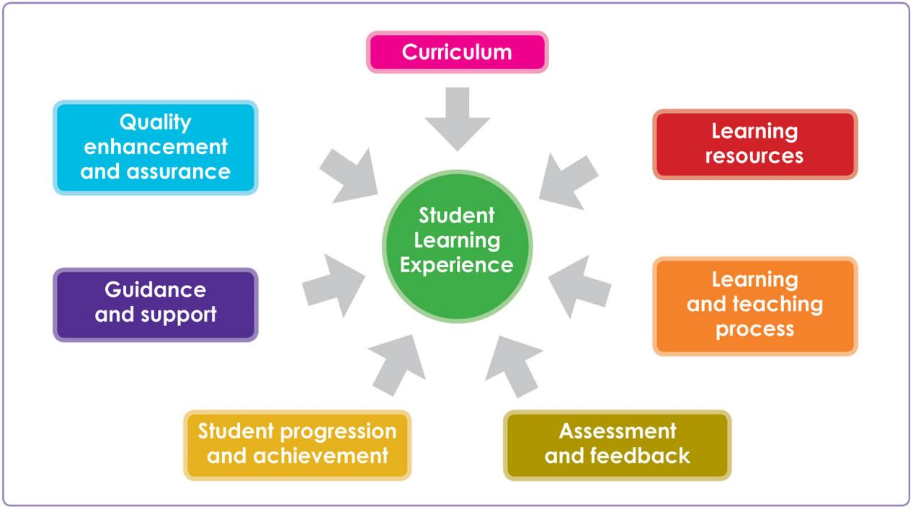
sparqs’ Student Learning Experience Diagram

Slide 14
Our takeaways
Students are experts in their own learning – student-led resources can give a new perspective on existing topics. Resources designed by students for students are often popular.
Issues of equity cross the entirety of the student learning experience and it’s important to consider all elements of the SLE when developing initiatives for particular student groups.
Sometimes, specific L&T decisions will make the learning experience more accessible for some students, while creating additional barriers for others. Where possible, offer choice as to how to engage.
Students (and staff) often hold multiple, intersecting identities that create unique experiences of L&T. One size does not fit at all – don’t be afraid to ask students what they need.
Fostering equitable practices is an ongoing process – remember to evaluate progress regularly and celebrate the distance travelled.

Slide 15
Thank you!
All our Student-Led Project resources can be found on the Enhancement Themes website: https://www.enhancementthemes.ac.uk//en/resilient-learning-communities/promoting-the-equity-of-the-student-learning-experience
Over the summer, we’ll be opening recruitment for new members of the SLP Steering Group.
Any questions, contact Megan at Megan.Brown@sparqs.ac.uk

