Slide 1

Promoting Student Resilience through the Curriculum
| An Online Micro-credential Course
Dr Amy Irwin @Dr_AIrwin
Dr Ceri Trevethan @CeriTrevethan1
Dr Heather Branigan @HeatherBranigan

Slide 2
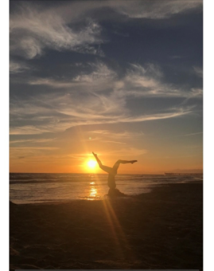
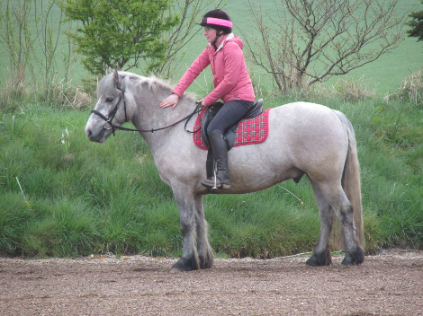
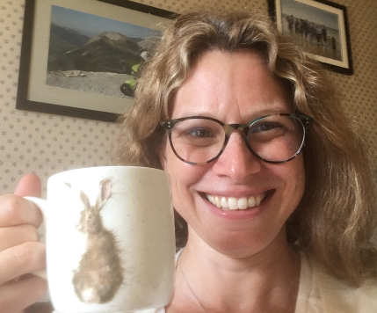
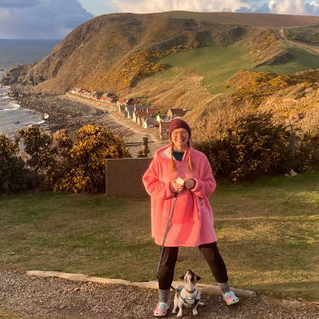
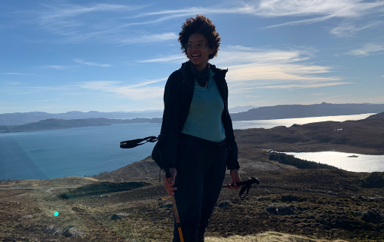

Project Team
Dr Amy Irwin, School of Psychology
Dr Heather Branigan, School of Psychology
Dr Ceri Trevethan, School of Psychology
Dr Joy Perkins, Centre of Academic Development
Caitlin Tawse, Student Intern
Sophie Westhead, Student Intern
Lea Tamba, Student Intern
Alice Alcaras, Student Intern
Funded by the Learning and Teaching Enhancement
Programme

Slide 3
Overview
Aim: Develop a micro-credential online course designed to promote, support and enhance student resilience
Phase 1 – Plan and Explore
  Literature review and focus groups
  Course framework
Phase 2 – Design and Create
  Student-generated content
  Resilience walks

Slide 4

Phase 1: Plan and Explore

Slide 5
Phase 1 – Literature Review
Led by student intern: Caitlin Tawse
Resilience definition: “a dynamic process of positive adaptation in the face of adversity or challenge. This process involves the capacity to negotiate for, and draw upon, psychological, social, cultural and environmental resources” (Brewer et al., 2019).
Resilience
Academic Resilience
Metacognition
Graduate Attribute
Mental Health and Wellbeing

Slide 6
Resilience – Links to Mental Health and Wellbeing
1
2
3
4
The value of social support
Value of peer support, student-generated content and voices
Understanding resilience
Social support builds resilience and helps to manage stress.
Support can include friends & family, University, work, 3rd sector organisations …
The need for action!
Trusted voices (talking about their own experiences) help with engagement and inclusivity.
Being prepared for challenges, understanding that skills can be developed and having realistic expectations all build resilience and improve coping.
Research highlights difficulties many students experience accessing support for their mental health and wellbeing needs.

Slide 7
Phase 1 – Focus Groups
Led by student intern: Sophie Westhead
Five focus groups (3-4 students per group)
Mixed disciplines (Psychology, Law, Music etc.)
and years (1-4).
Practical Aims:
Gather initial reactions to proposed resilience course.
Get feedback on proposed course design, content
and mechanisms.

Slide 8
Phase 1 – Focus Group Insights
Resilience is important
Practical resilience strategies useful.
Important to link to external resources / support
Student generated content important.
Physical and mental health important
Approach
Completion
Content
Importance of interaction
Activities more engaging than lectures.
Podcasts more appealing than lectures.
In-person element may be required for certain aspects.
Course certificate on completion may increase sign-up.

Slide 9

Outcome: Course Framework
Week 1: What is resilience and why do I want it?
Week 2: Adversity impacts everyone
Week 3: Building resilience and coping
with adversity
Week 4: The importance of community
and social connections
Week 5: Reflection
This Photo by Unknown Author is licensed under CC BY-SA

Slide 10
Resilience Course – Key Principles
Bite-size
Micro-credential
Avoidance of traditional ‘lecture’
Interactive
Connecting with peers
Student-generated content
Plan your own Journey
Choice of activities
Resilience journal
Interactions with staff

Slide 11
Phase 2: Design and Create

Slide 12
Student-developed content
What?
Generate a bank of student-generated content relevant to the concept of resilience
Why?
Student-led content is more impactful and engaging
How?
Student content providers
Provision of tasks or activities for students to engage with
Reflections on the impact of those activities on perceived resilience.
Generation of guidelines to ensure the content is relevant for resilience
In a variety of formats: podcasts, vlogs, blogs, testimonials, images
Important for teaching effectiveness across a diverse student body (Nava et al., 2019)
The majority of students do not engage with standard mental health support services and resources (ONS, 2018)
Students see peers as credible sources relating to mental health (Lattie et al., 2020)

Slide 13
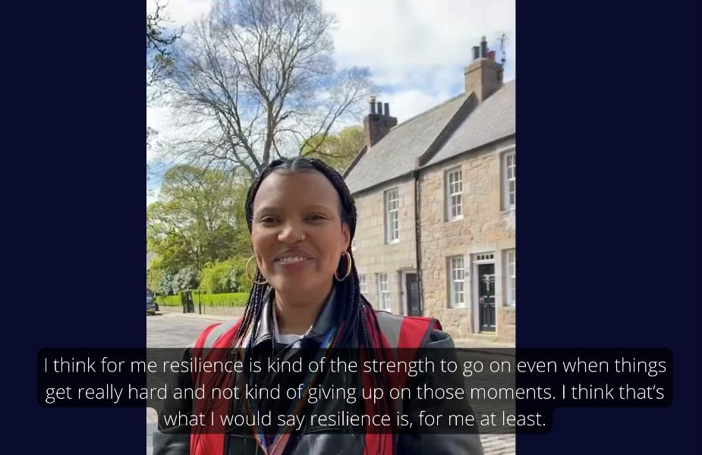
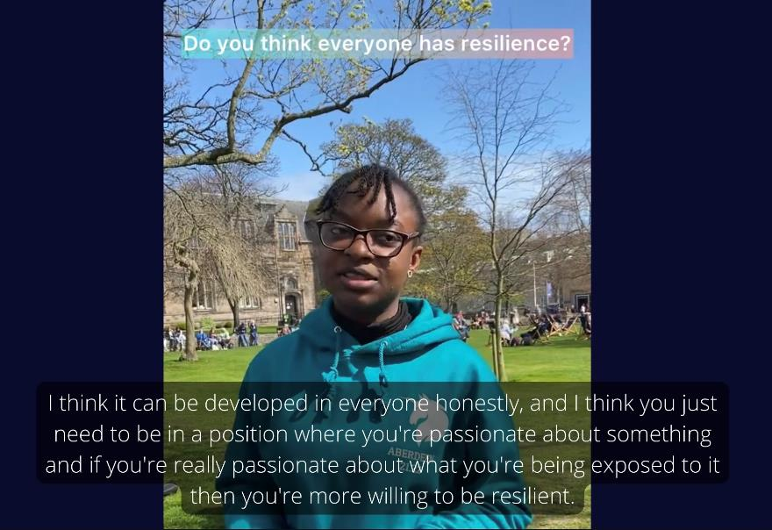
Student-Generated Content: An Example
Led by student intern: Alice Alcaras

Slide 14
Resilience Walks
What?
Develop a series of resilience walks, where students form small groups
and take part in a guided activity as they walk around local areas.
Why?
Students are keen to engage with in-person activities
How?
Plan walking routes and topics of focus
Resilience can be facilitated through informal activities, e.g., community building (Holdsworth et al., 2017)
Making friends and developing support networks is important to students (Laidlaw et al., 2015)
Group walks in nature play a role in ‘un-doing’ the effects off stressful life events (Marselle et al., 2019)
Intervention-based assessment of the walks, rating wellbeing and resilience before
and after walks (evaluation)

Slide 15
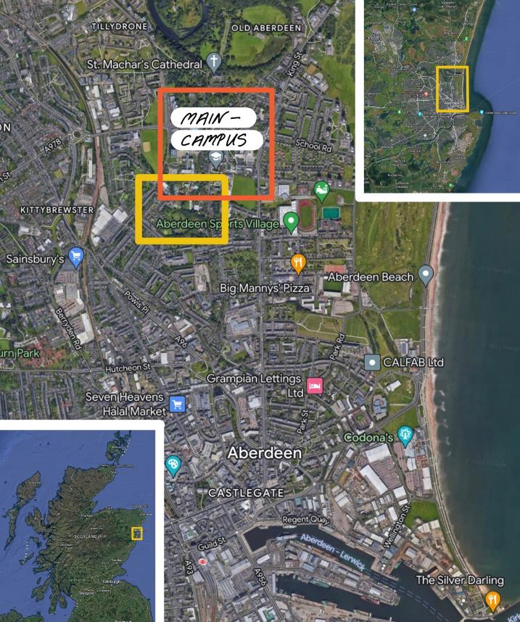
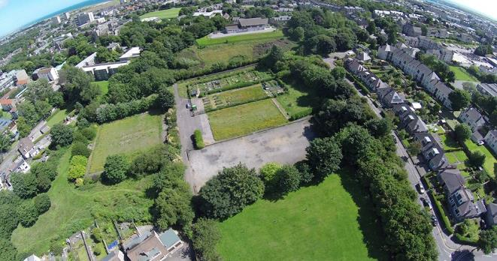
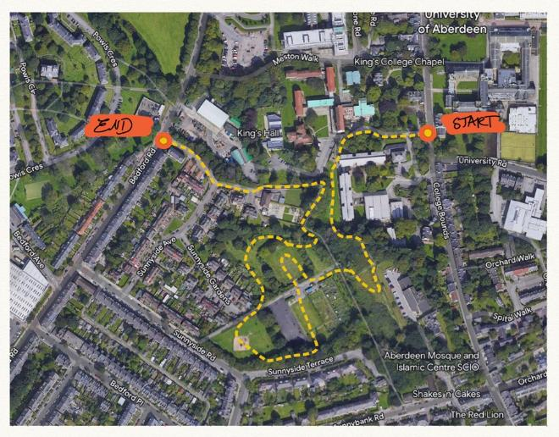
Example – Garden Walk
Led by student intern: Lea Tamba
“EXPLORE” 20 min
1.2 km

Slide 16

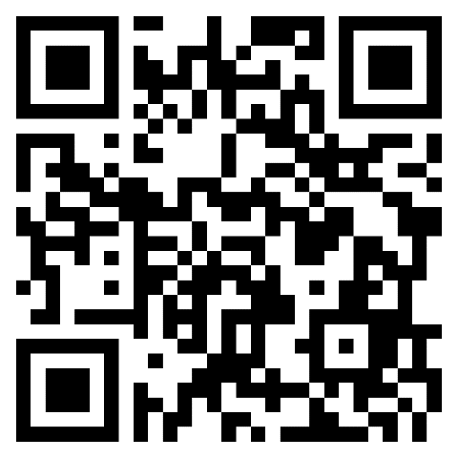
Future Directions
Course Design
  Course administration (Quality Assurance)
  Continue generation of materials
Resilience Walks
  Trialling of activities and routes
  Ensuring accessibility
Continued evaluation

Slide 17

Thank You!
We are happy to take any
questions or points for discussion
heather.branigan@abdn.ac.uk | @HeatherBranigan
a.irwin@abdn.ac.uk | @Dr_AIrwin
c.trevethan@abdn.ac.uk |@CeriTrevethan1

