Slide 1
Addressing the Digital Divide
Workshop: Exploring institutional approaches to digital inclusion and accessibility
Dr Amy Eberlin
Thursday, 9 June 2022

Slide 2
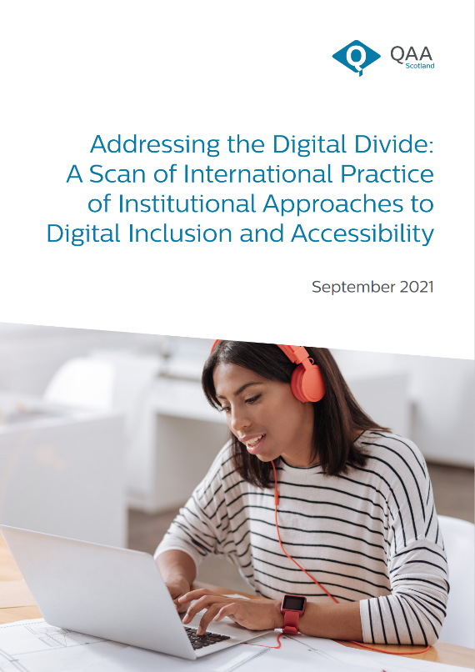
What is the ‘digital divide’?
What can we learn from international practice?
Exploration of themes and our practice

Slide 3




Hardware
Software
Learning Environment
Institutional Support

Slide 4


Hardware
Provision of hardware
Clarity of expectations of use of hardware

Slide 5

What is your institution’s long-term approach to ensuring that students have access to appropriate hardware?
How is this approach communicated to students?
How do you review this approach?

Slide 6

Software
Provision of subject specific software

Slide 7

How does your institution review its provision of subject-specific software licenses?
How do students know how to access subject-specific software?

Slide 8


Learning Environment
Physical environment
Digital environment
Existing distance and/or digital delivery

Slide 9

What support is offered to students who don’t have an appropriate physical learning environment to undertake their studies? How is this identified?
Who is involved in reviewing the accessibility, consistency and stability of the institution’s virtual learning environment? Is there anyone who you think should be included (but isn’t) – why?

Slide 10



Institutional Support
Digital upskilling
Support for specific learner groups
Personalised student support

Slide 11

What is your institution’s long-term approach to supporting digital upskilling?
How have staff and students been supported to improve their digital skills?
How do you support specific learner groups to develop the digital skills to effectively engage with digital learning and teaching technology?

