Slide 1
RCS – Coaching Resilience
Jamie Mackay and Ken Davidson

Slide 2

Year 1
Creative Conversations
Care Experience and Estrangement
In a research community
International Artists
Anti-Racism
Consent
Online Learning
Artist Development
Neurodiversity
Coaching
What do we mean by Resilience in our Learning Community?

Slide 3
Year 1
Creative Conversations
Coaching
What do we mean by Resilience in our Learning Community?

Slide 4
Definitions
Coaching is the art of facilitating the performance, learning and development of another.
Downey (2002:15)
GOAL
STRATEGY
Coaching is unlocking a person’s potential to maximize their own performance. It is helping them to learn rather than teaching them.
Whitmore (2009:177)
PRESENT

Slide 5

Transformation
Coach
Leader
Individual Student
Learner
Cohort
Mentor
Trainer
Status Quo
Adapted from Brockbank and McGill (2006)

Slide 6


Increasing resilience?
Learner Maturity and Autonomy
Teacher Control and Structure
PEDAGOGY
ANDRAGOGY
HEUTAGOGY

Slide 7
1 Learner-Defined Learning Contracts
2 Flexible Curriculum
3 Flexible and Negotiated Assessment
4 Collaborative Learning
heuta - discover
agogos - leader
HEUTAGOGY
https://www.heacademy.ac.uk/knowledge-hub/heutagogy

Slide 8
John Whitmore’s
GROW Model
Will
Goal
What will you do and when?
What do you want to achieve?
Options
Reality
What could you do to achieve the goal?
What currently supports or limits this?

Slide 9
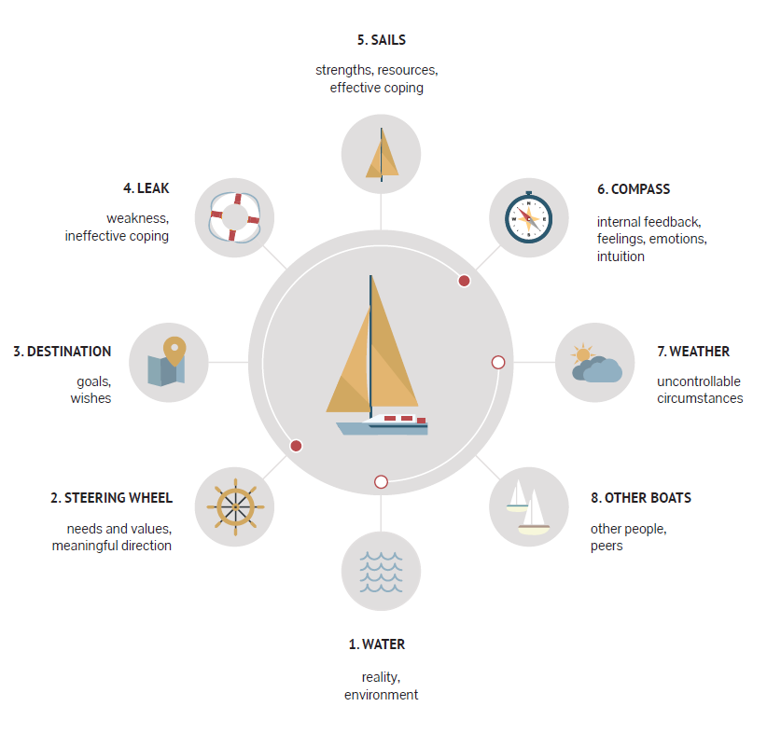
Hugo Albert’s
SAILBOAT Model

Slide 10
Coaching Models Explored
GROW
Case Study
Sailboat
Core Principles
STAR
SCARF
Solutions Focused

Slide 11
The Plan for Year 3
Developing Coaching Practice
Participants' Experience
Year 3 Survey
Future Challenges

Slide 12
Areas of Activity
Core Knowledge
QAA ET
Coaching
(RCS)
Coaching as Heutagogy
(PGLT)
Coaching Principles
(RCS)
Innovation Coaching (RKE)
Colleague
Coaching
(HR)
Transitions Coaching
(Fair Access)
Professional Values

Slide 13
References
Brockbank, A. and McGill, I. (2007) Facilitating reflective learning in higher education. Maidenhead: Open University Press. Available at: http://www.vlebooks.com/vleweb/product/openreader?id=RCScotland&isbn=9780335229550.
‘Coaching Model: STAR’ (2019), 15 April. Available at: https://coachcampus.com/coach-portfolios/coaching-models/lea-weyermann-lozar-star/ (Accessed: 6 June 2022).
Downey, M. (2003) Effective coaching: lessons from the coaches’ coach. New York: Texere.
[FREE TOOL] PositivePsychology.com’s Sailboat Metaphor (2016) PositivePsychology.com. Available at: https://positivepsychology.com/sailboat-metaphor/ (Accessed: 6 June 2022).
Grant, A.M. (no date) ‘The Solution-focused Approach to Coaching’, p. 14.
Presencing Institute - Resources - Case Clinic (no date) Presencing Institute. Available at: https://www.presencing.org/resource/tools/case-clinic-related-doc (Accessed: 6 June 2022).
Use the SCARF Model to Understand Our Individual Triggers (2019). Available at: https://childcareta.acf.hhs.gov/systemsbuilding/systems-guides/leadership/leading-ourselves/scarf-model (Accessed: 6 June 2022).
Whitmore, J. (2009) Coaching for performance: GROWing human potential and purpose : the principles and practice of coaching and leadership. Boston: Nicholas Brealey.

Slide 14

Questions, Queries, Quibbles?
Jamie Mackay J.Mackay@rcs.ac.uk
Ken Davidson
K.Davidson@rcs.ac.uk

