Slide 1

A Conversation Around Diagnostics and Personalised Approaches to Building Student Success
Andrea Cameron and Luke Millard, Abertay
Maggie Gibson, BCU
Colin Milligan, GCU
Pauline Bremner, RGU
Heather Fotheringham, UHI
Holly Heshmati, Warwick

Slide 2
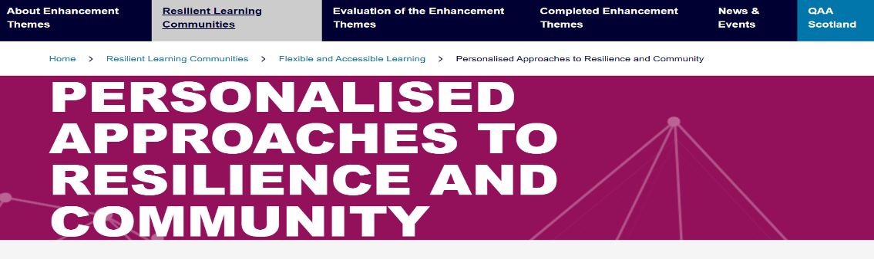








Slide 3
The conversation structure
Brief introduction to the PARC approach and the why!
Drawing on QAA PARC Collaborative project
  The purpose of a diagnostic approach
  Strengths and weaknesses
  Evidence and products required to engage sceptics
Institutional approaches, successes and challenges:
Abertay, BCU, Warwick, UHI
A developmental conversation on:
The potential for Diagnostic approaches
How this can be best supported

Slide 4
Drivers for a diagnostic approach
Pandemic and 16 months of disruption for new students
Institutional imperative – retention and graduate level outcomes
Moral imperative to enable our students to succeed
Personalisation of the student learning journey
Learning gain legacy – BCU, Warwick etc
Technological advances – AI and assessment

Slide 5


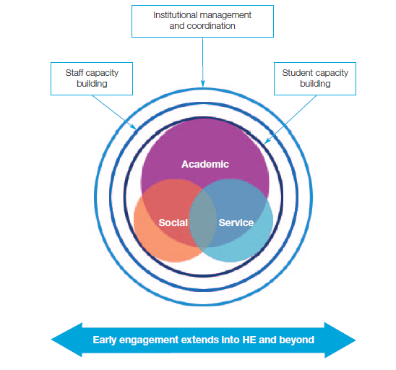
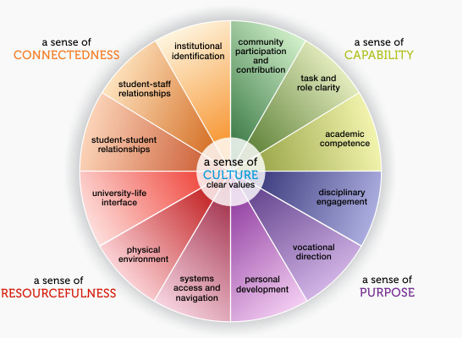
Building upon …….
McMillan and Chavis (1986)
Lizzio (2010)
Thomas (2012)
McNair et al (2016)
Felten and Lambert (2020)

Slide 6
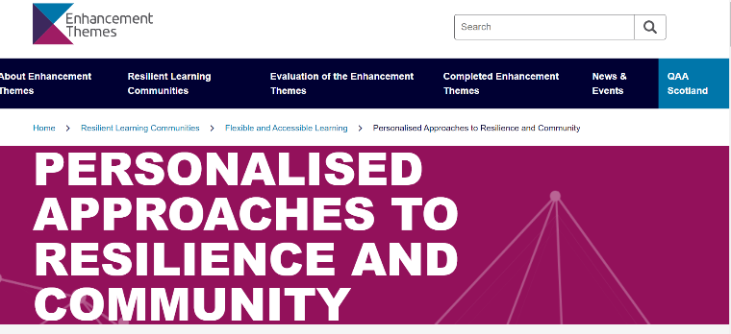
Purpose
To enable and enhance student success through personal reflection and engagement with diagnostic tools and the associated institutional development opportunities.
Recognise context of each institution
Recognise the institutional drive – student retention, EDI and attainment gaps, employability

Slide 7
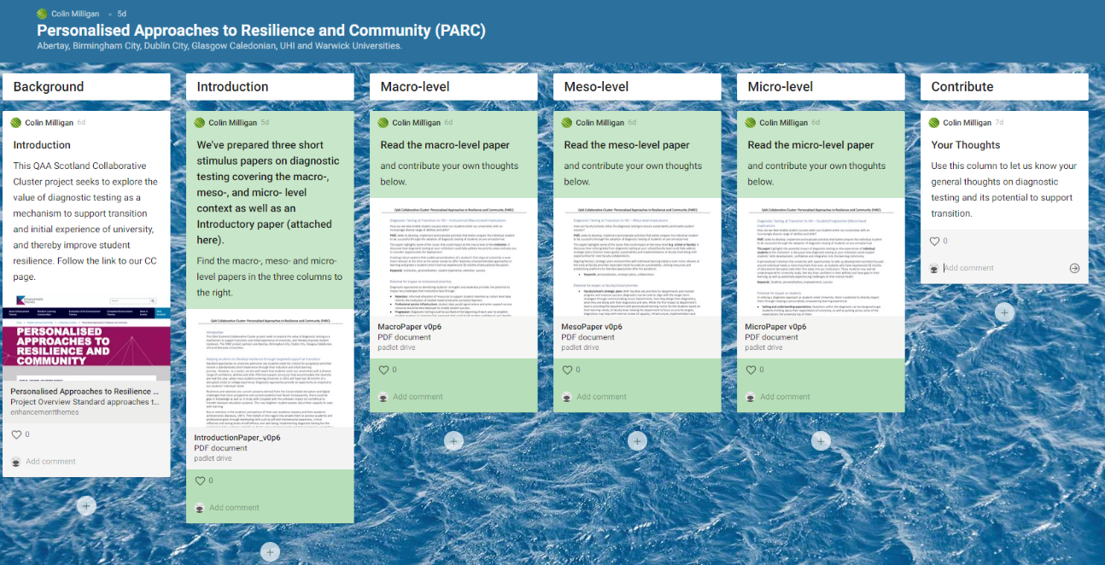
Institutional commitment - levels

Slide 8


Birmingham City University model
Steps to success discovery tool
Cohort level:
Informing course design, content and delivery, additional support requirements at cohort level and development of resources.
Student-level:
Building resilience. Providing students with recommendations and avenues for support, developing confidence in abilities and an awareness of areas for development.
Results
Feedback on strengths & areas for development
Summarised cohort feedback
Signposting to relevant resources
Action plan
Student
Course team

Slide 9

Design & Delivery
Example of a self-reflective question
Fully digital multiple-choice style
30 – 40 minutes to complete
Questions
Competency based
Self-reflective
Reporting
Students – automated, personalised
Staff – cohort based
How do you feel about academic writing?
(select the one that best describes your feelings)
I have done lots of academic writing so I feel quite confident about it
I am quite good but I would still like to improve
I have done some but I am not sure it is the right level for university
I do not feel confident about academic writing
I do not think I need to do writing in my subject
No answer

Slide 10


The Abertay Context
July 2020, Senate approved the recommendations of a University working group that it should initiate developments that would see a microcredential framework implemented for students in September 2021.
This would see the first year existing electives (20 credits) being replaced with a new suite of microcredentials.
A University development group, drawn from across Abertay, placed an emphasis on students utilising a microcredential framework to personalise their own development journey as they prepared themselves for their future careers.
The focus was on preparing students to be successful academically and socially within the Abertay community.

Slide 11

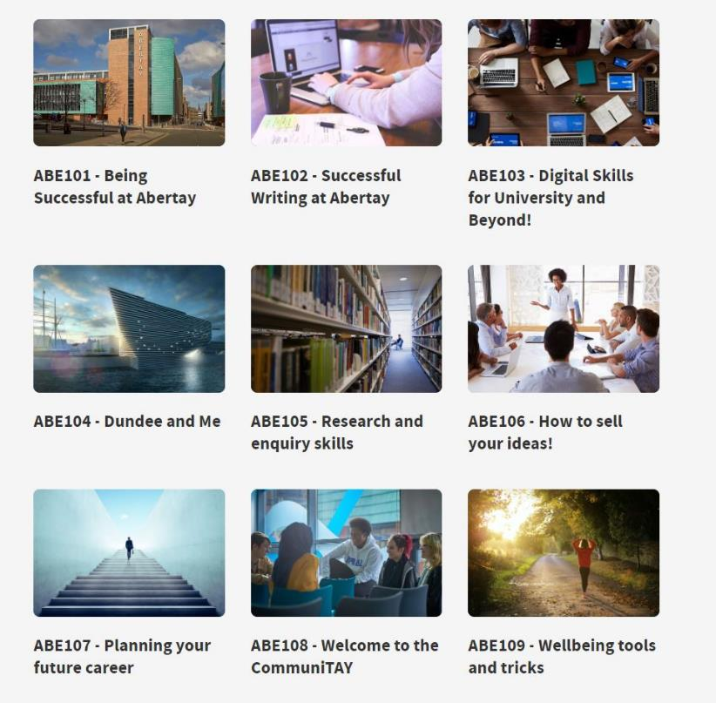

Year 1 Microcredentials
ABE 101 mandatory for all first year students.
Includes a strength based diagnostic in ABE 101 that directs students to other microcredentials that may address perceived weakness.
Transitional, developmental and programme related?
Normalise access to professional services and development
#UKATPARC

Slide 12

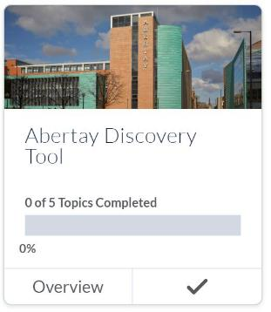
Abertay Discovery Tool
Identifying student strengths and areas for development
Feedback for each section with links to support services
Programme level reports (Available by week 4, term 1)
Sections Include:
Studying at University (Study habits, expectations, independent learning etc)
Academic Writing & Mathematics (Writing, reading, referencing, basic numeracy skills)
Digital Skills
Employability Skills (Career registration)
Wellbeing

Slide 13
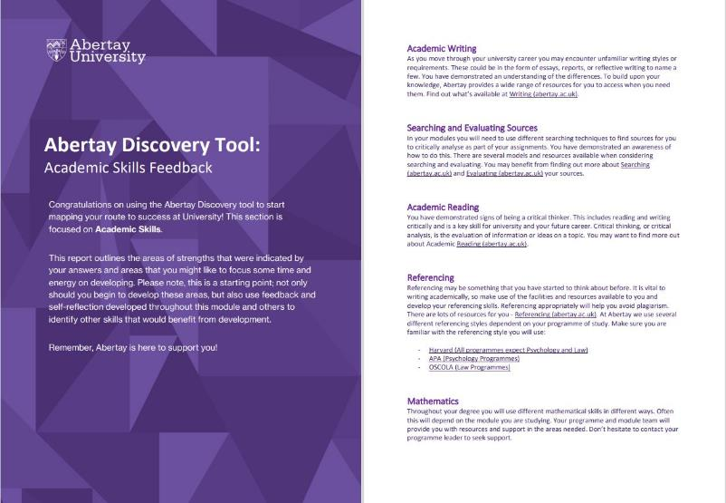
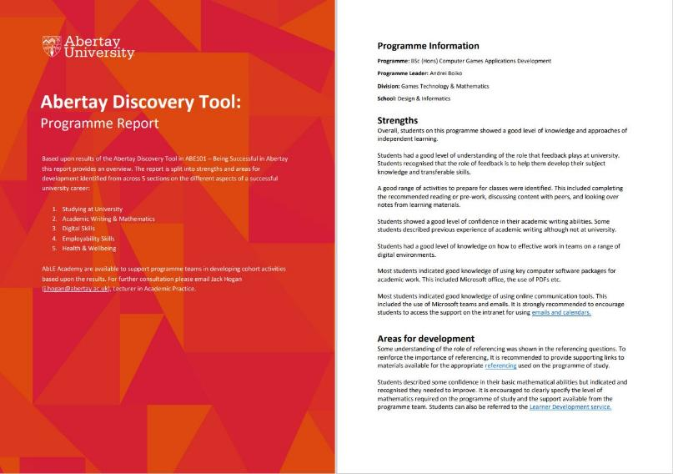
Abertay Discovery Tool

Slide 14
Impact so far…
Module Title | Number of Students | Term 1 Engagement
Module | Number of Students | Submission Rate | Pass Rate
ABE101 – Being Successful at Abertay | 714 (100%) | 95% | 96%
ABE102 –Successful Writing at Abertay | 410 (55.7%) | 93% | 95%
ABE103 – Digital Skills for University & Beyond | 355 (48.2%) | 91% | 98%
ABE104 – Dundee and Me | 191 (26%) | 90% | 100%
ABE105 – Research & Enquiry Skills for the Digital Age | 310 (42.1%) | 92% | 100%
ABE107 – Planning your future career | 490 (66.6%) | 94% | 98%
ABE108 – Welcome to the CommuniTAY | 92 (12.5%) | 100% | 96%
ABE109 – Wellbeing tools & tricks | 278 (37.8%) | 91% | 98%

Slide 15
The Warwick’s Model
The model aims to help students on professional courses engage with a process of employing skills and strategies to meet academic and professional demands of their programme through developing five aspects of academic, professional, motivational, social and emotional resilience.
The model focuses not only on the outcome but also the learning process happening over time. The model aims to go beyond more traditional, individualistic approaches by helping students develop knowledge, skills and experiences suitable for both academic and professional settings in collaboration with others.
The model is not to concentrate on individuals' strengths; it is to provide focus for supporting students on professional programmes.

Slide 16
Design & Delivery
The five modules are designed to help PG students on professional programmes build their awareness of the skills and practices that will help facilitate five aspects of resilience.
Students initially take self-quizzes to identify their learning needs. They are then directed to online resources to learn about skills and strategies, apply skills and strategies, and build their personal and group toolkit.
Each module is designed using the following principles:
-Personalised with the self-quiz, personalised plan and tool kit;
-Interactive with the reflection activities and problem-based scenarios;
-Enabling students to develop the modules’ resources in collaboration with other participants.

Slide 17

UHI (micro) pilot
Motivators
Enablers
Personal interest in student retention
Enhancement Theme Collaborative Cluster
Support of one SN Leader
Contact with the programme via SN Leader
Questions from BCU
Report templates from Abertay
My time via Enhancement Theme

Slide 18
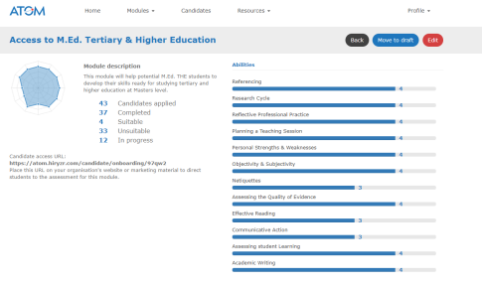
Challenges
Potential levers
Stretched resources
The right expertise
Distributed structure
Institutional commitment beyond strategy
ELIR
Revival of Access to Masters (AtoM) project

Slide 19
Moving to a conversation
Our work is exploratory, we are trying to understand the space, so would like your input.
Two questions to discuss over the next 25 minutes or so.
Facilitated by one of us, on tables or online.
Pick up on one key theme from table

Slide 20
Conversation 1
For your institution and context……
What would be the value or purpose of a diagnostic approach and what would you hope to achieve?

Slide 21
Conversation 2
What do YOU need to engage the sceptics?
Functioning Toolkit - Templates for questions – groupings – guidance & instructions – case studies? Create a question bank?
Macro – Meso- Micro

