Slide 1
Flexible, accessible learning
Professor Ruth Taylor, University of Aberdeen | Enhancement Theme Deputy Leader
9 June 2022

Slide 2
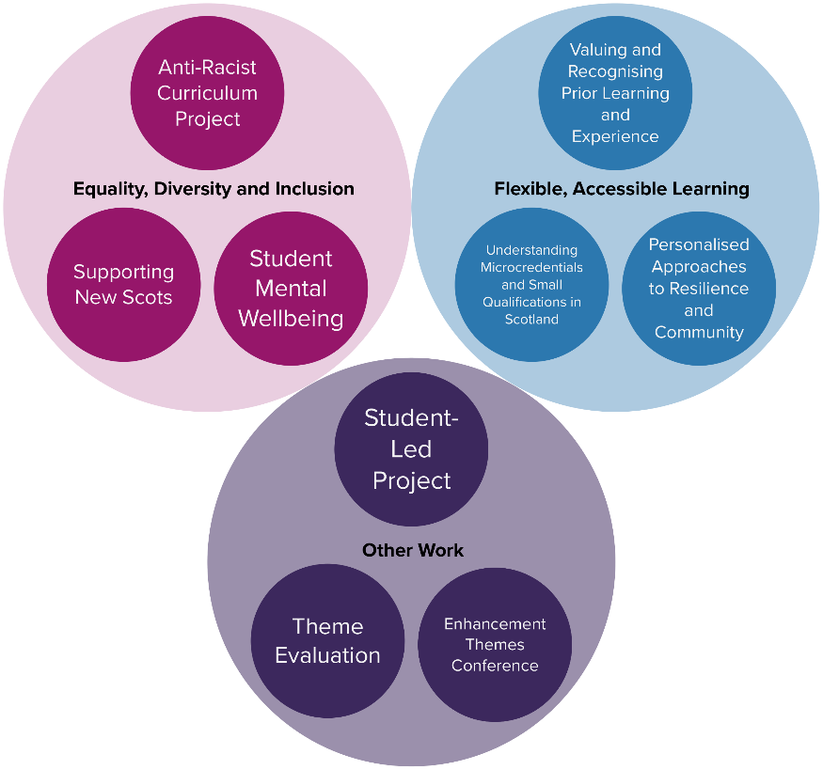
Resilient Learning Communities : Enhancement Theme
Year 2 Theme structure (2021-22)

Slide 3
Flexible, accessible learning
Valuing and recognising prior learning and experience; Understanding micro-credentials and small qualifications in Scotland
Exploring the potential of micro-credentials and digital badging; Personalised approaches to resilience and community
A range of projects/activity, many reflecting sector and cluster work and other important bespoke projects

Slide 4
Why is flexible, accessible learning important now?
Covid-19 has impacted education at all levels of the tertiary sector
SFC review of Coherent Provision and Sustainability identifies a need for flexible provision and the development of shorter, sharper courses to support lifelong learning
A dynamic labour market demands upskilling, re-skilling and new opportunities to meet ever-changing job and career requirements
Existing skills should be recognised through credentialing and/or RPL

Slide 5
Distance travelled so far…Micro-credentials
Scottish Tertiary Education Micro-credentials Network established as a unique forum to identify opportunities to embed micro-credentials as a key to lifelong learning journeys
Input from HEIs, colleges, students, cross-sector stakeholders
Micro-credential glossary for Scotland
Underpinned by Collaborative Cluster projects
Delivered in practice through PARC project

Slide 6
Distance travelled so far…RPL
RPL Framework for Scotland – produced 2014
Inconsistent adoption across the sector
Update of the framework, reflecting a tertiary sector

Slide 7
The road ahead…
Collaborative approaches through tertiary networks for both micro-credentials and RPL
Identification and dissemination of good practice for micro-credentials in Scotland
Community of Practice for RPL and sharing of Models of Practice to support RPL across the sector

