Slide 1
Welcome & looking forward to year 3 of Resilient Learning Communities and 20 years of Enhancement Themes
Debra Macfarlane, Quality Enhancement Manager
Caroline Turnbull, Acting Director, QAA Scotland
9 June 2022

Slide 2
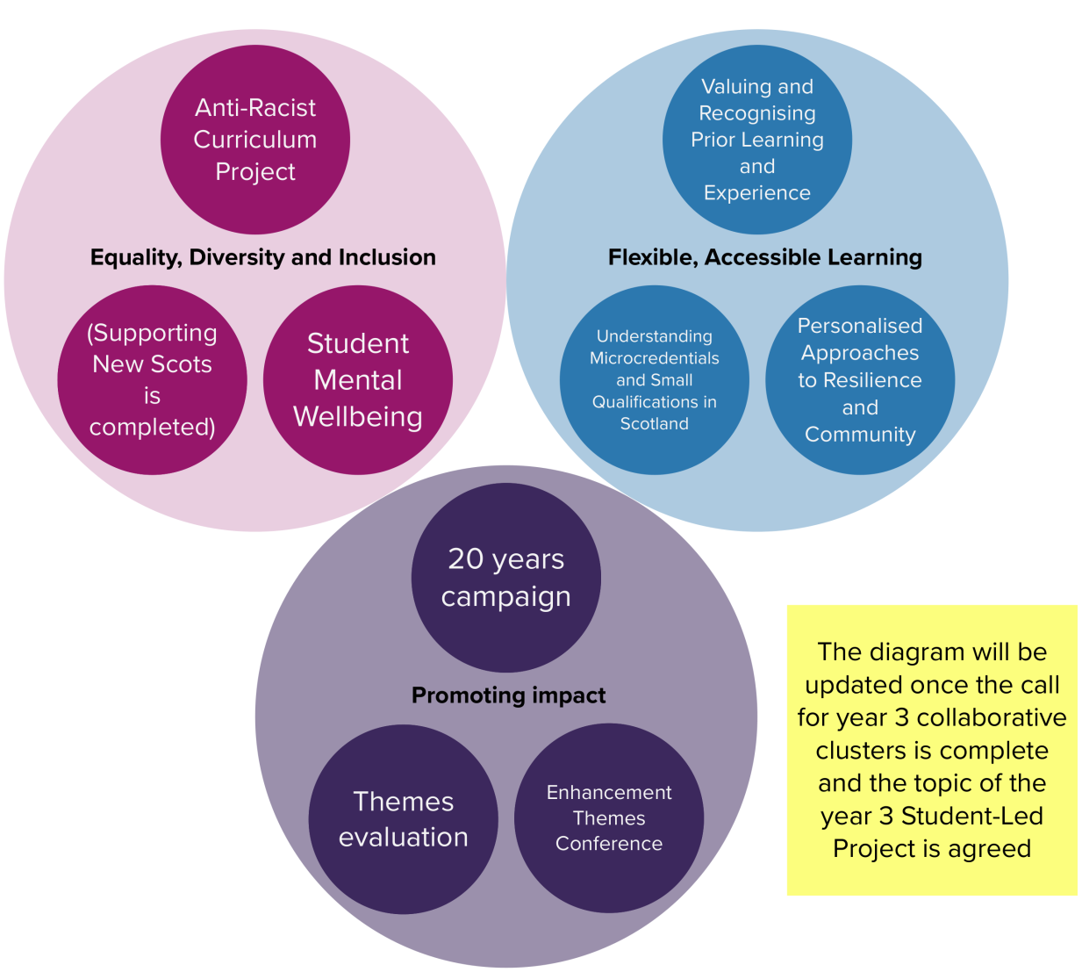
Year 3 Priority topics and focus

Slide 3
Equality, diversity and inclusion
Anti-racist curriculum (ARC) project
Student mental wellbeing
Work to continue in year 3
Executive group
Evaluation of use of resources and impact of year 2 subject-specific workshops
Decolonising the Curriculum in the Time of Pandemic – Edinburgh Napier University
More discipline specific workshops
Supporting New Scots
Continues to be important across the sector - many institutions already engaged in specific projects
Potential activity in year 3:
transition back to campus (students/staff) a possible area
Work with Scottish Government’s developing work on Student Mental Wellbeing Action Plan
Work completed in year 2
Desk-based research and institutional responses collated
Report being published during Refugee week (end June)

Slide 4
Flexible, accessible learning
Valuing and recognising prior learning and experience
Understanding Micro-credentials and small qualifications in Scotland
Work to continue in year 3
Expert Review Group continues
Promote the revised framework
Develop supporting resources
Tertiary RPL Community of Practice
Publish Models of practice
Evaluation
Personalised Approaches to Resilience and Community
Work to continue in year 3
Tertiary Education Network will continue (link to RPL group)
Publication of guidelines and a glossary for micro-credentials in Scotland
Feed into to Scottish Funding Council National Framework for micro-credentials
Evaluation
Work could continue in year 3 (pending outcome of cluster call)
Further activity guided by work to date and ongoing evaluation
Evaluation

Slide 5
Other
Themes evaluation
A major output at Theme end and intended to support future Theme evaluation
Digital Universal Evaluation Framework (UEF), which will be piloted across Theme activities
Lines of enquiry work will conclude and theory of change model completed
Expert Refence Group will continue to meet and act as a sounding board
Sector building capacity activities will continue
Student-Led Project
New topic TBC
Previous topics: 21-22 Promoting the equity of the student experience, 20-21 Digital student communities)
20 years of the Themes
Website re-development and 20 years of the Themes campaign
Themes website re-development project underway
Campaign to be launched celebrating 20 years of the Quality Enhancement Framework including Enhancement Theme activity
Enhancement Conference
2023 conference
June 2023 - two-day event
Title, focus and scope to be agreed but will be a major international conference

Slide 6
20 years of the Enhancement Themes
How many of us were there at the start?
How many Themes have there been?
Can you name them all?

Slide 7
20 years of the Enhancement Themes
There have been 12 Themes
Assessment and Integrative assessment (2003-04) (counts as two!)
Responding to student needs (2003-04)
Employability (2004-06)
Flexible delivery (2004-6)
First year: engagement and empowerment (2005-08)
Research – teaching linkages enhancing graduate attributes (2006-08)
Graduates for the 21st century (2008-11)
Developing and supporting the curriculum (2011-14)
Student Transitions (2014-17)
Evidence for Enhancement: Improving the Student Experience (2017-20)
Resilient learning Communities (2020-23)

Slide 8
20 years of the Enhancement Themes
Do you have the merchandise?
How many of our Enhancement Conferences have you participated in?
What are your best bits?
Who else will be 20 next year?

Slide 9
Our 20 year campaign
Series of activities planned to mark 20 years of the Themes, including blogs, webinars, refreshing resources from previous Themes etc
Setting up a small advisory group to support with this, our Enhancement Theme website, the 2023 conference and the scoping for the next Theme.
We will be undertaking a re-development of the Enhancement Themes website – to make our resources more accessible to the sector
The campaign will draw to an exciting conclusion with the 2023 International Enhancement Conference

Slide 10
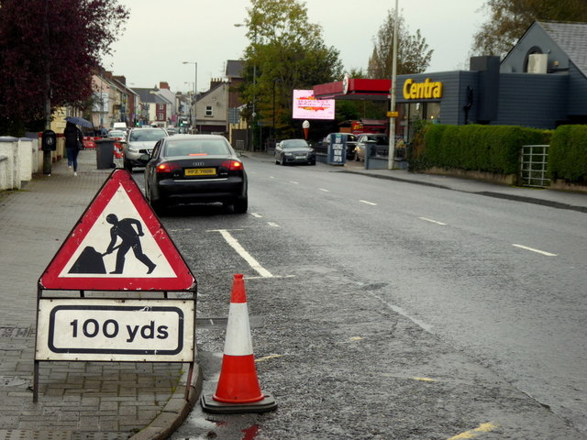
Summary - work in Session 2022-23
Completing year 3 of Resilient Learning Communities and applying our learning to the next Enhancement Theme
Reflecting on our 3-year Enhancement Theme evaluation odyssey and what this means for future Theme evaluation/impact activity
Working with the sector to identify the topic and scope of the next Enhancement Theme and transitioning into it
Celebrating 20 years of Enhancement Themes – year long campaign and major conference in June 2023
Major re-development of Enhancement Theme web pages
This Photo by Unknown Author is licensed under CC BY-SA

