Slide 1
Resilient academic leadership: a kaleidoscope of metaphors
Dr Alison Nimmo, PFHEA
Glasgow Caledonian University
Professor Fiona Smart, PFHEA
Visiting Professor
Edinburgh Napier University &
UWE

Slide 2
Resilience?
When you think about the word resilience in your context, what comes to mind?

Slide 3
The Starting Point
Some things are slippery
Hard to get hold of
But they still matter
They still leave a mark
NB: Unless otherwise stated, all images are downloaded from Pixabay

Slide 4
Resilience in the Context of Academic Leadership
Resilient Universities as Resilient Learning Communities

Slide 5
The Search
What is resilience?
What is academic leadership?
The context – March 2020 through to April 2021

Slide 6
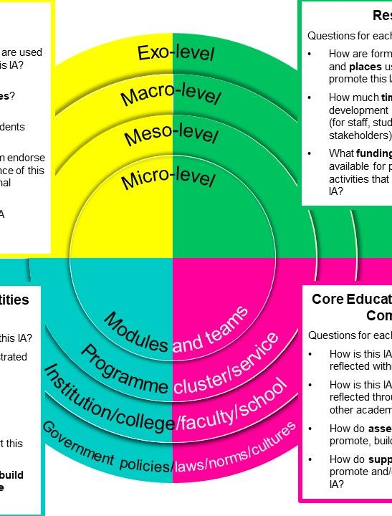
And our tool?
The Evidencing Value Framework

Slide 8
https://www.grammarly.com/blog/metaphor/

Slide 11
When we looked at our data, what did we find?

Slide 13
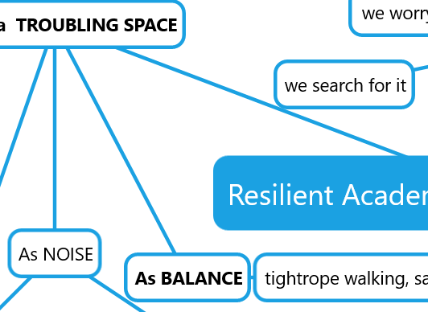
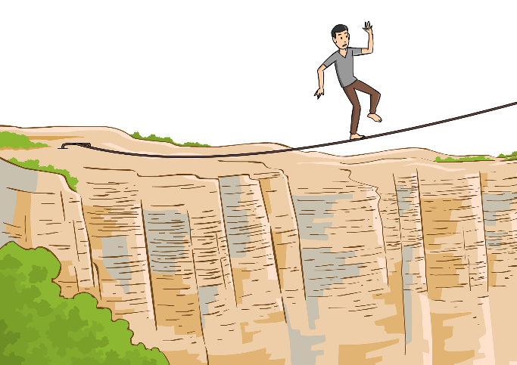
Emergent Metaphor: Core Educational and Support Components
Balance

Slide 15
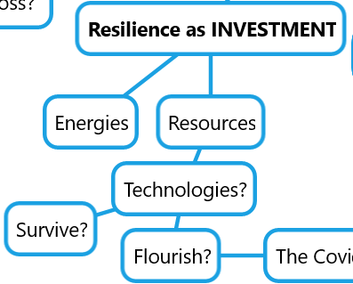
Emergent Metaphor: Resources
Investment/ energy bank

Slide 17
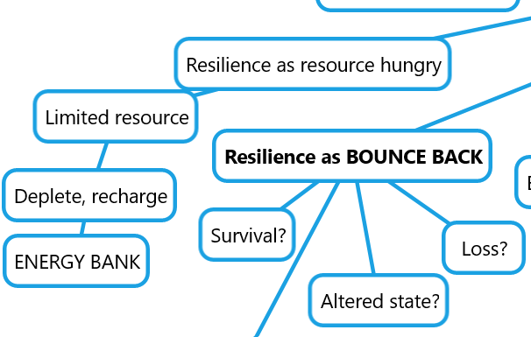
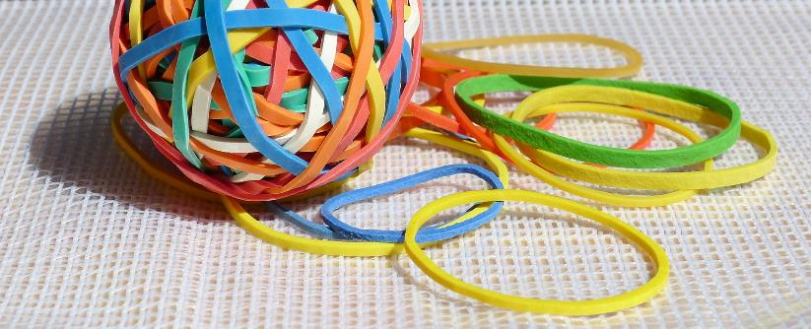
Emergent Metaphor: Ethos Cultures, Identities
Bounce back; bounce forward

Slide 19
Emergent Metaphor: Systems and Structures
Interconnectedness

Slide 20
The treasures we found; do they glitter for you?

Slide 21
Examples in Action

Slide 22
Example 1: Delivery Principles

Slide 23
GCU is a predominately campus-based university; the in-person, face-to-face student learning and social experience is key to our identity, something we must retain as we nurture and strengthen our University community and meet the full range of our educational and professional objectives.

Slide 24
Benefits of in-person learning and teaching include:
For Learners
• access to a richer understanding from a wider range of information and emotional cues e.g. body language, facial expressions, voice not that are not mediated by technology
• easier to conduct group work activity such as problem-based learning
Bullets continue on
For Teachers
• ability to gain a greater understanding of student learning progress during classes from a wider range of information and emotional cues e.g. body language, facial expressions and tone.
• easier to build emotional rapport with students that enhances student engagement and stronger learning communities.

Slide 25
Benefits of online learning and teaching include:
For Learners
• Enhanced flexibility of access to and pace of learning e.g. asynchronous recordings of lectures and online tests and quizzes
• Enhanced flexibility and access to support services: academic and pastoral
• Enhanced digital literacy and ability to learn online which are key graduate skills.
For Teachers
• Greater flexibility for preparation and delivery of learning and teaching activities
• Enhanced opportunities for a wider range of assessment tasks and formats

Slide 26
Optimising our delivery principles
We want to optimise the benefits of in person and online learning and teaching, building on the significant lessons learned and advances made over the Covid-19 pandemic.
We will not simply return to a traditional delivery diet dominated by face-to-face lectures as content delivery and on-campus examinations.
Our practice has moved beyond that, and our students’ needs and expectations are no longer met by just these methods of delivery.

Slide 27
In refreshing the principles, it is important to re-iterate the importance of health, safety and wellbeing of our students and staff.
The University will follow Government regulation and develop its own guidance in line with the Government’s Covid-19 framework for decision making and assessing the four harms2.
Appropriate contextualisation will be applied at GCU London.

Slide 28
Example 2: Embedding Wellbeing in the Curriculum

Slide 29
Activity

Slide 30
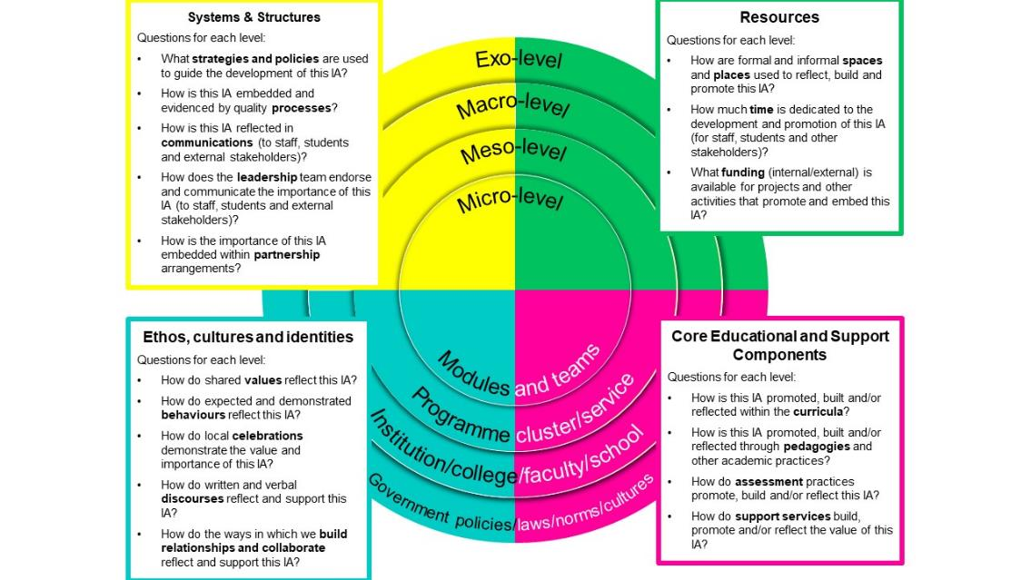
In Groups of 3
Either drawing in one or two of the metaphors you shared into the Padlet or
Working with ours
…use the connotations that they bring to you to devise an action which would deliberately design resilience into a change situation facing you, your students or your staff.

Slide 33
a.nimmo@gcu.ac.uk and FMSmart@outlook.com

Slide 34
a.nimmo@gcu.ac.uk and FMSmart@outlook.com

