Slide 1
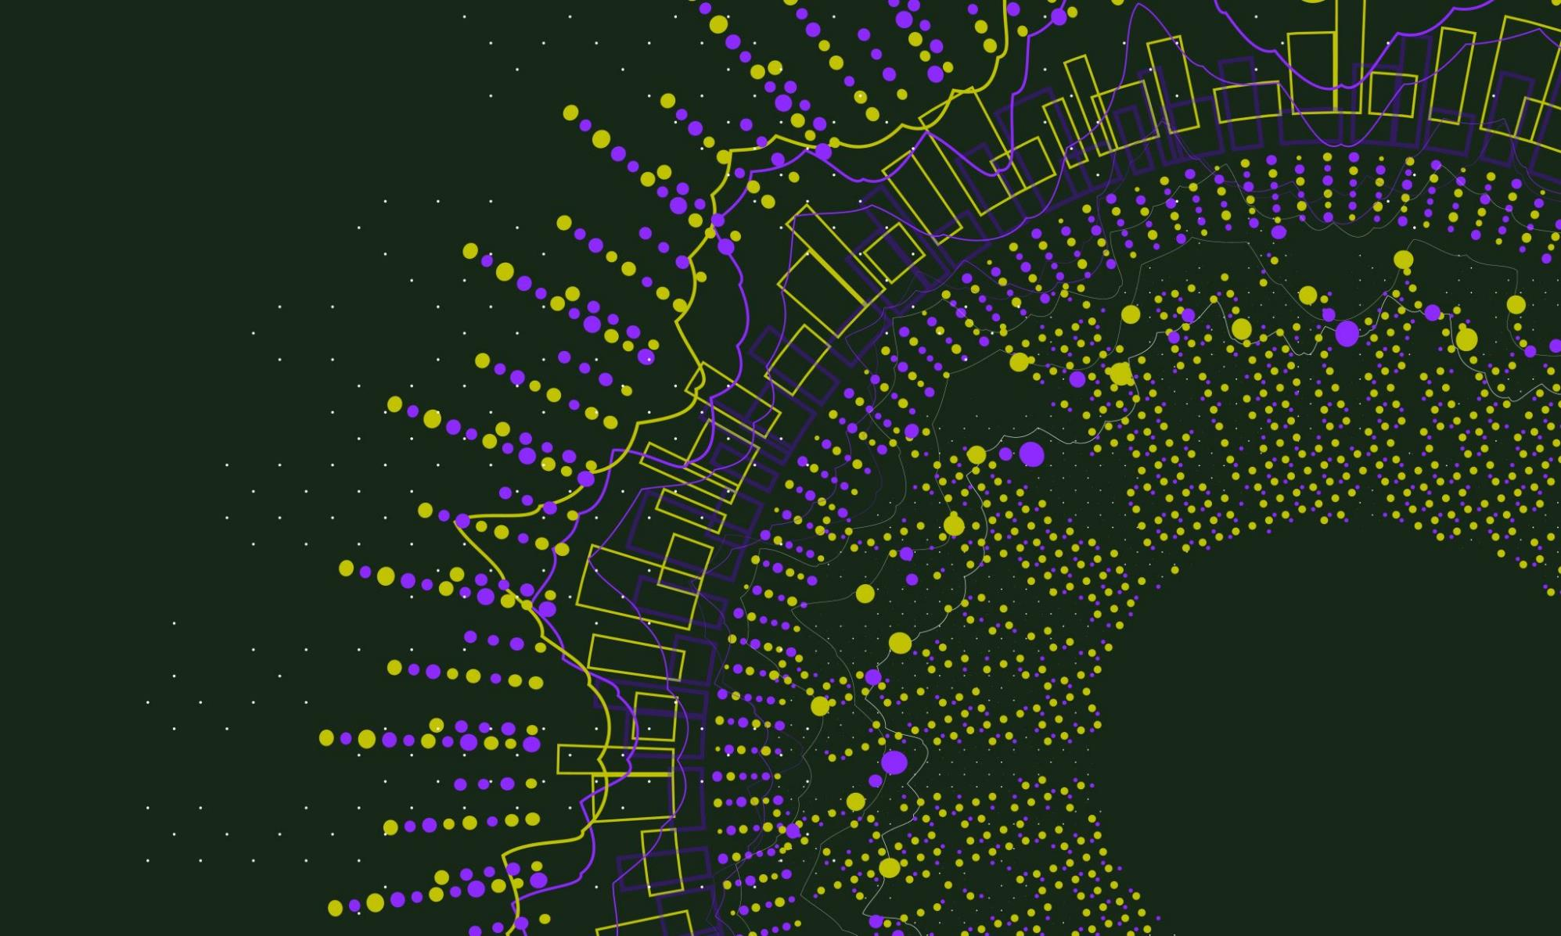
Learning from the impact of individual identities on staff’s experiences during Covid-19:
Ethically implementing new styles of working
Jenny Zike
Sam Illingworth

Slide 2
Research Questions
RQ1: In what ways did participants feel their protected characteristics impacted their experiences of learning and teaching during Covid-19?
RQ2: Is there evidence that digital learning and teaching resulted in more/less equal experiences for staff during Covid-19?

Slide 3
Methods
Survey sent to staff and students across the University – open from 7 May until 1 July 2021.
173 responses (50 students, 123 staff).
Asked a range of questions about their experiences of remote working due to Covid-19, in relation to protected characteristics.
Data was ‘cleaned’ to remove students and any duplicate data. Left with 118 responses.
Responses were analysed using thematic content analysis (Hsieh & Shannon, 2005) to look for emergent narratives in response to RQs.

Slide 4
A Quantitative Snapshot

Slide 5
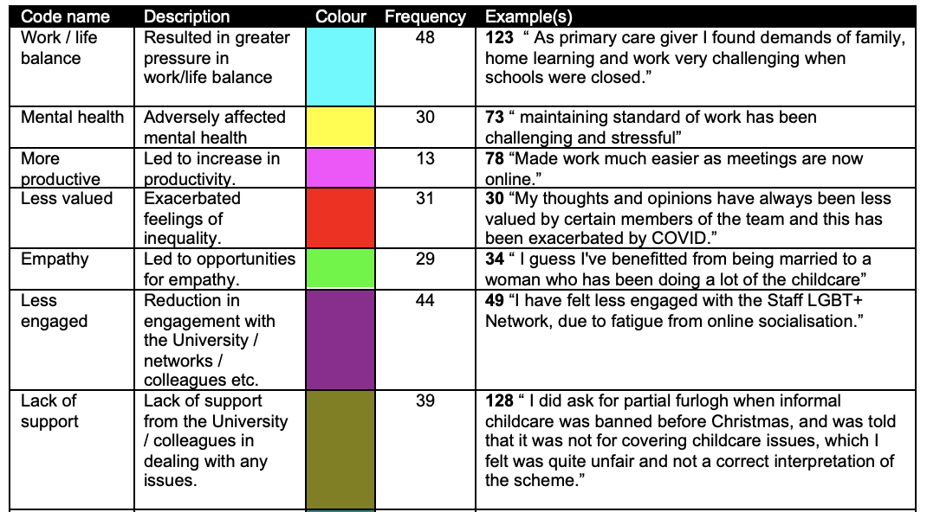
Example of Codebook

Slide 6
Emergent Categories
Community
Support
Wellbeing
Self-efficacy

Slide 7
Community
Almost universally experienced as a loss of community regardless of protected characteristics:
  “I have found the isolation of working from home for such a prolonged period difficult, despite the online platforms. My role previously was extremely collaborative and often corridor/ library conversations would be a rich source of ideas and plans for interesting student opportunities/ engagement. Although students have benefited greatly from the resources we have produced the remote service has returned to being reactive and supportive rather than being developmental.” (Participant 135)
Informal conversations were important to staff and the communities they help foster are important for developing learning and teaching (Thomson & Trigwell, 2018).

Slide 8
Support
Support was crucial to staff’s experiences during the pandemic and had strong overlap with the wellbeing and self-efficacy categories.
A nuanced narrative emerged – lack of consistency and largely dependent on immediate supervisors and colleagues:
  “I think the confusion over flexible working, on the one hand being encouraged to take time out in the day if needed but policies around flexi-time/TOIL and how to track this haven't been revised at all during Covid-19 - this relies on managers discretion and can lead to differences in treatment.” (Participant 116)
  “I have struggled more with anxiety over the past year. Edinburgh Napier, and my line manager in particular, have been very supportive and helped me through these issues.” (Participant 68)

Slide 9
Wellbeing
Experiences were highly dependent on individual life contexts - ‘we are all in the same storm, but we are not all in the same boat’ (Mental Health Foundation 2020, 3).
Age, disability, and caring responsibilities had the most impact on experiences of wellbeing, but the impact on these groups was not straightforward:
  “Without the routine trip to work and moving about on campus, have lost further mobility” (Participant 73).
  “I have found it easier to manage my condition whilst working from home. It is easier to manage pain and fatigue and I am in a better state of mind because of it” (Participant 21).

Slide 10
Self-efficacy
Participants’ beliefs about their ability to accomplish tasks/goals related to their professional role and their ability to ‘exercise control over events that affect their lives’ (Bandura, 1990, p 128).
Responses in this category were also nuanced:
  “Increased flexibility in working hours and pattern has made a huge difference to my ability to do my job well and balance my childcare/caring responsibilities.” (Participant 70)
  “Nothing was done despite absence of school/nursery for nearly a year for some of us. Overall, the quality of my work was negatively affected but also had direct effect on my relationship with partner and children and my physical health.” (Participant, 75)
Participants’ social, physical, and psychological resources had an impact on their feeling of control and ability to address the challenges that emerged during the pandemic.

Slide 11
Recommendations
What is it about existing multi-institutional communities that work, and how could colleagues utilise this to avoid any sense of online fatigue in nurturing community more closely to home?
A need to build on individual empathies and how these could be converted into supportive, flexible, and well-communicated policies across the University as a whole.
Such policies should be supportive and flexible enough to centre staff autonomy when making decisions around how to manage workload.

Slide 12
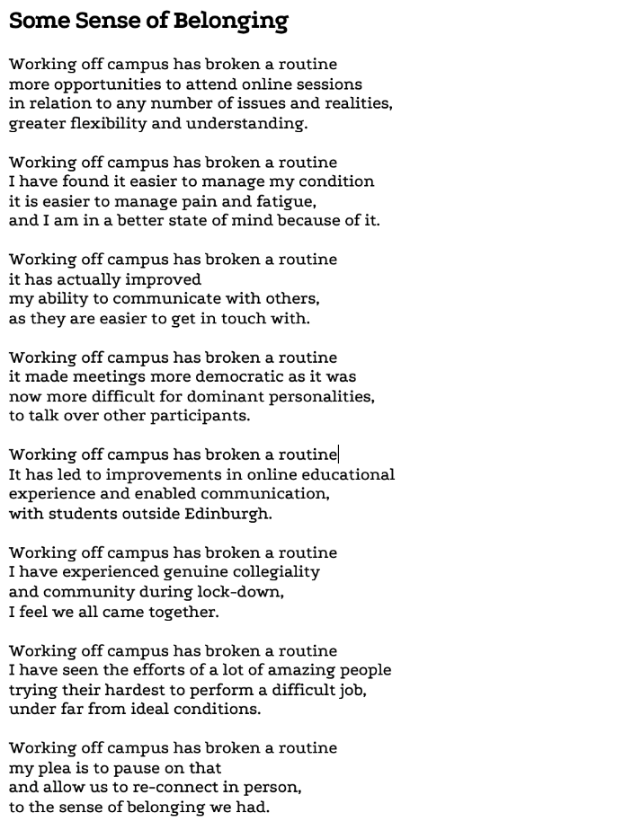
A Poetic Turn
*This poem was created using verbatim responses to the Equality Impact Assessment (EIA) survey for the Digital Support ​Partnership (DSP) Project.

Slide 13
Discussion
In our recommendations, we suggest centring staff wellbeing in a flexible way that considers individual situations, resources, and challenges in order to promote staff autonomy.
What might this look like in practice?
How might this approach impact on students’ experiences?

Slide 14

Questions?

Slide 15
Learning from the impact of individual identities on staff’s experiences during Covid-19:
Ethically implementing new styles of working
Jenny Zike
Sam Illingworth

