Slide 1
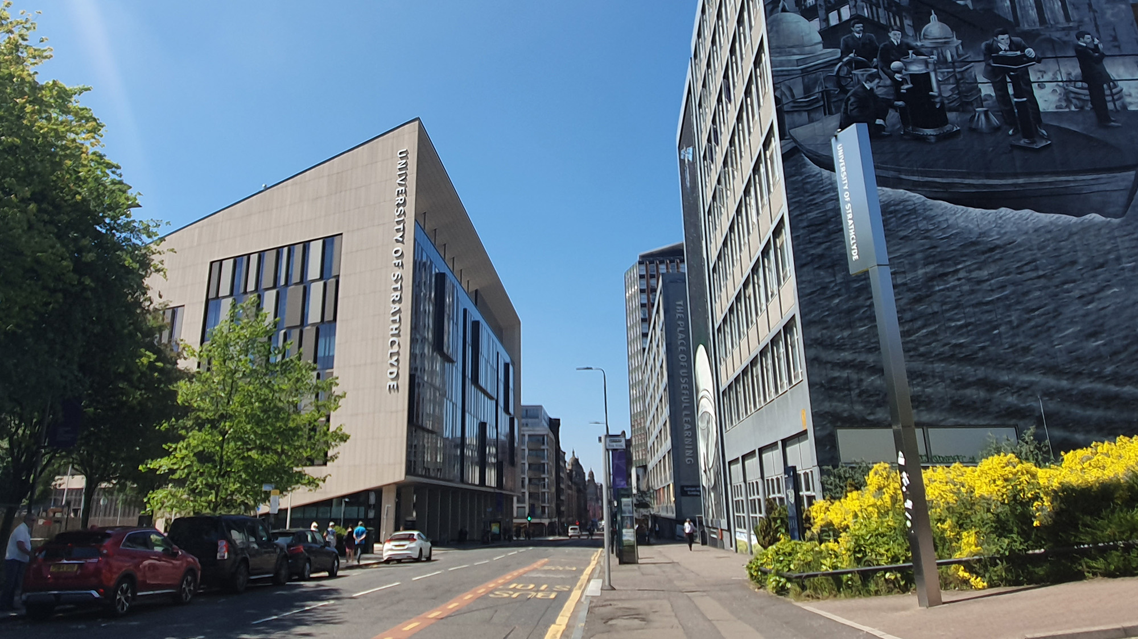

THE UNIVERSITY
OF STRATHCLYDE
X THE PLACE OF USEFUL LEARNING
www.strath.ac.uk

Slide 2
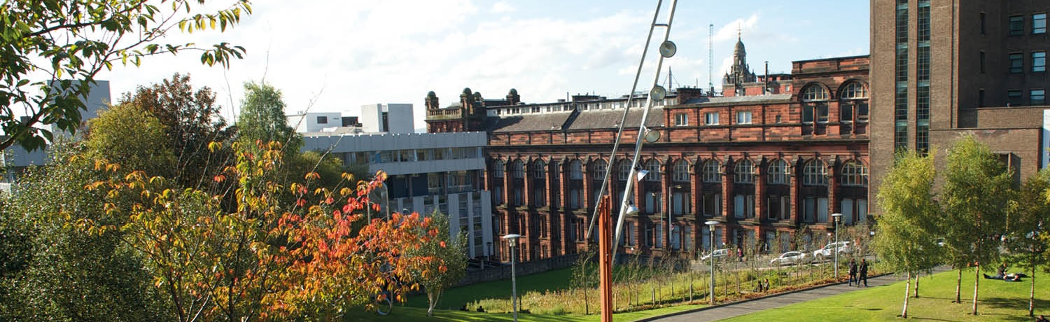
Facilitating Widening Access Students Transition into Postgraduate Studies
Dr Manuela Williams – Senior Teaching Fellow in History
Nicola Sutherland - Senior Careers and Employability Consultant

Slide 3
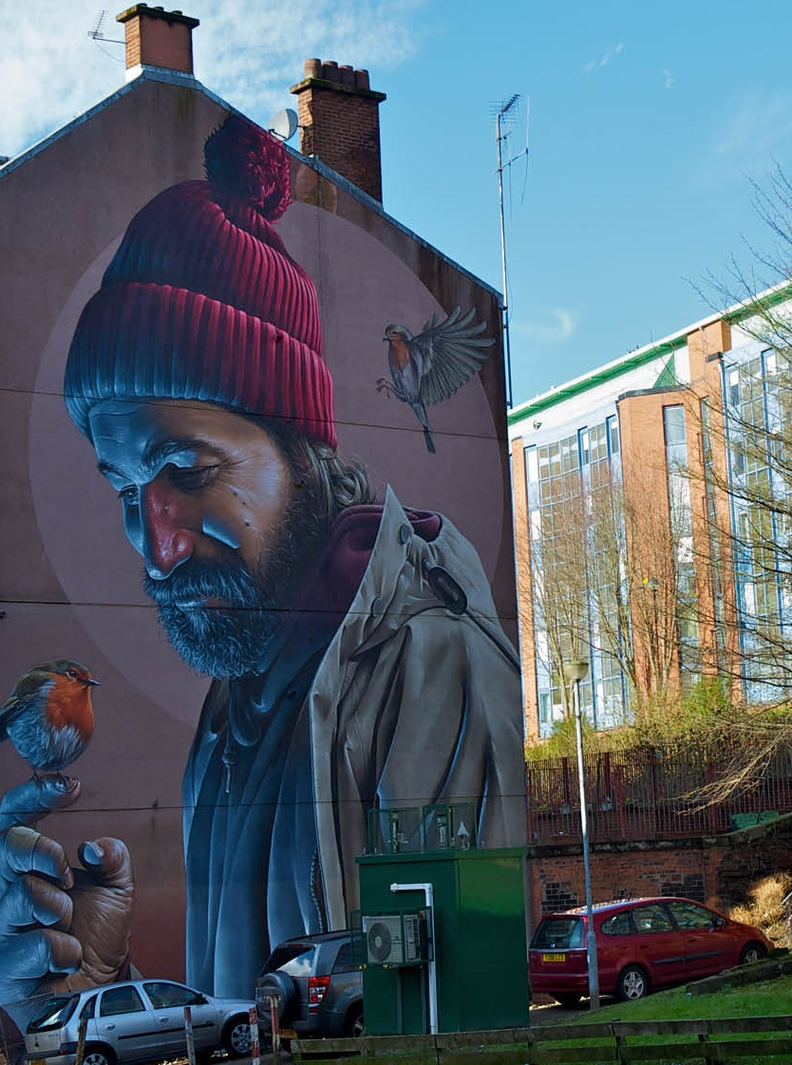
Session Overview
What do we know about Widening Access students' transition into PGT studies? The wider research context that has influenced our work
Exploration of findings of our research on Widening Access students’ transition into postgraduate studies conducted in 2015 and 2019
Overview of application of 2019 findings - creation of a set of online resources designed to support future PGT students’ choices and enhance their experience

Slide 4
Research on PGT
WA students' transition into postgraduate studies is a growing area
Wakeling (2005), (2009), Wakeling and Hampden-Thompson (2013) - Differences in progression to higher degrees by social class, gender and ethnicity
2014-2015 'Widening Access to Postgraduate Study and Fair Access to the Professions' - HEFCE funded project – six Russell Group universities – Financial; Academic Innovation; Information, Advice and Guidance; Understanding Students
Importance of signposting information and resources and creating clear scholarship schemes
Wakeling and Laurison (2017) - investigation into the relationship between social origins, postgraduate attainments and occupational outcomes

Slide 5

Also important to our research - negotiating identities
Tobbell J., O’Donnell V. and Zammit M (2010)
Shifting identities during transition to different levels of education as a result of interaction between students' personal experiences, learning and academic environment
This is particularly relevant to WA students

Slide 6
Our Research - 2015
2015-2016 'Widening Access students transition through university' - funded by QAA Transition Enhancement theme – we employed 2 UG interns
Focussed on History UG students
Key findings:
  need for more information and better access to student services;
  lack of confidence in academic skills;
  limited opportunities for work experience and international studies;
  limited engagement with Careers Service and notion of employability

Slide 7
Our Research – 2019
Faculty of Humanities and Social Sciences (HaSS) funded project – Widening Access students transition into postgraduate studies. One researcher for six months. Survey, interviews and 1 focus group.
107 students took part in the survey, with an average age of 32; 66% were female, 34% were male; 6% were BAME, 33% identified themselves as LGBTQ+; 2% had experienced care, 11% were estranged, 15% were from low progression schools, 60% were first generation to attend university and 74% were first generation to progress into PG studies.
22 one-to-one interviews and 1 focus group also took place. Of the participants, 46% were female and 56% male, and with an average age of 34; 15% were BAME and 6% had experienced care; 12% were estranged, 54% were first generation to attend university

Slide 8
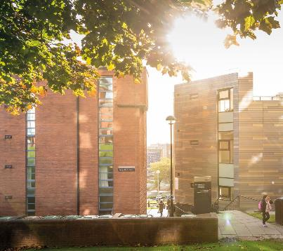

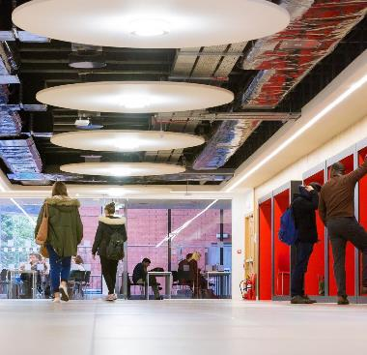
Leaky Pipeline
“They’ve changed the whole structure, and so some people just don’t have that information […] so I think that lack of information is a challenge to certain people, especially those who aren’t in their undergrad just now, people like myself who left and moved away.” – Ben, 26 year-old MSc student (first generation) - Wakeling and Hampden-Thompson noted in 2013 that further research was needed on students returning more than one year after completing their undergraduate degree
“I think that the uni has a lot of things to give, but I think for postgrads we need to have a better understanding of how to get that message across.” – Elena, 27 year-old PhD student
“Better signposting at the start would be helpful. To know if you’re having an issue, if you don’t know who in your course to turn to, it’s this person. Right from the bat.” – Ben, 26 year-old MSc student (first generation)
“It’s been a strange cycle. Sometimes the help and support is there and it’s very nice. And sometimes it’s abundant. But other times it’s non-existent and just shying away and just unreachable.” – Henry, 28 year-old MSc student (first generation, estranged)

Slide 9
Key Takeaways from Research
Postgraduate cohorts are far more diverse than at undergraduate level, and face different barriers
Funding is important -“We know the student loan doesn’t pay enough. They know the student loan doesn’t pay enough. And you know the student loan doesn’t pay enough.” ... but there are more than just financial barriers to postgraduate study
First generation students face similar barriers to other WA groups, and yet are often not included in widening access initiatives
Providing more avenues for information around postgraduate study (what to expect, how to apply, etc.) is critical for encouraging students to apply & succeed in PG
Employability – knowledge gap and limited engagement with Careers Service - ‘Everyone is now starting to ask me, “What do you want to do?” and I’m like, “What can I do?” I have no idea’ - highlighted in both 2015 and 2019 research
Transition into PG is not to be treated as insignificant
Don’t just default to supporting SIMD students

Slide 10
Quick Wins
What can universities do to widen access to postgraduate study?
First Generation Society
Better information on applying to postgrad - both online & in person (e.g., sessions for UG students on applying for PG)
Create a sense of community from early on, even for part-time and distance learners
Honesty (e.g., from course leaders, from current/past students)
This led us to apply for QAA Resilient Learning Community Funding.

Slide 11

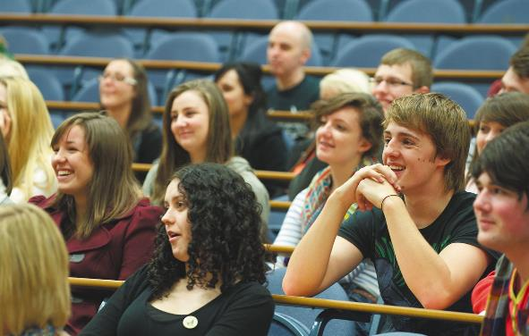
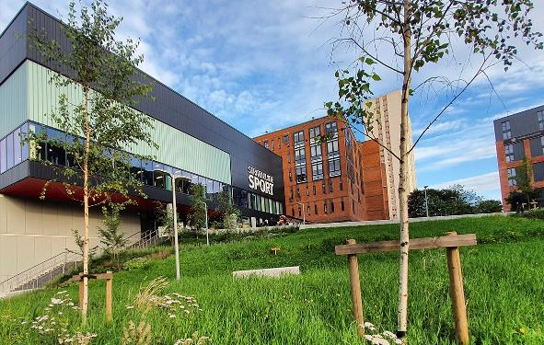
Overview of Project
Successfully achieved QAA Resilient Learning Community funding (HaSS Faculty, Widening Access and Careers)
Hired a PGT student to support project
Outputs
Collection of resources – academic and support service resources (from across UK)
Redevelopment of PGT pages
Creation of PGT WA strategy with Associate Principal for Social Inclusion (targeted funding, employability activities, tailored Careers support, new online info)

Slide 12
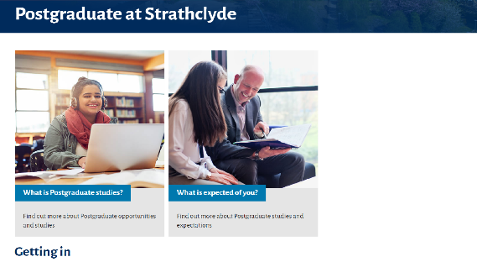
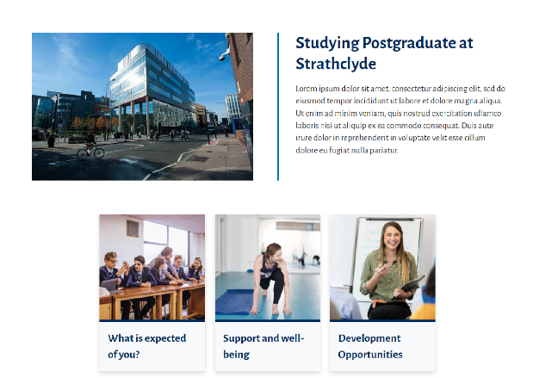



Ideas for Changes to PGT Webpages – draft versions only!

Slide 13

Key Drivers Behind Project
University KPIs
Recruitment tool
Highlighting reality of PGT study
Showcase excellent support services that aren’t always utilised (for example Careers Service)
Increasing retention
Contribution to institutional PGT WA strategy

Slide 14
References
Thomas, L. and Quinn, J. (2007) First Generation Entry to Higher Education: an International Study. Buckingham: SRHE and Open University Press.
Tobbell J., O’Donnell V. and Zammit M (2010), ‘Exploring Transition to Postgraduate Study: Shifting Identities in Interaction with Communities, Practice and Participation’, British Educational Research Journal, 36 (2), 261-278
Widening Access to Postgraduate Study and the Professions, HEFCE, 2014-2015 https://www.sheffield.ac.uk/polopoly_fs/1.511531!/file/Widening-Access-to-Postgraduate-Study-and-Fair-Access-to-the-Professions-f.pdf
Wakeling, P. (2005). 'La noblesse d’état anglaise? Social class and progression to postgraduate study', British Journal of Sociology of Education, 26(4), 505–522.
Wakeling, P. (2009). 'Are ethnic minorities underrepresented in UK postgraduate study?', Higher Education Quarterly, 63(1), 86–111.
Wakeling, P., & Hampden-Thompson, G. (2013). Transition to Higher Degrees across the UK: An analysis of national, institutional and individual differences. York: Higher Education Academy.
Wakeling, P., & Laurison, D. (2017). 'Are postgraduate qualifications the ‘new frontier of social mobility’?', British Journal of Sociology, 68(3), 533–555.

Slide 15


