Slide 1
Foundations for all: lessons learned from a pilot designed to bridge access to higher education for refugee students in Uganda
Sandra Nanyunja; Refugee Law Project
Michael Gallagher, University of Edinburgh

Slide 2
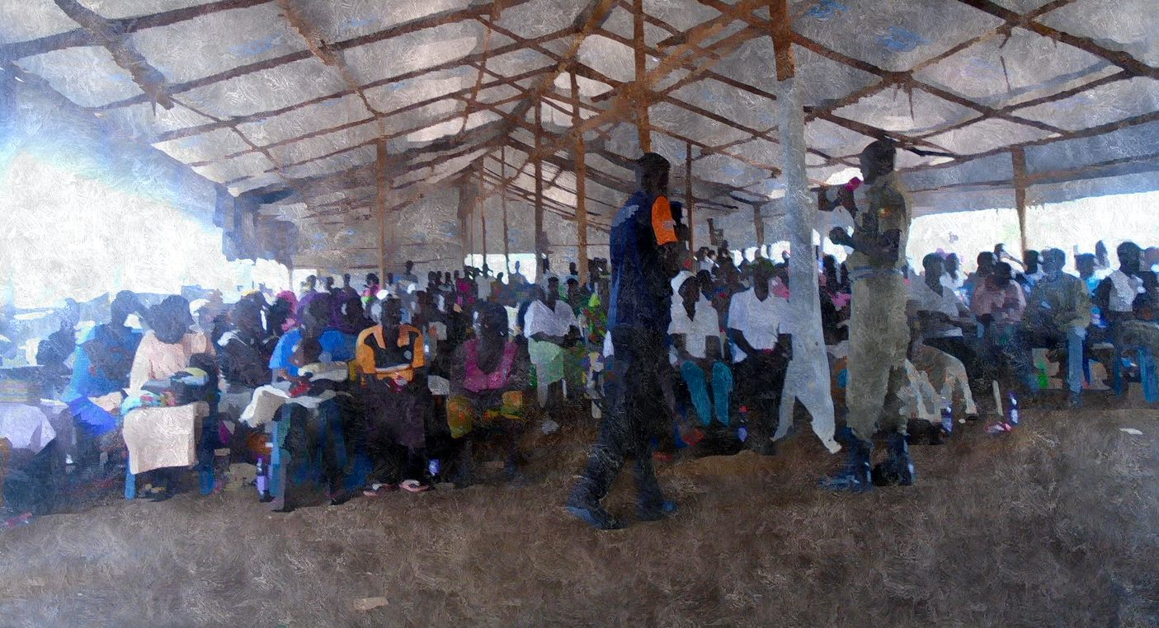
Bridging Programmes: An Overview
Foundations for All : Reflections on the programme design & its outcomes
Why this all matters in Scotland and more broadly

Slide 3
Why have bridging/access/foundation programmes?
Explicitly designed to assist learners in developing and accessing particular personal, professional or educational opportunities
Design of the course (curriculum, mode of delivery, duration, etc.) depends on factors inc.:
Where you’re meeting learners at: Demographics, aspirations, educational gaps and strengths, context, etc.
Where you’re aiming to take them: Desired, realistic and accessible endpoint(s) of learners and programme designers = a balancing act
Resources and capacity of team
Structural constraints and opportunities

Slide 4
PARTNERS
Funder
Preparing new round of Africa scholarships (25% to refugees, and also online learners)
Co-designing FFA curriculum Course Organizers: Math, Digital Skills, Study Skills Monitoring & Evaluation Research (All aspects)
Co-designing FFA curriculum design (based on PADILEIA)
Research (Lebanon Case Study, Scoping Tool and Transformative Education Research)
Intern Management
Co-designing FFA curriculum Course Organizers: UMO, English Lead FFA implementation M&E Research (Uganda Case Study, Psychosocial aspects)

Slide 5
Foundation for All: Programme Aims
To enable students to access and thrive in higher education
To design a best-practice educational curriculum for refugee and host community learners
To provide spaces for refugee and host community learners that are inclusive, transformative, and effective (including extensive psychosocial support)
To evidence collaboratively-developed, holistic and contextually relevant higher education programmes
To support calls for structural change in how institutions of higher education and host governments respond to refugee learners

Slide 6
Student Learning Aims
Enhance students’ self-confidence and transferable skills
Enable students to achieve subject-specific learning outcomes
Empower students to effectively and confidently express their knowledge, needs and skills in professional and personal environments
Support positive interaction between refugees and host communities
Prepare students to apply for and succeed in securing scholarships and admission to university (Mature Age Exam)

Slide 7
The team are implementing a bridging education programme in Uganda for adult learners from refugee backgrounds & disadvantaged members of host communities to prepare them for the mature entrance exam at Makerere University through the following courses:
FFA PROGRAMME STRUCTURE
Mathematics and Numeracy
Understanding Myself and Others (UMO)
Digital Skills
Study Skills
English
EXTRACURRICULAR
Mentorship from MCF Scholars

Slide 8
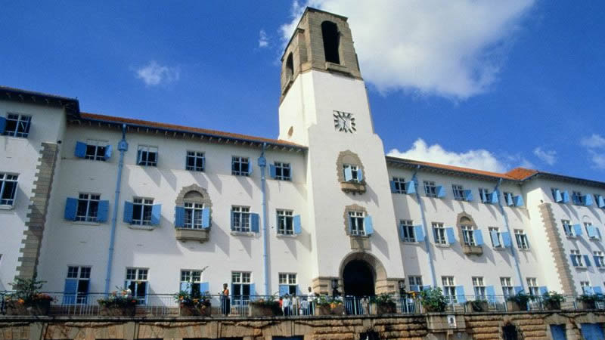
Mature Age Entry Exam for Makerere University
University entrance exams for candidates who are > 25 years old
Applicants submit two separate exams:
A general aptitude paper: comprising a Maths, English and general knowledge section
Programme-specific paper (Art/Science based): designed to test students basic knowledge the degree programme they would like to enrol in at University

Slide 9
PROJECT DEVELOPMENT TIMELINE
Sept 2020: Online Programme design workshop
Oct 2020 - Feb 2021: Ongoing course design meetings
2019: Kampala Potential Student Survey
Accredited course -> Mature Age Exam
August 2019: Team site visit to American University of Beirut
Feb 2020: Kampala workshop with EFA5 students and stakeholders
Sept 2020: Course-level design workshops

Slide 10
PROJECT IMPLEMENTATION TIMELINE
Jan-Feb 2021: Technology testing & review
Feb 2021: Tutor orientation, student induction
July – Nov 2021: Semester 2 (15 weeks)
Jan 2021: Student recruitment & preparation of learning centres
Feb – May 2021: Semester 1 (15 weeks)

Slide 11
OUTCOMES
Were objectives right for the students?
Any other pathways we should have incorporated in it?
Hard to tell overall as disruptions and closures forced considerable flexibility in how we did this
Explicit emphasis on psychosocial support necessary
Some evidence of self-confidence and transferable skills
Self-expression in personal and professional contexts: some suggestion this was met
Making admission to university (Mature Age Exam) explicit changed the programme
Accreditation challenges preceded this
Once emphasis became Mature Entry Exam, curriculum potentially needed rethinking
Skills in different centres considerably divergent; learning engagement and outcomes divergent as well

Slide 12
Thick vs Thin Educational Models
We propose a distinction between ‘thick’ models of refugee access programmes which offer blended or online content along with substantial psychosocial support, interaction with specialist tutors, contextually-relevant content, accessible technology and financial support, along with meaningful exit pathways for students, against ‘thin’ models which offer curated online content for free to refugees without the additional support.
Tutors onsite
High levels of support
Self-led learning (re: MOOCs) problematic
Blended models provide some flexibility but carry their own issues
Significant disruptions can upend the best laid plans
OER useful but problematic

Slide 13
Advocacy around Mature Age Entry Exam
Significant barriers to registering for exam including in-person requirement, financial cost and requirement for specific forms of ID
Content of exam then prohibitively challenging for EAL speakers, those who did not go through education in Uganda & those without work experience (who it is designed to capture) → how to prepare students for this?
Q. How to structure an advocacy campaign to remove barriers to registration and successful completion?
e.g. Who won the Uganda Motor Rally Championship of the year 2011. (2012)
e.g. Name the Executive Director of the Uganda Investment Authority. (2013)
e.g. Name the winner of Miss Uganda 2014. (2014)
e.g. (2012) The examination was…
Exceedingly Difficult
Just Difficult
Terribly Difficult
Fairly Difficult

Slide 14
Outputs
Akello, Martha (Refugee Law Project); Atherton El-Amine, Brooke (American University of Beirut); Cole, Georgia (University of Edinburgh); Egwalu, Robert (Refugee Law Project); Gallagher, Michel (University of Edinburgh); Kompogo, Mary (Refugee Law Project); Lugala, Cosmos (Refugee Law Project); Miranda, Juan-Jose (University of Edinburgh); Mulondon, Apollo (Refugee Law Project); Nanyunja, Sandra (Refugee Law Project); Symons, Kate (Open University) (2021). Blended learning in refugee education: the case of the Foundations for All project in Kampala and Kiryandongo, Uganda. Africomm Conference 2021, Zanzibar.
Foundations for all Toolkit: a resource for those wanting to create or undertake similar educational bridging activity with refugee populations (due 2022 July)

Slide 15
Thank you
Sandra Nanyunja; Refugee Law Project
Michael Gallagher, University of Edinburgh (michael.s.gallagher@ed.ac.uk; @mseangallagher)

