Slide 1

Student-led Exploration of the Effects of Online and Hybrid Learning
Nicole Cizauskas, Hitanshi Badani, Dr Paula Miles

Slide 2
Who Are We?
We (Nicole and Hitanshi) are two student interns at the University of St Andrews Enhancement Theme Team
Dr Paula Miles of the School of Psychology and Neuroscience is our team head
For the past year, we have been performing research on online and hybrid learning together.
Our research was given to the Proctor’s Office and other key decision-makers at the University to help advise the return to in-person learning

Slide 3
Our Research Goals
Our research has three main goals:
Goal 1
To understand the effect of emergency online learning and hybrid learning on student life, in particular the positive aspects that should be kept in the future
Goal 2
To identify any demographics that were affected more by online and hybrid learning
Goal 3
To practice creative and holistic research methods with a focus on student perspectives

Slide 4
Fully Online Learning Studies
Focuses on the fully online second semester in the 2020-2021 academic year
Qualitative – Focus Groups and Questionnaire
Quantitative – Questionnaire

Slide 5
Focus Group Findings
Low turnout of participants
All participants identified recorded lectures as a positive of emergency online learning
All participants struggled to connect with peers and lecturers during emergency online learning
Sources of certain perspectives – commuting students, neurodivergent students, postgraduate students

Slide 6
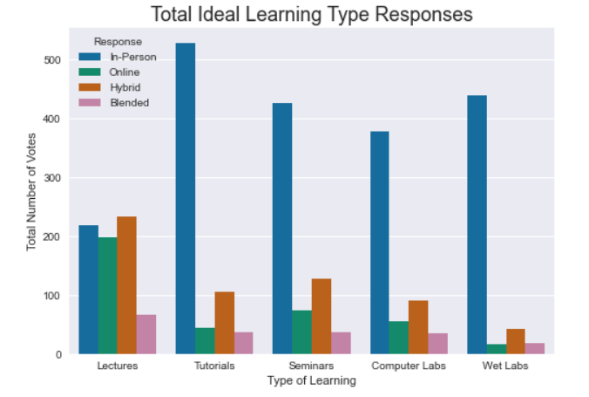
Questionnaire (1) Findings
Overall:
  Students preferred in-person learning for tutorials, seminars, and practicals/labs
  Students were neutral on mode of delivery for lectures

Slide 7
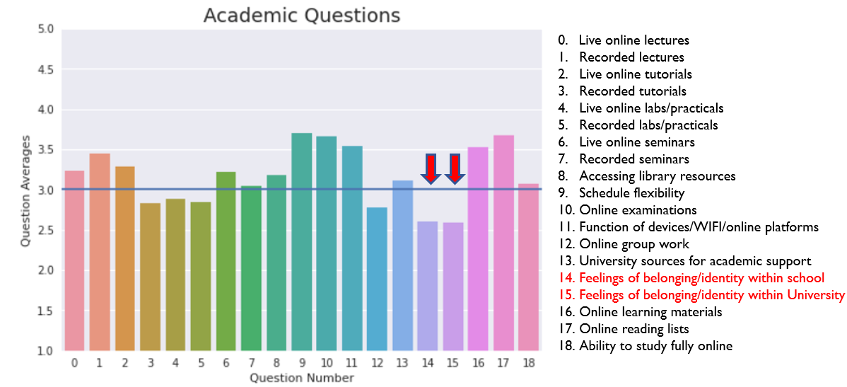
Questionnaire (1) Findings
Area of concern:
  Low university-wide ratings for feelings of identity and belonging

Slide 8
Questionnaire (1) Findings
Demographic areas of concern:
  Care experienced students rated financial impact on wellbeing very negatively
  Certain schools expressed discontent with residence-run events and online society-run chats
  The graduate school had lower than average ratings for formal/informal student group chats

Slide 9
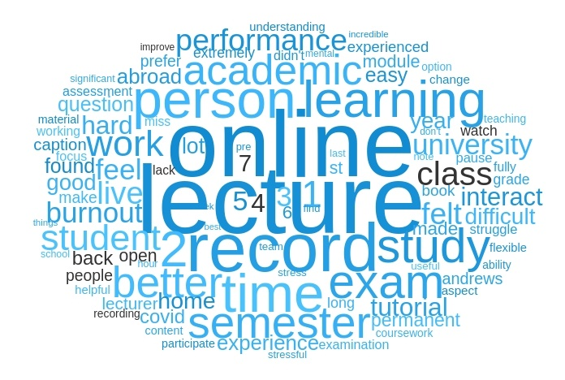
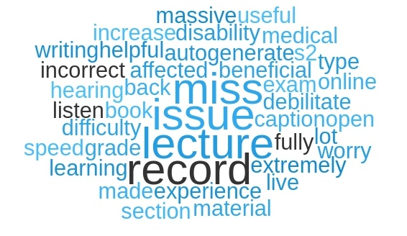
Questionnaire (1) Findings
On Academic Matters
Use of filters to isolate experiences
Observations based on word clouds
Notable findings:
  Not uniform – experiences differed across schools
  Reception of online assessments, recorded lectures, and communication
  Mentions of institutional communication and pathos

Slide 10
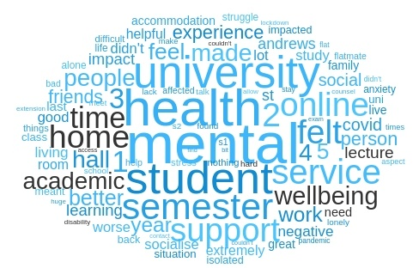
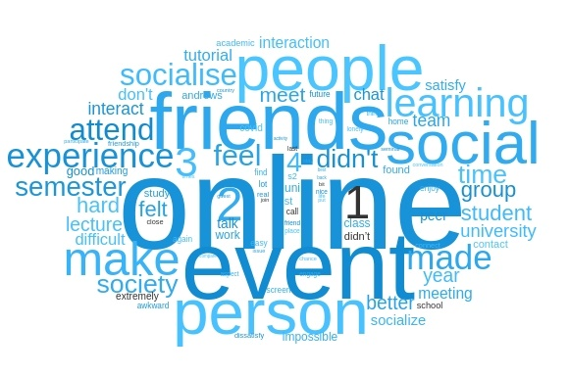
Questionnaire (1) Findings
On Socializing and Wellbeing:
Interacting relationship – Academic matters, social life, and mental health
Recognizing different experiences based on new determinants like year of study or country of residence, household situations
Mention of mentorship schemes, university communication, student services, and CEED.
Factors such as:
  Accommodation
  Support services
  Group studying, activities, and projects

Slide 11
Impact of Fully Online Learning Studies
Focus groups reinforced previous research on lecture recording
Recorded lectures will be kept for the foreseeable future
Questionnaire showed preference for in-person tutorials, seminars, and practicals/labs
The return to in-person learning was prioritized for these categories

Slide 12
Hybrid Learning Studies
Focuses on the hybrid first semester in the 2021-2022 academic year
Qualitative – Creative Digital Storytelling
Quantitative – Questionnaire
Context:
  The University of St Andrews recorded all lectures and most tutorials/seminars during this time
  Fully online learning was still available for most degrees
  In-person options for seminars, tutorials, and practicals/labs were prioritized

Slide 13
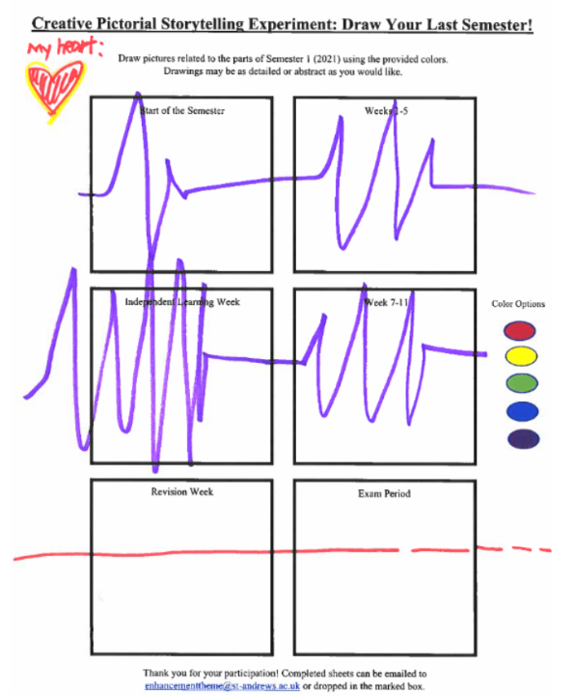
Creative Digital Storytelling Findings
Sheets with six empty blocks, crayons and markers, and submission boxes were placed around the campus
Six blocks represent time periods across the semester
Minimal advertisement and no prize draw
  Despite this, over 100+ submissions

Slide 14
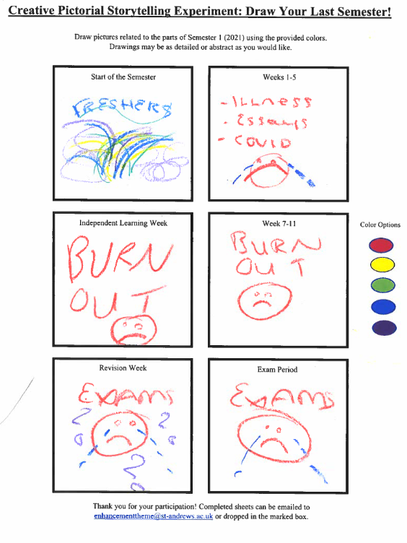
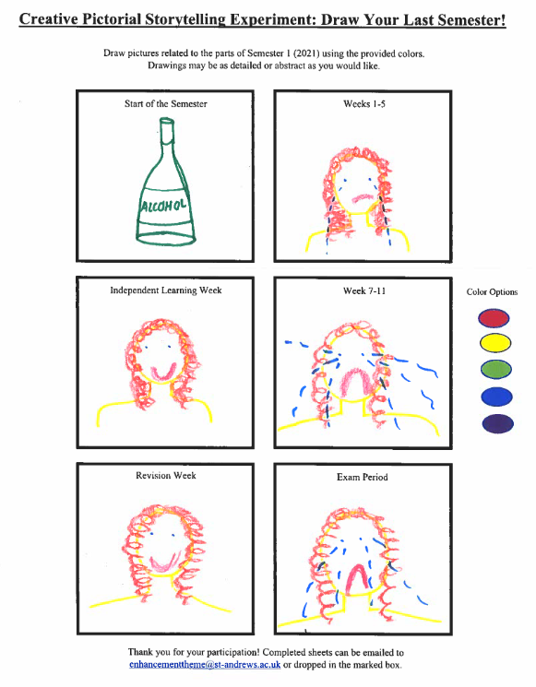

Slide 15
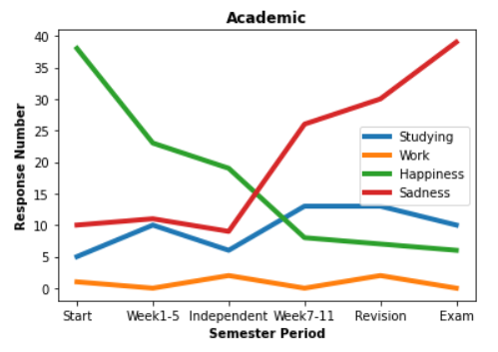
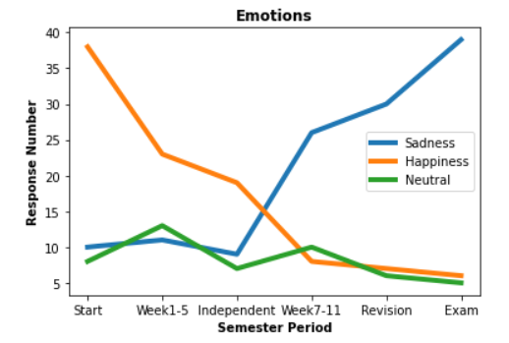
Creative Digital Storytelling Findings

Slide 16
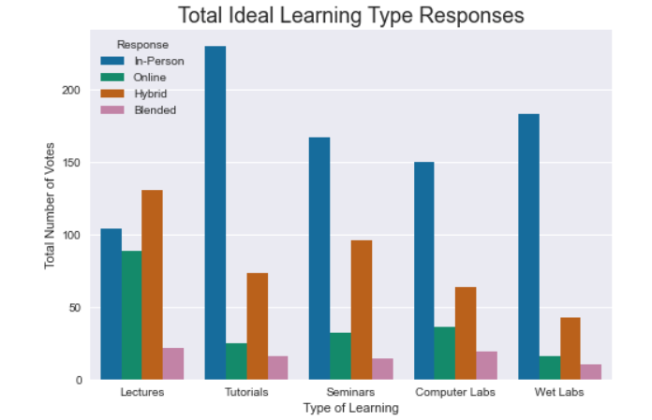
Questionnaire (2) Findings
Overall:
  No major changes in student opinion since last semester
  Slight increase in hybrid learning preferences for seminars

Slide 17
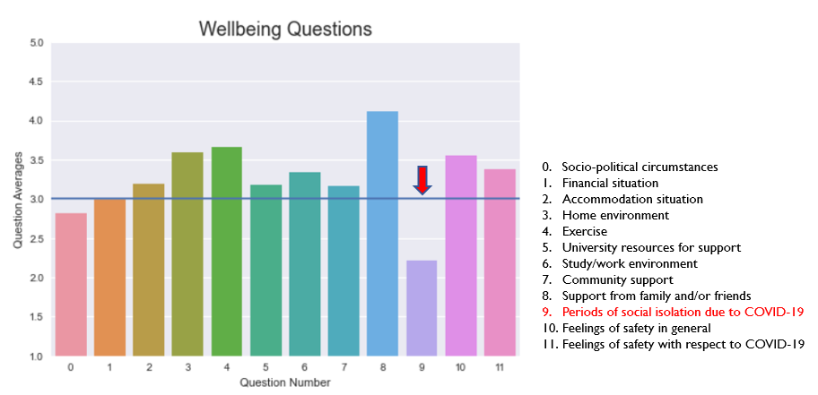
Questionnaire (2) Findings
Area of concern:
  Very low ratings for student wellbeing during periods of social isolation due to COVID-19

Slide 18
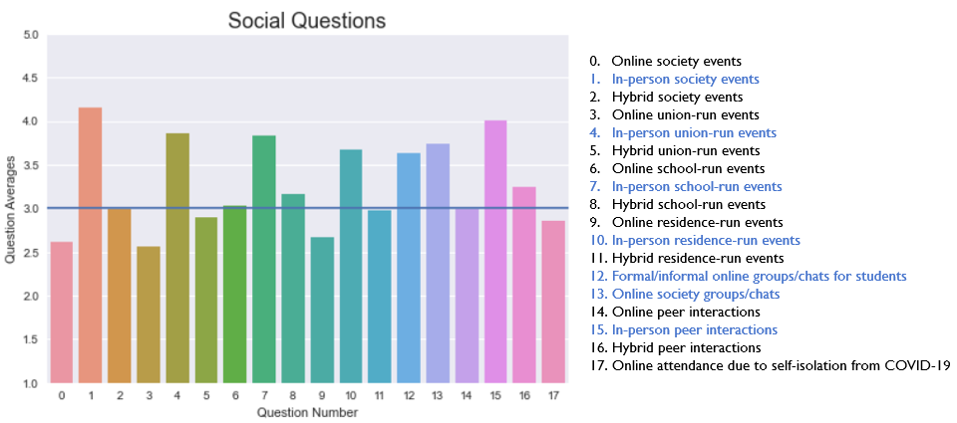
Questionnaire (2) Findings
Much higher ratings for in-person social events than their online or hybrid counterparts
High ratings for online group chats and online society groups chats

Slide 19
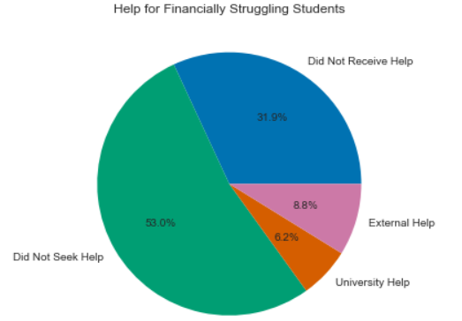
Questionnaire (2) Findings
Demographic areas of concern:
  31.9% of students stated that they did not receive financial support after seeking it from the University and/ or external sources

Slide 20
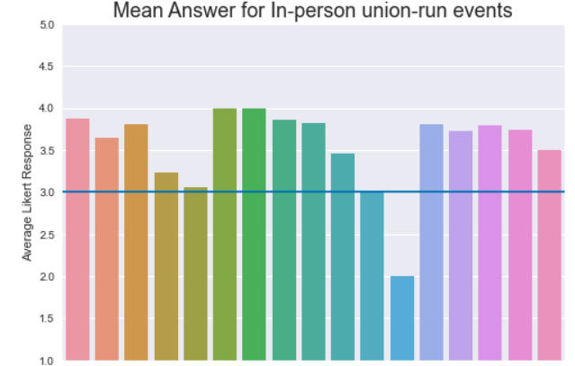
Questionnaire (2) Findings
Demographic areas of concern:
  Evening degree students rated in-person union-run events very low

Slide 21
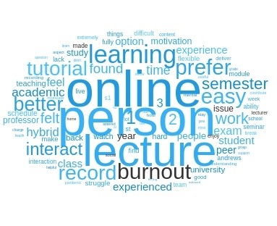
Questionnaire (2) Findings
Academic Matters
Preferences for hybrid learning
Impacts on academic performance
Discrepancy between schools and lecturers
Important observations:
  Flexibility and Schedule
  Burnout and Motivation

Slide 22
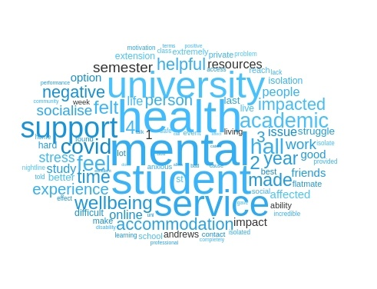
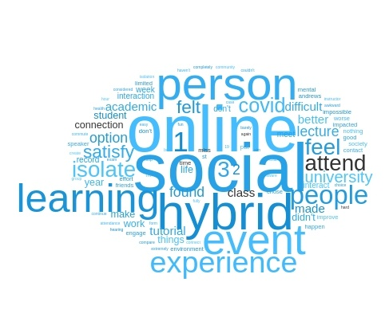
Questionnaire (2) Findings
Socializing and Wellbeing Matters
Key Takeaways:
  Discourse on institutional level of responsibility
  Policy level – halls contracts and Student Services funding
  Town and Gown Relations
Reflections on Qualitative Research Methodologies:
  Quantifying qualitative data? Pros and Cons
  Organizing and Interpreting
  Challenges with isolating groups

Slide 23
Takeaways for Future Research
Goal 1: Effect of online/hybrid learning on student life
Students want recorded lectures
Students prefer in-person tutorials, seminars, and practicals/labs
Goal 2: Identify demographic categories more affected by online/hybrid learning
Groups at risk of crisis remain at risk of crisis
Demographic needs change even between two semesters
Goal 3: Creative and holistic research methods
Creative digital storytelling is a good data collection method
Focus groups are difficult to get participants for, even with voucher payment

Slide 24
Why Choose Student Interns?
Students know students best
Research experience and learning opportunities
Building a student-staff community

Slide 25
Our Personal Experience
What we gained by being a part of the Enhancement Theme Team:
Improving the future of our education
Confidence through experience
Strong friendships with staff members

Slide 26
Thank you for listening!
For more details on our research methods or findings, you can contact us via email:
enhancementtheme@st-andrews.ac.uk

