Slide 1

Student success officers and a personalised approach to success
Jan Law – School Academic Advisor
Noelle McAra – School Academic Advisor
Lee Hutchison – Student Success Officer

Slide 2
Introduction to presentation
Who are the SSOs and the SAAs and what is their role in retention?
SSO Retention process for the personalised approach
How do the SSOs work with the SAAs and the wider university?
Impacts of personal approach and student experiences
Data impacts and retention
Issues for the SSO role and Development
The SSO role and moving forward

Slide 3
Why the role of SSO was developed
The SSO role was created by Abertay University’s Dean of Teaching and Learning, Luke Millard.
The position was funded Northwood Trust for three years in relation to Retention for Success.
To ensure more students from disadvantaged backgrounds complete their degrees and so improve their life chances after leaving Abertay.
to encourage students to re-engage and to return to class. Most importantly, it provides a personalised approach to those who need support.
The role is filled by recent graduates on courses from their respective schools, they are already familiar with the university, its staff and its students from a student-based perspective.

Slide 4
Who are the SSOs and SAAs?
Business, Law and Social Sciences
Jan Law
Student Success Officer
Brooke Ireland
School Academic Advisor
Applied Sciences
Noelle McAra
Student Success Officer
Aimee Grant
School Academic Advisor
Design and Informatics
Euan Dempster
Student Success Officer
Lee Hutchison
School Academic Advisor

Slide 5
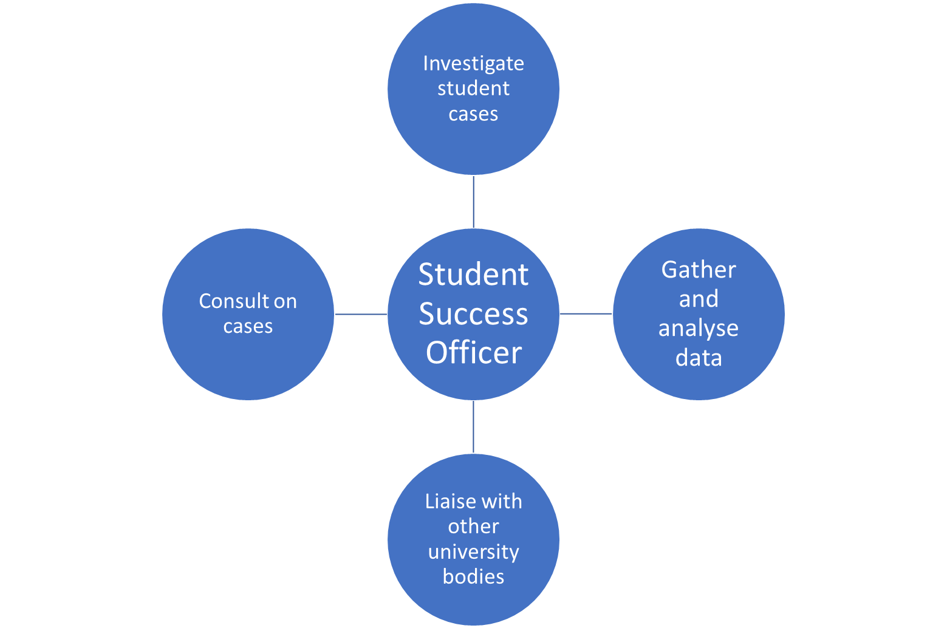
Role of SSOs, Retention and the Personalised Approach

Slide 6
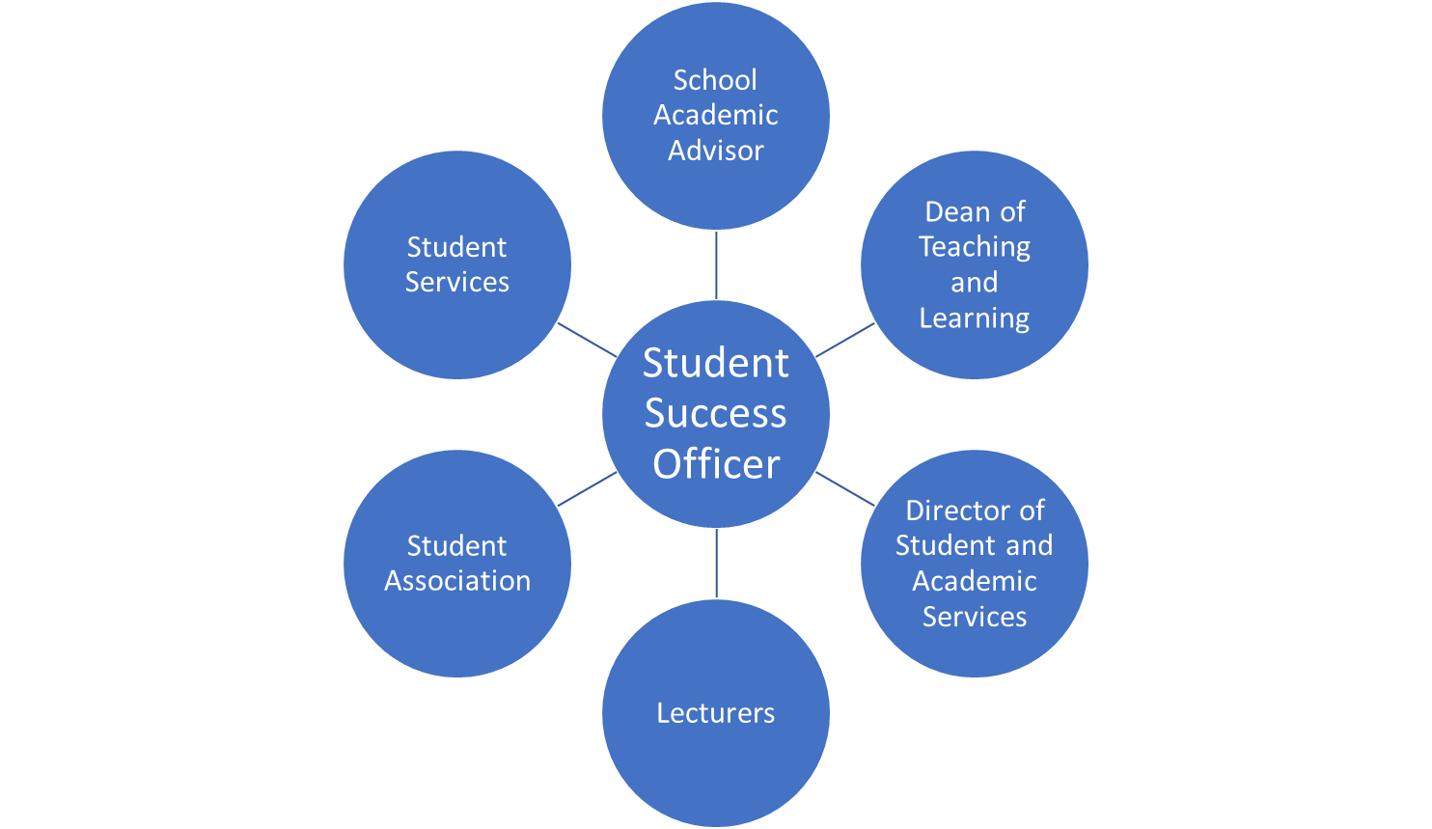
Who the SSOs liaise with in the university in their role

Slide 7
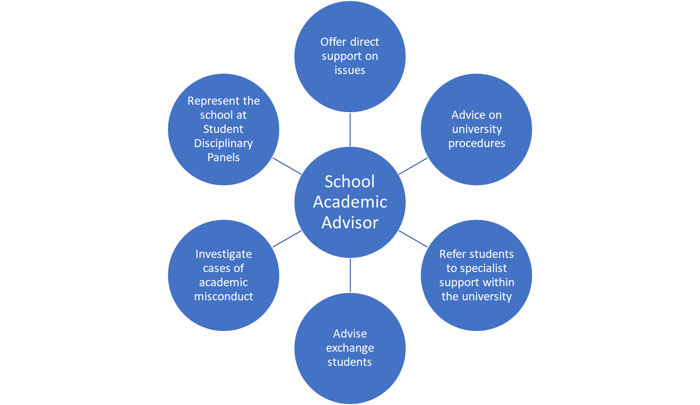
Role of SAAs and Retention

Slide 8
SSO's Process and Retention
Data is gathered from Jisc and MyLearning Space (VLE)
Contact Module Tutors and SAA
Contact the student
SSOs and SAAs are contacted
Student is emailed
Contact the student
Result
Students who are not engaging and attending are found and contacted

Slide 9
Impacts of the personalised approach and student experiences
How we have supported students:​
  A student who has crippling anxiety and found it difficult to ask for help but they are getting the help they need.
  A student unwittingly committed plagiarism due to personal issues. The SSO spoke with the student and explained their circumstances to the relevant people​.

Slide 10
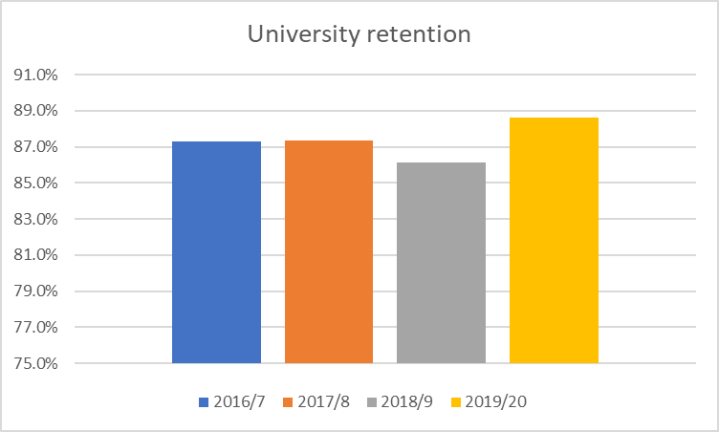
University retention statistics
Note that we are seeing an improvement in retention and are eager to see how this has changed with the SSOs in place from 2021-2022 and the collaboration between both the SSOs and the SAAs.

Slide 11
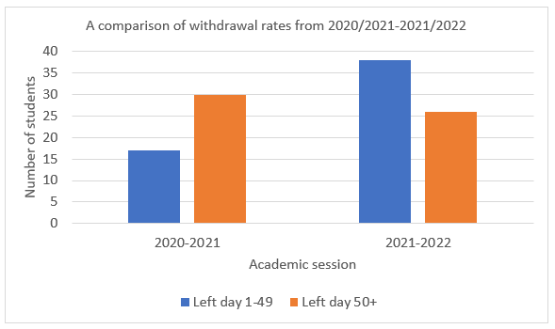
Data for Semester 1

Slide 12
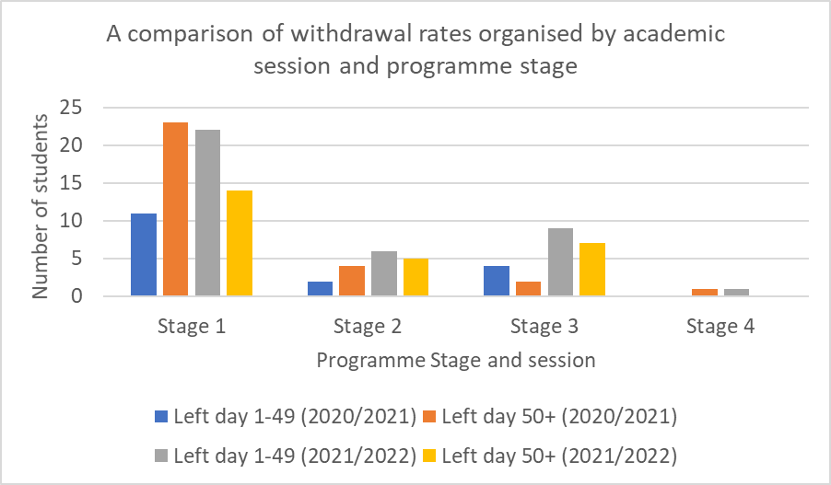
Data for Semester 1

Slide 13
Issues for the SSO role and Development
Need to more synergy between the SSOs and other structures in the university.
How the SSOs can adapt more to the needs of their specific Schools.
During the summer SSOs can work at a more university wide level.

Slide 14
The SSO role and moving forward
The SSO role is new and while many things have worked with the role, we also recognise that there is other work to be done in developing and embedding the role into the university more and developing more synergy between the SSOs and other university structures to further improve retention in the university.
From the SSOs themselves:
“We have done a lot of learning on the job, and we have adapted to the demands of the role over the past year and while the role grows and changes, we feel that at the heart of the process is how we help retain and support students in a personalised way and compassionate way.”

Slide 15
Thank you for listening
Any questions?

