Slide 1




Re-imagining Resilience for PGT: A community focused approach collaborative cluster
Donna Murray, Gale Macleod, Julie Brooks

Slide 2
Background
Why PGT?
Why a community approach?

Slide 3
Four meetings
What is resilience? (host – Edinburgh)
Resilient people (host – Heriot Watt)
Resilient systems, cultures and practises (host – UWS)
Guidelines for developing resilience communities of practise (host – St. Andrews)

Slide 4
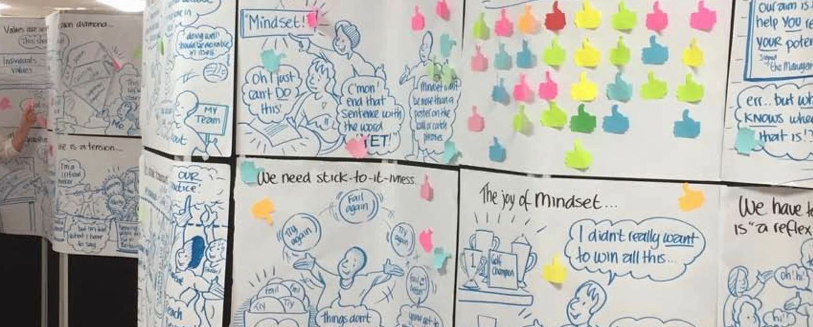

Slide 5
Outcomes
A three-part resource that has discussion points for different members of the PGT community to consider
  Senior leadership teams
  Programme teams
  Personal tutors
Padlets
The final meeting of the group was also ‘live drawn’
While these resources are important, as a group the most valuable outcome for us was the positive benefit to our own resilience.
https://www.enhancementthemes.ac.uk//en/resilient-learning-communities/completed-projects/re-imagining-resilience-for-taught-postgraduate-students

Slide 6
Example Institutional prompt
What is the 'place' of PGT within an institution? What is its purpose? And does it have to have a purpose beyond developing the next generation of students?

Slide 7
Example Programme prompt
How can a focus on learning, community, student diversity and programme diversity be retained in programme development?

Slide 8
Example Individual prompt
When thinking about how you are managing with studies and life in general, to whom do you compare yourself? Why do you make this comparison and are others potentially more helpful?

Slide 9
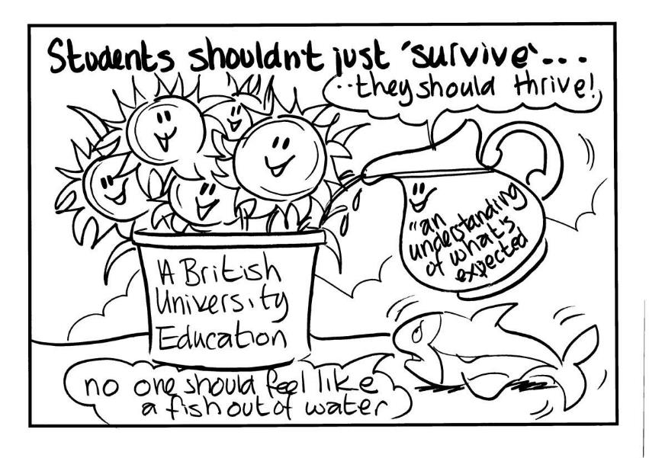
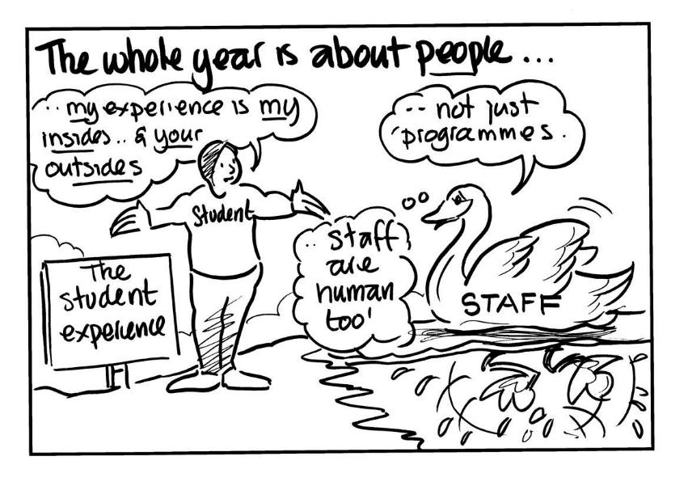
Some of the images from our discussions

