Slide 1
Resilient Learning Communities
Male students in Higher Education: addressing the disparities in outcomes.
Dr Liam Waldron 8 June 2022
Robert Gordon University

Slide 2
What I would like to cover
Male students in HE: some themes from the literature
Male students in HEIs in Scotland: some statistics
RGU’s work on the male student experience / what we found
Some enhancements that HEIs could consider

Slide 3
Some themes in the wider literature
The impact of previous educational experiences on the male HE experience
Poor guidance and preparation at school
Familial expectations
External responsibilities
Peer pressure
Male student engagement with HEI support services
Mismatch with subject.
National/international context
Studies reveal that the experience of male students in HE institutions is a tale of underachievement relative to females.
This is seen not only in the statistics for entry which show that more female than male
students attend university, but also in levels of satisfaction, non-continuation rates, rates of help-seeking, and the number of those graduating with good honours degrees.

Slide 4
The picture in Scottish HE: some relevant background statistics (SFC 2021)
There were 307,215 students in higher education in Scotland in 2019-20, the highest number on record. Females made up 58.1% of all HE students, 16.4% more than males at 41.6%.This gap between females and males has been increasing since 2010-11, when females made up 55.6% of all HE students and males 44.6%.
The highest proportion of female entrants were into subjects allied to Medicine, Veterinary Science, Social Sciences, and Education and Teaching. The highest proportion of male entrants were into Engineering and Technology, Computing, Architecture, Building, and Planning, Physical Sciences, and Mathematical Sciences.
As regards qualifiers (those leaving HEIs with a degree qualification), females made up a higher proportion of qualifiers from HE in 2019-20 at 58.2%. This is more pronounced for full-time courses where females constituted 59.8% of qualifiers in 2019-20 and less so for part-time courses where females accounted for 53.4% in the same year.
A greater proportion of female than male undergraduate qualifiers receive a First or 2:1 in Scotland: 81% of women compared to 75% of men.

Slide 5
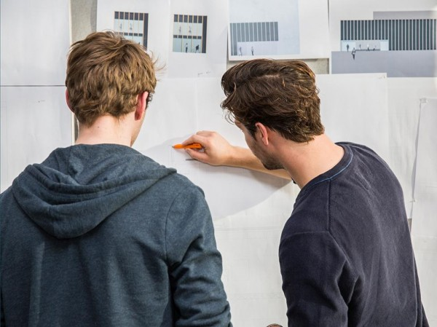
Some RGU: Equality Outcomes
2021 – 2025
Improved retention rates for those most likely to withdraw (male, mature and students with a declared disability);
Increase the proportion of disabled, Black, Asian, and male students who achieve Good Honours;
Increase the overall satisfaction of students with characteristics that have a satisfaction rate below that of the University average;
Increase the proportion of male students who take up a place at the University.

Slide 6
RGU focuses on the male student experience as one of its Enhancement Theme projects
The aim is to understand the nature of male student dissatisfaction, underachievement, and non-continuation at RGU, to consider how these challenges could be ameliorated, and to take action via the implementation of appropriate measures to improve the overall experience of male students at RGU.

Slide 7
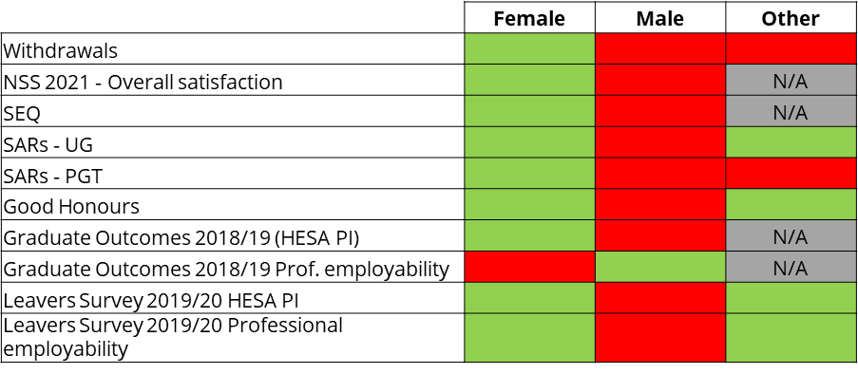
RGU’s work on the male student experience
A survey of our institutional student data does reveal a patchwork of good and poor male student satisfaction and achievement relative to that of female students.
Four broad areas of concern
Male student course satisfaction;
Male student levels of non-continuation;
Male student help-seeking;
Male student final degree designation.

Slide 8
Appointments with Study Skills and Counselling/Wellbeing by gender
Academic year | Number of students seen | Female | Male
2015-16 | 347 | 234 | 113
2016-17 | 380 | 282 | 98
2017-18 | 433 | 316 | 117
2018-19 (up to March 2019). New AskRGU system in place. | 594 | 241 | 91
01/09/21 – 02/11/21 | 151 | 113 | 38
Academic year | Number of students | Number of appointments | Female/Male students | Female/Male appointments
2014 | 1118 | 2470 | 799/319 | 1776/694
2015 | 1197 | 2567 | 898/299 | 1931/636
2016 | 1039 | 2104 | 791/248 | 1621/483
2017 | 969 | 1853 | 746/223 | 1449/404

Slide 9
What we did at RGU - focus groups and questionnaires
Male students recruited via School Officer and RGU: Union.
Male students asked about:
Satisfaction
Non-continuation
Help-seeking

Slide 10
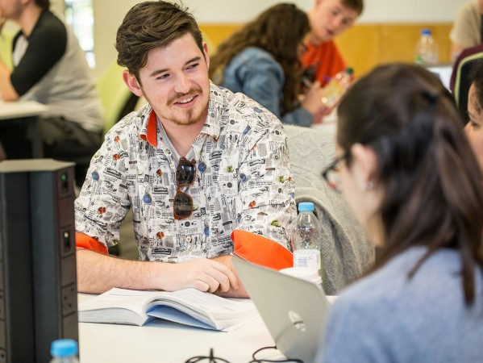
Satisfaction – some key themes emerging
- Relevance of course content
- Assessment regime
- Timing of placements
- Internationalising curriculum
- Subject mismatch
‘Getting a degree and getting value from it’

Slide 11
Non-continuation – some key themes emerging male students are ‘end oriented’.
Preparation for HE
The problem of ‘immediacy’
Course structure (anxious to go on placement)
Tenacity
Self-determination
Familial expectations
Options other than withdrawing.

Slide 12
Help-seeking – some key themes emerging
Barriers to help-seeking
- male image and ‘ego’
- impact on grades/results
- gender of the help-giver
- dislike of a ‘process’
- ‘extent’ of help on offer
These have an impact on overall satisfaction and attrition rates.

Slide 13
Help-seeking
Suggestions from students
around help-seeking
- Approachability
- The Personal Tutor
- Make more use of the Class Rep/
School Officer
- The ‘visibility’ of information.

Slide 14
Given the feedback from our focus groups…some suggestions for us and for other HEIs
Satisfaction | Option of placements earlier in the course (right from Stage 1)? Increased ‘internationalisation’ of the curriculum with a ‘broader outlook’ in the material delivered? More variety in assessment type, with fewer single 100% assessments.
Non-continuation | Could the process for changing course be simplified or the facility to have a ‘taster’ introduced to prevent withdrawal? Could there be a clearer path of communication between academic staff and the support services so that ‘early warning signs’ can be flagged? Offer enhanced advice on financial matters since many withdraw for financial reasons.
Final degree designation | Exit awards (other than degrees) as a positive outcome? Explicit rationale for students as to the value of all course content – linked to employment perhaps?
Help-seeking | The possibility of ‘’social support’ groups for male students as an alternative to the one-to-one? Could the University ‘target’ male student mental health explicitly in a campaign? The question of ‘school-based’ support services could be considered – students thought that a school-based system would understand their needs better.

Slide 15
My contact details…
Dr Liam Waldron
Lecturer in Student Transitions
Robert Gordon University
w.j.waldron@rgu.ac.uk
01224 262040

Slide 16
Resilient Learning Communities
Male students in Higher Education: addressing the disparities in outcomes.
Dr Liam Waldron 8 June 2022
Robert Gordon University

