Slide 1
Reflections on decolonising: the curriculum in the time of pandemic
Catriona Cunningham, Jasmine Millington
Edinburgh Napier University

Slide 2
In this session, we will offer a brief outline of our ARC project, which develops our 2021 Collaborative Cluster work on decolonising the curriculum, funded by the QAA Scotland Enhancement Theme. We will then share our reflections from both staff and student perspectives through our resources and will explore in particular what decolonising the curriculum means for staff-student partnership.

Slide 3
Project Team
Cluster Leads: Catriona Cunningham & Marita Grimwood
Student Intern: Jasmine Millington
Team:
Julie Blackwell-Young, Abertay University
Lindy-Ann Blaize-Alfred, University of Sheffield
Rayya Ghul, University of Edinburgh
Heather Gray, Glasgow Caledonian University
Jasmin Hinds, University of St Andrews Kevin Leomo, University of Glasgow
Joan Ma, Queen Margaret University
Rosemary McIlwhan, Heriot Watt University
Paula Miles, University of St. Andrews
Nathalie Tasler, University of Glasgow
Melanie Smith, AdvanceHE Scotland/University of Strathclyde

Slide 4
‘It takes more than one tongue to tell a story’ (Jackie Kay, Threshold, 2016)
Decolonisation of the curriculum is the process of analysing and interrogating how disciplines have been shaped by colonial history, and the impact of this on individuals and communities. The decolonising process seeks to challenge and dismantle the ways in which the academy operates to privilege the needs of some groups and marginalise those of others. We wanted to come together as a sector to share and learn from one another what works and what more we can do as individuals and as a learning community.

Slide 5
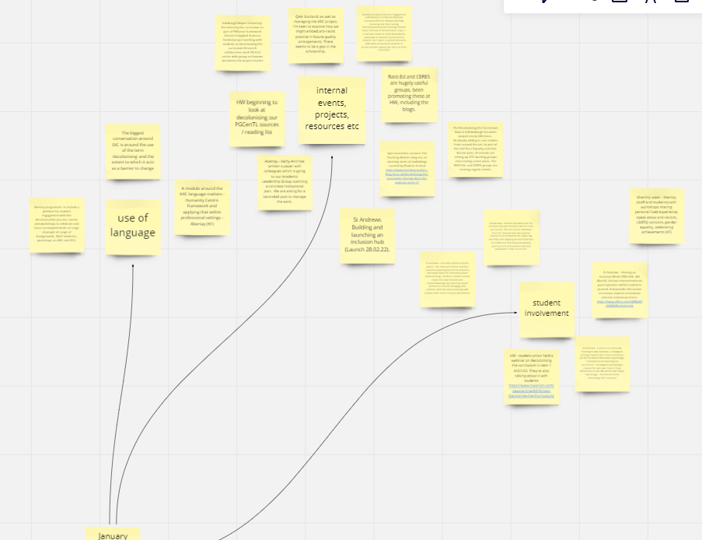
Where are we?

Slide 6
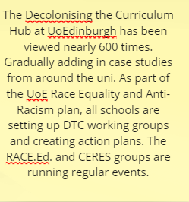
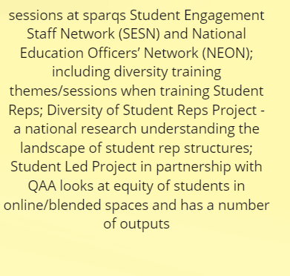
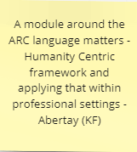
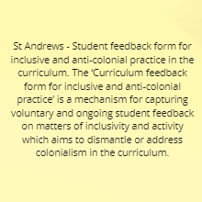
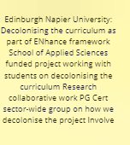
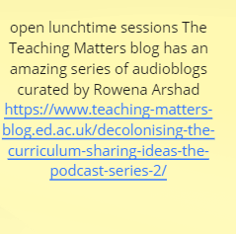
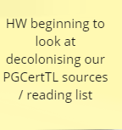
Recent and ongoing events and discussions at various institutions

Slide 7
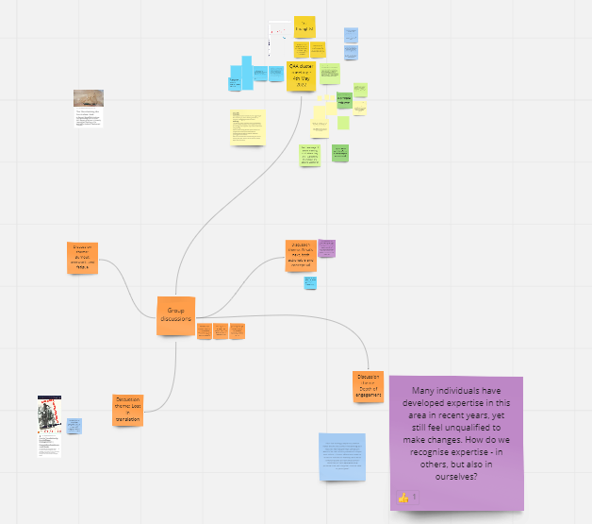
Latest Cluster meeting discussion notes

Slide 8
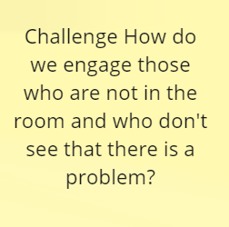
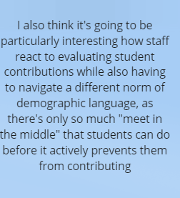
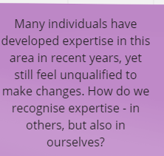
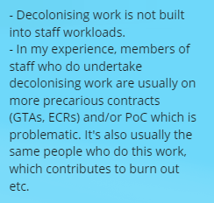

Slide 9
Narrative storytelling
Stories bring us together, untold stories keep us apart.
(Shafak, 2021, p. 9)

Slide 10
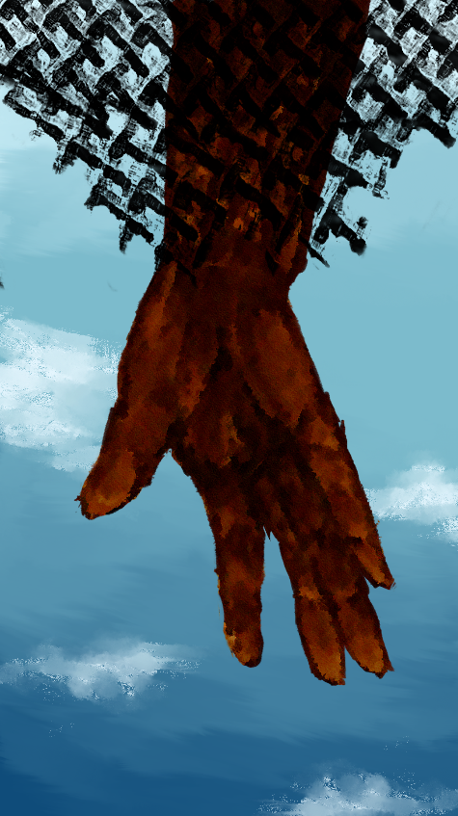
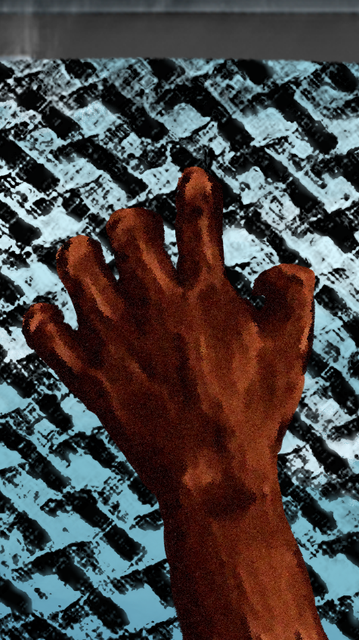
Student Voices
Interactive gallery!
Voices from student podcasts
(led by Jasmine, 2022)
Acted interviews
(Advance HE ARC Project 2021)

Slide 11
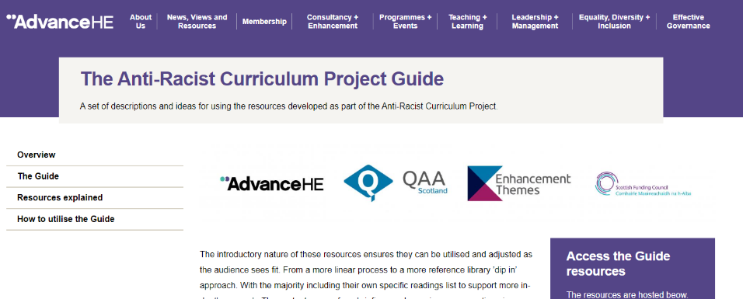

Slide 13
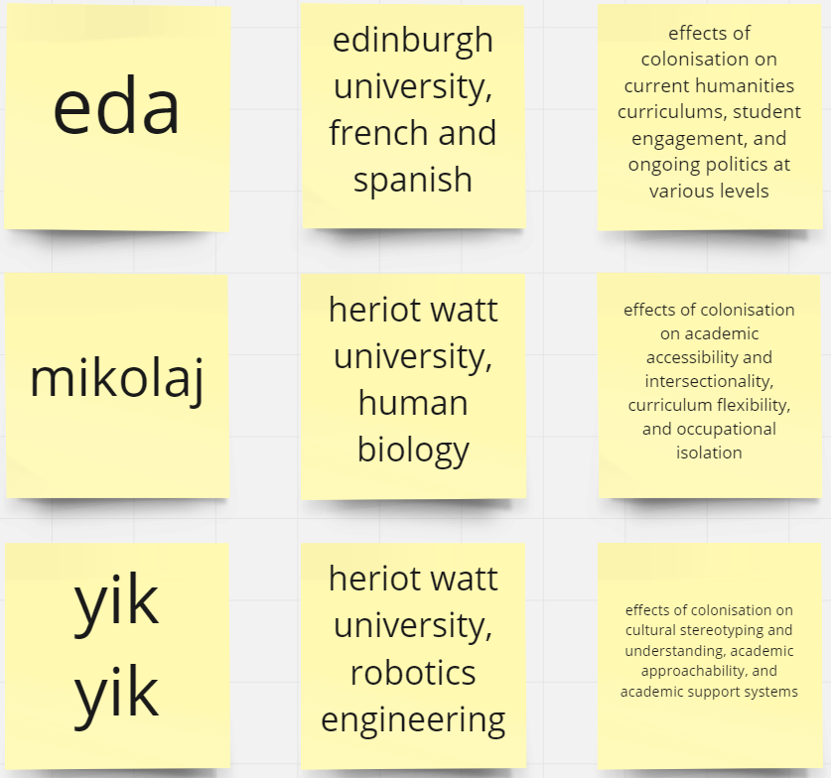
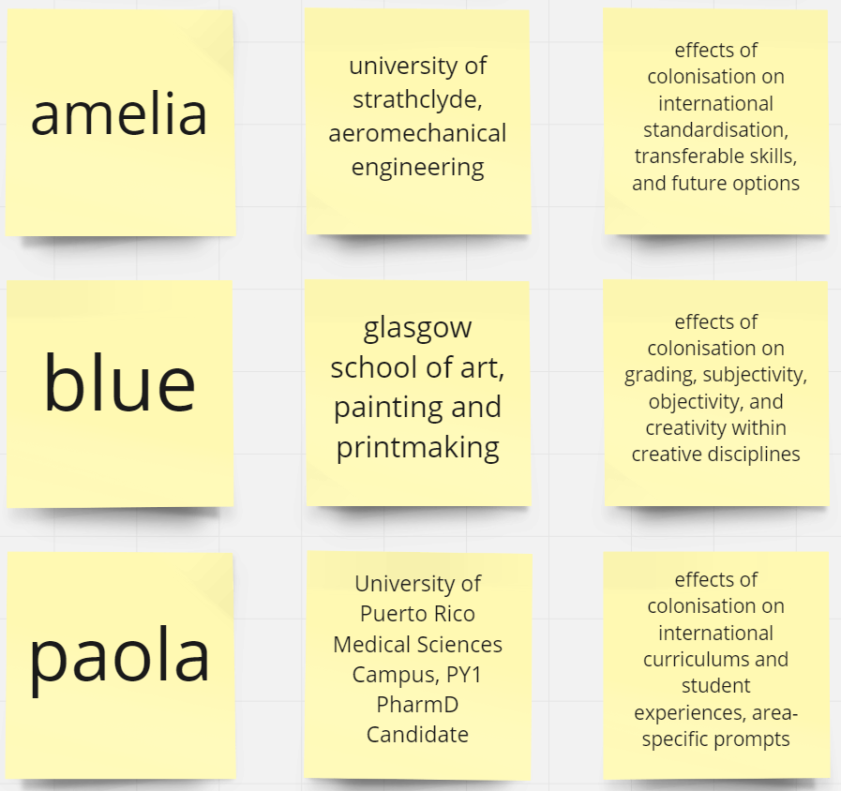
Student Podcasts

Slide 14
Narrative Storytelling Activity setting the scene
Essay
assignment submitted
Marked as 0-100% grading scheme
5 x students each submit essay and each get mark of 65%
Each student
responds
differently
to this mark.

Slide 15
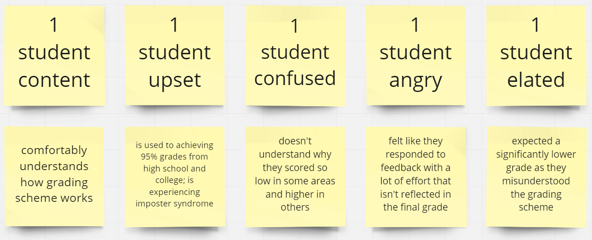
Narrative Storytelling
Examining outcomes

Slide 16
Narrative Storytelling
Listening in to the student and staff
Perspectives…

Slide 17
Narrative Storytelling – your turn
We’ll return to our 5 students and would now like you to imagine yourself from both the staff and student perspectives, thinking about the stories you have heard but also your own academic experiences in this context.
For those of you online, please take one of these students and write down either in your own notebook or in the chat what the stories behind the student response might be, either from a staff or student perspective.
For those of you in the room, please discuss these imaginary responses in your groups.

Slide 18
Narrative Storytelling
Examining outcomes

Slide 19
So what?
Implications for the role and agency of the teacher (see Biesta, 2013)
Implications for the ways in which we acknowledge and welcome our students’ voices and perspectives into our learning (teaching?) spaces
A need to listen in to staff-student relations and to revisit our ‘single stories’ (Adichie, 2009) – acknowledge the ‘darkness of higher education’ (Bengsten
There is hope…

Slide 20
Continued Work
Staff discussions
Student podcasts
Developing Dialogue resources to bring in student and staff perspectives to the curricula

Slide 21
Continued Work
Decolonising the curriculum serves to broaden the way we teach and think, to better reflect, serve and enable a working world with people of many different backgrounds.

Slide 22
And in the midst of this terrible despair, it offers us a chance to rethink the doomsday machine we have built for ourselves. Nothing could be worse than a return to normality. Historically, pandemics have forced humans to break with the past and imagine their world anew. This one is no different. It is a portal, a gateway between one world and the next. We can choose to walk through it, dragging the carcasses of our prejudice and hatred, our avarice, our data banks and dead ideas, our dead rivers and smoky skies behind us. Or we can walk through lightly, with little luggage, ready to imagine another world. And ready to fight for it.
(Peters et al., 2022)

Slide 23
References
Adichie, C. N. (2009, October). Chimamanda Ngozi Adichie: The danger of a single story. https://www.ted.com/talks/chimamanda_ngozi_adichie_the_danger_of_a_single_story
Bengtsen, S., & Barnett, R. (2017). Confronting the dark side of higher education. Journal of Philosophy of Education, 51(1), 114–131.
Biesta, G. Receiving the Gift of Teaching: From ‘Learning From’ to ‘Being Taught By’. Stud Philos Educ 32, 449–461 (2013). https://doi.org/10.1007/s11217-012-9312-9
Peters, A., Rizvi, F., McCulloch, G., Gibbs, P., Gorur, R., Hong, M., Hwang, Y., Zipin, L., Brennan, M., Robertson, S., Quay, J., Malbon, J., Taglietti, D., Barnett, R., Chengbing, W., McLaren, Fatar, R., Papastephanou, Burbules, N., Jackson, L., Jalote, P., Kalantzis, M., Cope, B., Fataar, A., Conroy, J., Misiaszek, G., Biesta, G., Jandrić, P., Choo, S., Apple, M., Stone, L., Tierney, R., Tesar, M., Besley T. & Misiaszek, L. (2022). Reimagining the new pedagogical possibilities for universities post-Covid-19, Educational Philosophy and Theory, 54:6, 717-760, DOI: 10.1080/00131857.2020.1777655

