Slide 1
Enhancement Conference 2022: Resilient Learning Communities – Inclusive, Flexible and Accessible
Scott Connor - Digital and Open Education Lead
Keith Smyth - Professor of Pedagogy and Dean of Learning and Teaching

Slide 2
Update
We identified 3 areas:
Early identification of students who may be at risk
Developing more effective means of gauging and understanding module and programme cohort patterns
Supporting Personal Academic Tutors, and equivalent student support roles
What we said last time
Linking dialogue to data and data to dialogue: from analytics to understanding student engagement

Slide 3
Update
Moved to a new VLE in 2019/20
Formed a Learning Analytics Steering Group January 2021
Made a decision to focus on the VLE
Initiated 2 workstreams
Course overview widget
Structure and pedagogy
What we have done since
Focus on the learning analytics capabilities of the VLE, but also to look at other systems.

Slide 4
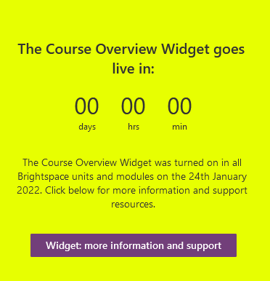
Update
Website
Yammer
Newsletters
Email
Social media
Webinars
Faculty events
Where we are now
Communications strategy

Slide 5
Update
Created a Privacy and Ethics CoP
Developed support resources
Implemented the Widget Jan 2022
Continued to promote
Where we are now
Workstream 1:
Course Overview Widget

Slide 6
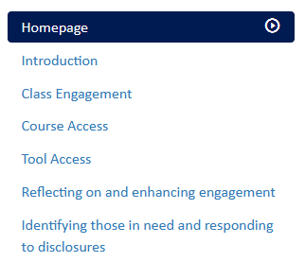
Supporting resources

Slide 7
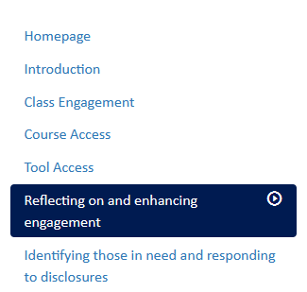
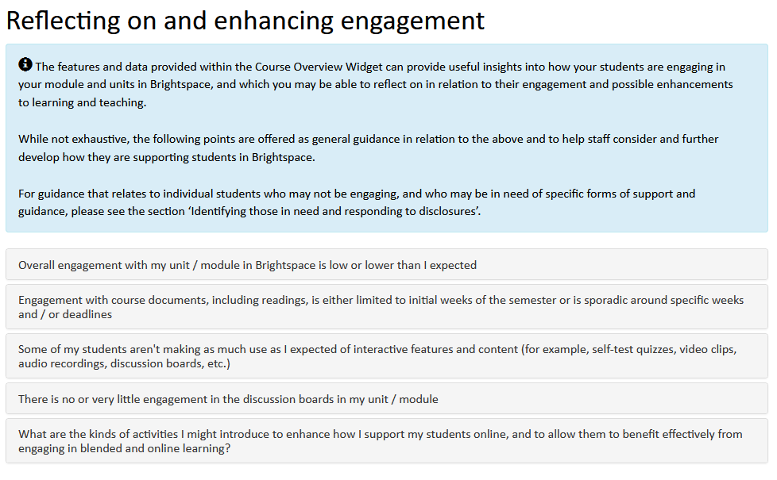
Supporting resources

Slide 8
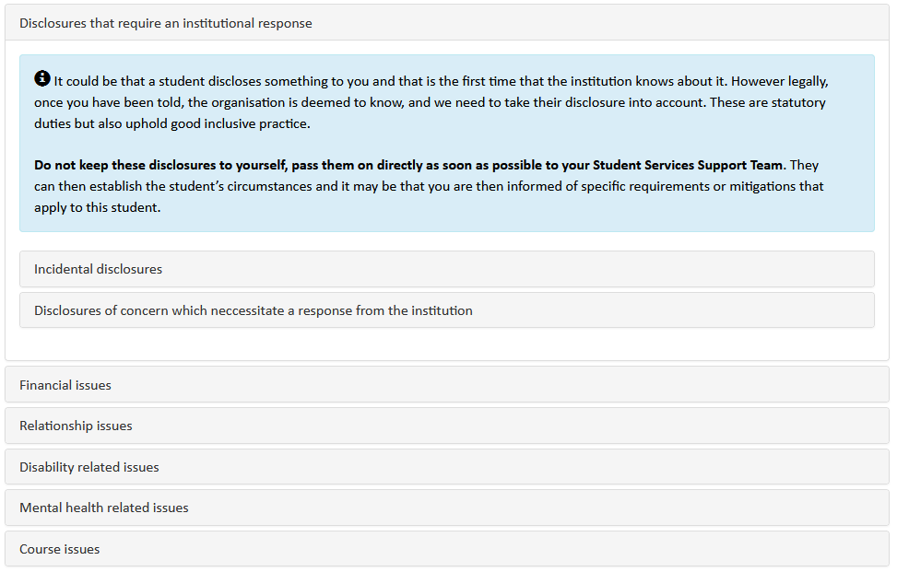
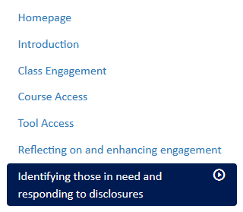
Supporting resources

Slide 9
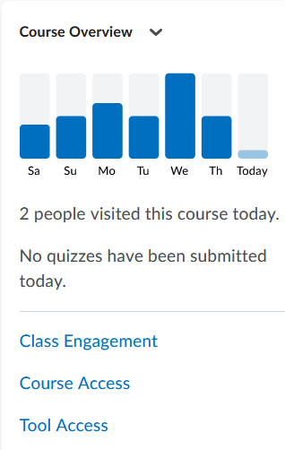
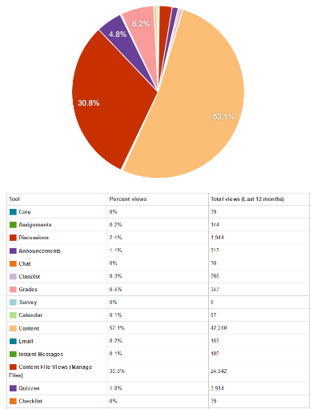
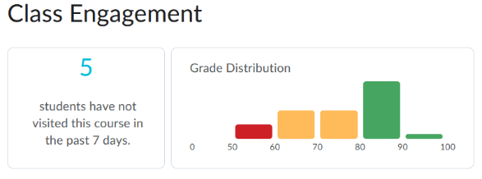
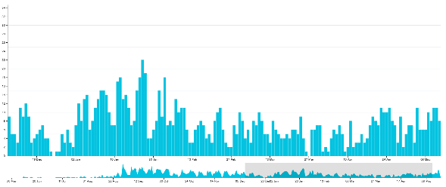
Supporting resources

Slide 10
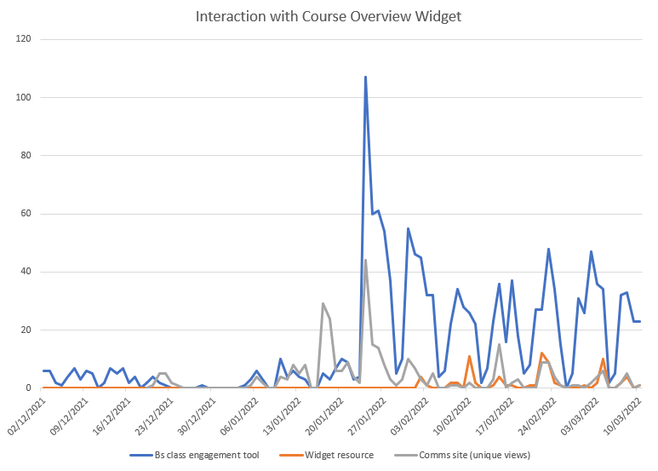
Early Indications & Next Steps
Uptake through the systems
Course Overview Widget

Slide 11
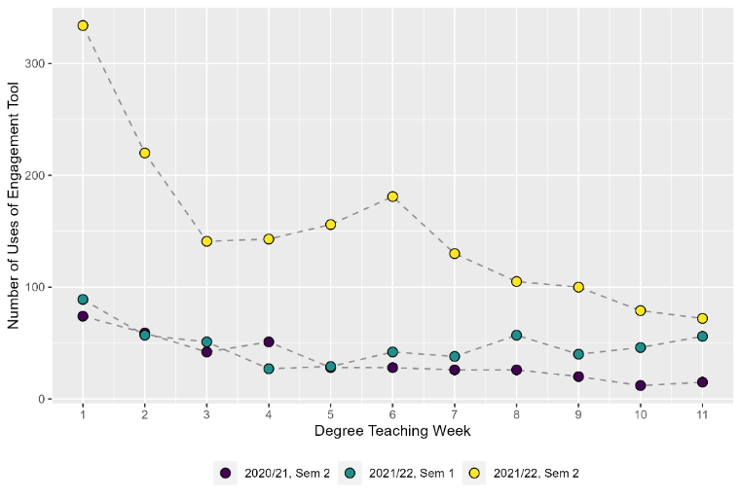
Early Indications & Next Steps
Comparing across semesters
Course Overview Widget

Slide 12
Early Indications & Next Steps
A total of 855 users from a population of 1700 active VLE teaching staff
Half have never used the tool...why?
610 were accessing the data prior to the launch
245 new users since we launched
128 accessed once since launch and have not returned...why?
Interestingly, females form the vast majority of the top 25 users...why?
Course Overview Widget

Slide 13
Early Indications & Next Steps
“As leader of a module that is taught by multiple lecturers, I can monitor the course widget and flag up any students of concern to each tutor, who can then prioritise contacting individual students as a support measure. ”
“Having the course overview widget on the front page of the module space serves as a regular reminder to check in on student progress. Less button clicks are always helpful! “
“It helps me to gain an overview of the large volume of students more quickly and allows me to communicate more effectively and more objectively (i.e., by providing dates of last access, etc.) with other tutors, with students’ Personal Academic Tutors.”
“The ones that were not engaging as much I was able to see this straight away and contact them to offer support, in some instances they had been working or ill but were getting back on track where as others had been struggling and were starting to drift away from the course.”
“I use a lot of quizzes for one of my teaching units and the Course Overview widget lets me see at a glance, how many students are completing quizzes on any given day and flagging that there is value in me navigating to the quiz tool to check students work.”

Slide 14
Early Indications & Next Steps
3 groups of interest:
Accessed before and after
Accessed once and stopped
Never accessed
Questions:
Usage and impact – pedagogy, support
Demographic – gender, discipline, level of study
Course Overview Widget
Areas of interest

Slide 15
Update
In pilot phase
Selected a flagship programme
Backup and restore of all associated modules into a test environment
Investigating content and structure
Where we are now
Workstream 2:
Programme level analysis

Slide 16
Achievements
Comprehensive communications plan
Privacy and Ethics CoP
Implemented a tool that has the potential to meet our objectives
Created supporting framework and resources
Identified patterns of use and users
Where we are now

Slide 17
Future Directions
Activity | Timescale
Pilot 1 – Course Overview Widget | Short term
Pilot 2 – Gauging online supported practice | Short – Mid term
Pilot 3 – Predictive analytics - efficacy | Mid term
Pilot 4 – Student interface dashboard | Mid term
Pilot 5 – Cross institutional LA | Long term

Slide 18
Thank you Tapadh leibh

