Slide 1
The power of learning analytics to impact learning and teaching: a critical perspective @DrBartRienties Professor of Learning Analytics Open University UK
Tuesday 16 April 2019

Slide 2
What will we talk about today?
What do you think and feel about learning analytics?
What is learning analytics?
What is the role of learning design in learning analytics?
What is the role of teachers in learning analytics?

Slide 3
What do you hope learning analytics will do for you (and your organisation)?
Just post your thoughts into the chat box

Slide 4
What are your potential concerns if your organisation would implement learning analytics
Just post your thoughts into the chat box

Slide 5
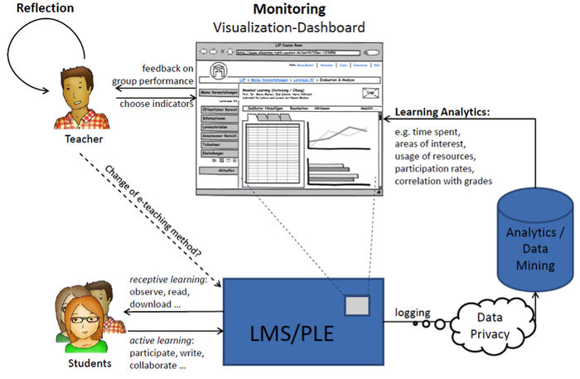
Dyckhoff, A. L., Zielke, D., Bültmann, M., Chatti, M. A., & Schroeder, U. (2012). Design and Implementation of a Learning Analytics Toolkit for Teachers. Journal of Educational Technology & Society, 15(3), 58-76.

Slide 6
Dyckhoff, A. L., Zielke, D., Bültmann, M., Chatti, M. A., & Schroeder, U. (2012). Design and Implementation of a Learning Analytics Toolkit for Teachers. Journal of Educational Technology & Society, 15(3), 58-76.

Slide 7
Learning Design is described as “a methodology for enabling teachers/designers to make more informed decisions in how they go about designing learning activities and interventions, which is pedagogically informed and makes effective use of appropriate resources and technologies” (Conole, 2012).

Slide 8
Open University Learning Design Initiative (OULDI)
 | Assimilative | Finding and handling information | Communication | Productive | Experiential | Interactive/ Adaptive | Assessment
Type of activity | Attending to information | Searching for and processing information | Discussing module related content with at least one other person (student or tutor) | Actively constructing an artefact | Applying learning in a real-world setting | Applying learning in a simulated setting | All forms of assessment, whether continuous, end of module, or formative (assessment for learning)
Examples of activity | Read, Watch, Listen, Think about, Access, Observe, Review, Study | List, Analyse, Collate, Plot, Find, Discover, Access, Use, Gather, Order, Classify, Select, Assess, Manipulate | Communicate, Debate, Discuss, Argue, Share, Report, Collaborate, Present, Describe, Question | Create, Build, Make, Design, Construct, Contribute, Complete, Produce, Write, Draw, Refine, Compose, Synthesise, Remix | Practice, Apply, Mimic, Experience, Explore, Investigate, Perform, Engage | Explore, Experiment, Trial, Improve, Model, Simulate | Write, Present, Report, Demonstrate, Critique
Conole, G. (2012). Designing for Learning in an Open World. Dordrecht: Springer.
Rienties, B., Toetenel, L., (2016). The impact of learning design on student behaviour, satisfaction and performance: a cross-institutional comparison across 151 modules. Computers in Human Behavior, 60 (2016), 333-341
Notes:
Explain seven categories

Slide 9
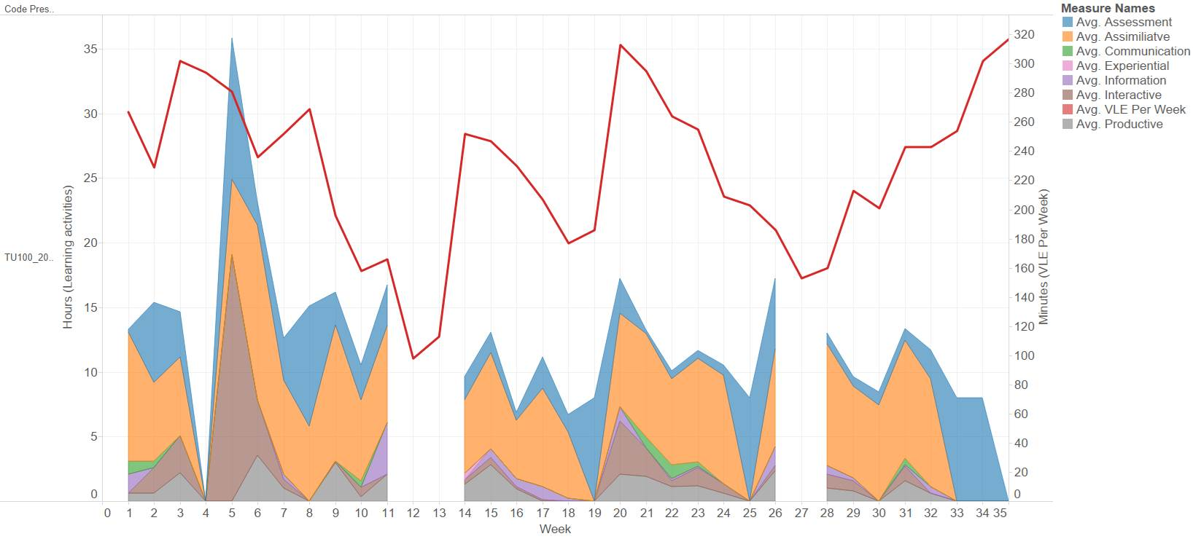

Slide 10
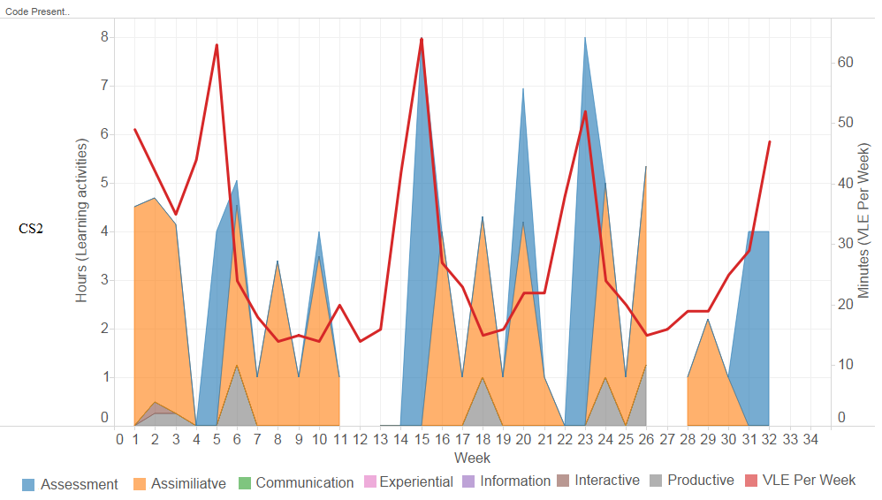
69% of what students are doing in a week is determined by us, teachers!
Nguyen, Q., Rienties, B., Toetenel, L., Ferguson, R., Whitelock, D. (2017). Examining the designs of computer-based assessment and its impact on student engagement, satisfaction, and pass rates. Computers in Human Behavior. DOI: 10.1016/j.chb.2017.03.028.

Slide 11
Constructivist Learning Design
Student Satisfaction
Assessment Learning Design
VLE Engagement
Productive
Learning Design
Week 1
Week 2
Week30+
Socio-construct. Learning Design
Student retention
Communication
150+ modules
Rienties, B., Toetenel, L., (2016). The impact of learning design on student behaviour, satisfaction and performance: a cross-institutional comparison across 151 modules. Computers in Human Behavior, 60 (2016), 333-341
Nguyen, Q., Rienties, B., Toetenel, L., Ferguson, R., Whitelock, D. (2017). Examining the designs of computer-based assessment and its impact on student engagement, satisfaction, and pass rates. Computers in Human Behavior. DOI: 10.1016/j.chb.2017.03.028.
Notes:
Cluster analysis of 40 modules (>19k students) indicate that module teams design four different types of modules: constructivist, assessment driven, balanced, or socio-constructivist. The LAK paper by Rienties and colleagues indicates that VLE engagement is higher in modules with socio-constructivist or balanced variety learning designs, and lower for constructivist designs. In terms of learning outcomes, students rate constructivist modules higher, and socio-constructivist modules lower. However, in terms of student retention (% of students passed) constructivist modules have lower retention, while socio-constructivist have higher. Thus, learning design strongly influences behaviour, experience and performance. (and we believe we are the first to have mapped this with such a large cohort).

Slide 12
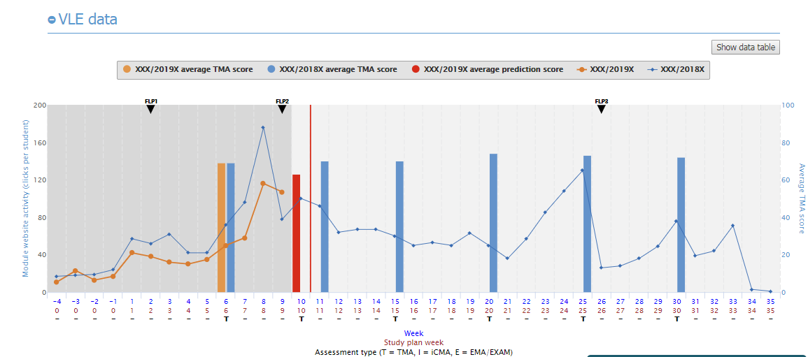
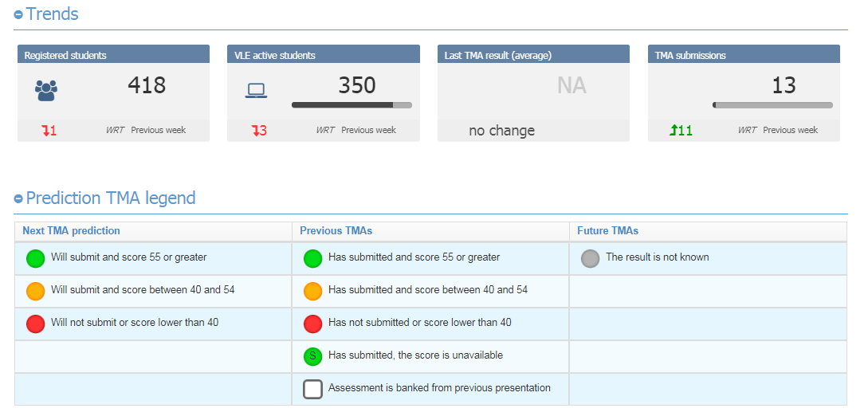
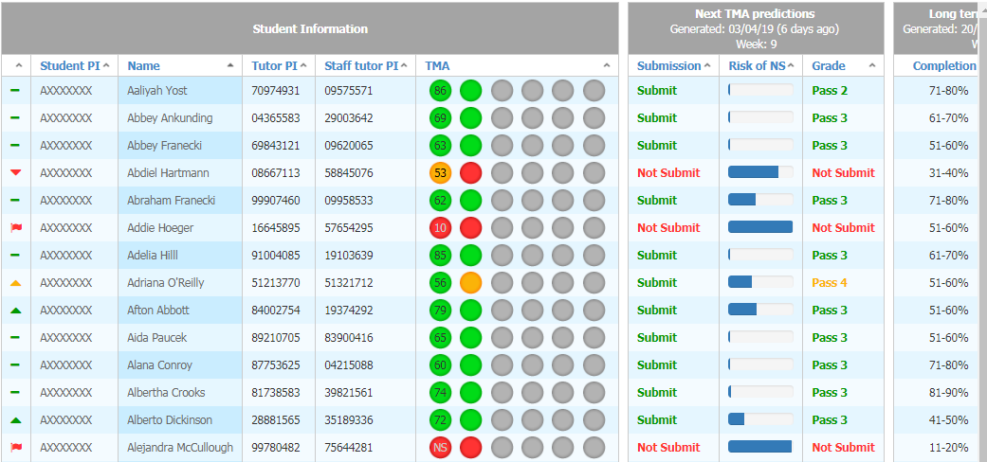

Slide 13
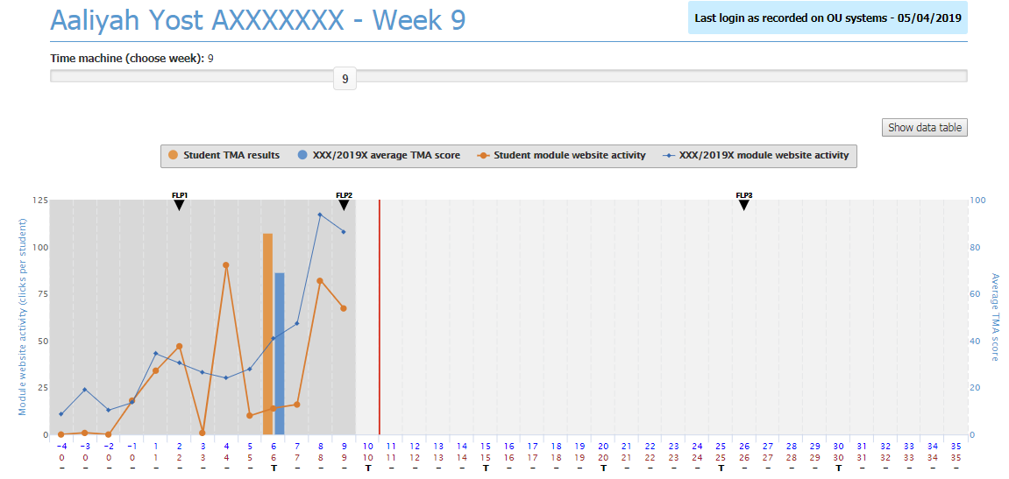
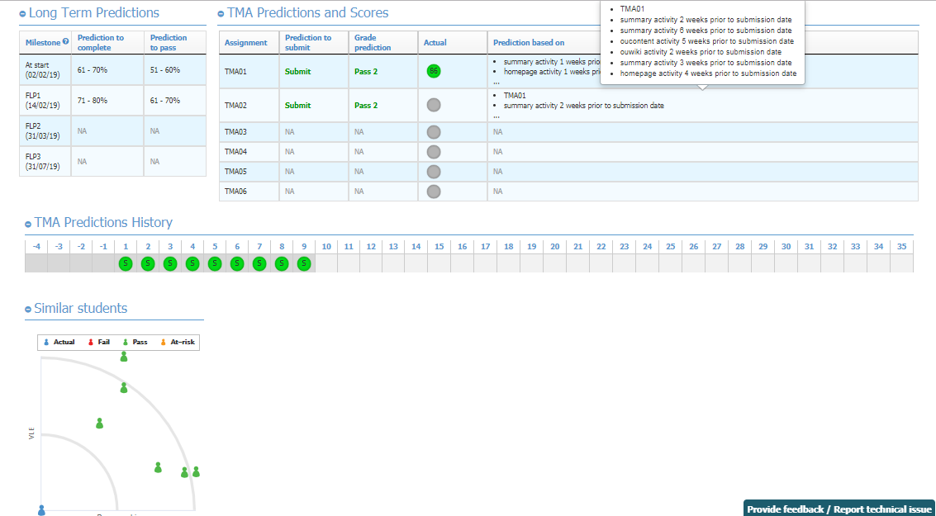

Slide 14
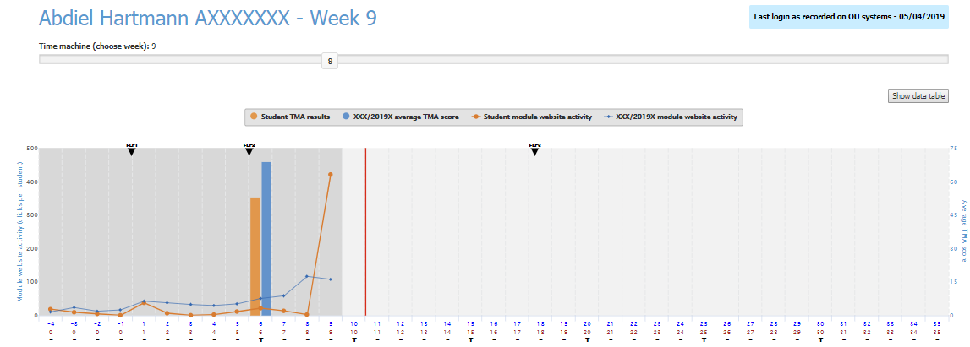
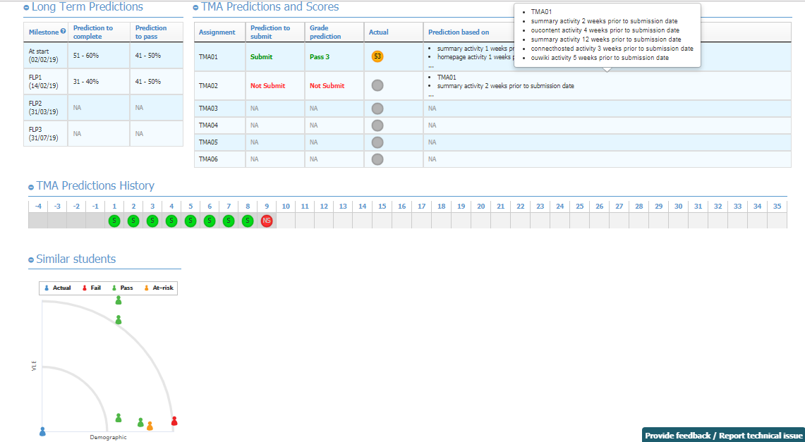

Slide 15
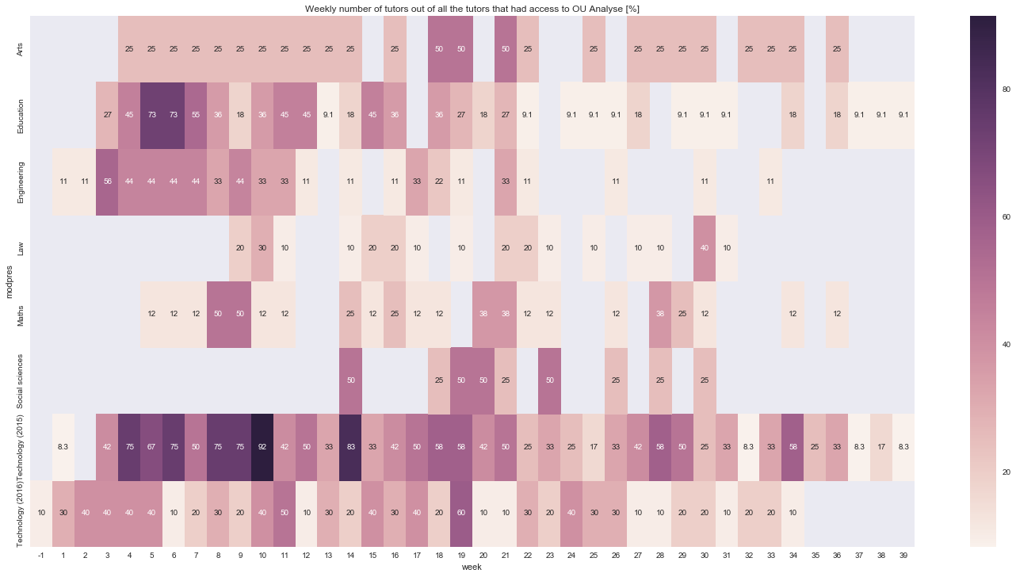
Usage of OUA dashboard by participating teachers
Herodotou, C., Rienties, B., Boroowa, A., Zdrahal, Z., Hlosta, M., & Naydenova, G. (2017). Implementing predictive learning analytics on a large scale: the teacher's perspective. Paper presented at the Proceedings of the Seventh International Learning Analytics & Knowledge Conference, Vancouver, British Columbia, Canada, pp. 267-271

Slide 16
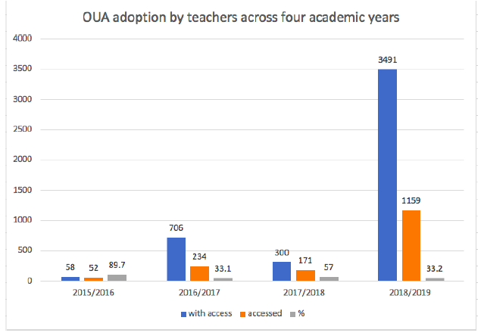
Herodotou, C., Rienties, B., Hlosta, M., Boroowa, A., Mangafa, C., Zdrahal, Z. (Submitted: 31-03-2019). The scalable implementation of predictive learning analytics at a distance learning university: Insights from a longitudinal case study. Internet and Higher Education.

Slide 17
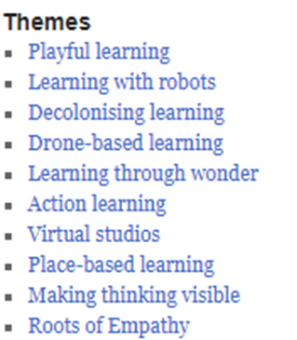
Ferguson, R., Coughlan, T., Egelandsdal, K., Gaved, M., Herodotou, C., Hillaire, G., Jones, D., Jowers, I., Kukulska-Hulme, A., McAndrew, P., Misiejuk, K., Ness, I. J., Rienties, B., Scanlon, E., Sharples, M., Wasson, B., Weller, M. and Whitelock, D. (2019). Innovating Pedagogy 2019: Open University Innovation Report 7. Milton Keynes: The Open University.

Slide 18
Conclusions and moving forwards
Teachers and professional development key in world of learning analytics
Learning design and teachers strongly influences student engagement, satisfaction and performance
Learning analytics can be quite powerful to understand complexities of learning in- and outside class
Learning analytics approaches can help researchers and practitioners to test and validate big and small theoretical questions
I am open for any collaborations or any wild ideas ☺

Slide 19
Any questions or comments?

Slide 20
The power of learning analytics to impact learning and teaching: a critical perspective @DrBartRienties bart.rienties@open.ac.uk Professor of Learning Analytics Open University UK
Tuesday 16 April 2019

