Slide 1
Evidence for Enhancement:
Students Using Students’ Data
Sorcha Kirker
Vice President Higher Education
Highlands and Islands Students’ Association
18th June 2019

Slide 2
Introduction
This presentation will look at student interaction with, engagement with, and use of data, covering:
  The types of data we interact with, and why
  What problems we face with these data sets
  What barriers we face in relation to student interaction with data
  What the benefits are of student involvement in data processes
  Case study – The HISA Student Rep Summit
Notes:
William to introduce the overall topic, Sorcha to pick up?

Slide 3
Key Performance Indicators
Social Media Data
Survey
Results
WHAT DATA?
Student-led Teaching Awards
Student Rep Data
Feedback Data
Notes:
Just a snapshot of some of the data sources that SA Officers in particular interact with
Flag welfare data and internal review data
Ask if there are other types that they can think of

Slide 4
Challenges with the data
Issues with accuracy and skewed results
Survey fatigue – low response rates and the ‘tick-box effect’
Are we measuring the right areas in relation to the student experience?
KPIs – very important, but next to no student involvement
Competitiveness
‘Inside the box’ data – are we looking at the right kinds of data?
Quantitative vs qualitative?
Notes:
Can use UHI as an example when mentioning skewed results
Tick-box effect –data can loose it’s meaningfulness
KPIs:
Are we measuring the right areas?
Do students care/know about KPIs?
Are we measuring areas students care about?
Should we be measuring ourselves based on students perspectives and standards?
Our focus could be misdirected to areas that engage students the least?
Hitting KPIs can get us more funding/resources – these should go to the areas students care about the most?
Competitiveness – data can sometimes cause us as a sector to compete with one another, rather than to work collectively for the good of the student experience
‘Inside the box data’ – What else could we look at that could be beneficial? (discussion point?)
Quantitative vs qualitative – Quantitative is too easily manipulated, and you don’t get the full picture without the information to back the statistics up. Qualitative on it’s own can lack impact (e.g. those snappy statistics). We can focus too much on one or the other, but we need both.

Slide 5
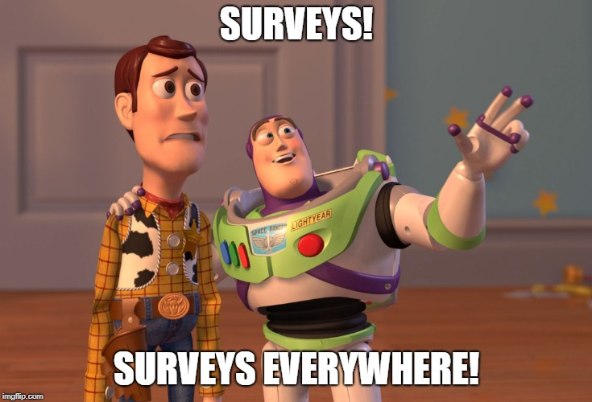

Slide 6
What are the barriers for students?
Survey Fatigue
Lack of understanding/awareness
Apathy
Skill level
Lack of support available
Lack of involvement
Ethics
Notes:
Students can feel over-surveyed which can lead to them disengaging from surveys
Are we really explaining to students how important the data collected is, and how it can help to shape change?
The less involved the students are, the less they will care about the outcome
Ethics can be a very tricky barrier, particularly if we are dealing with welfare data

Slide 7
Opportunities
With better support, there are so many opportunities for students engaging with data:
  Increased student engagement & more meaningful data
  Student buy-in and ownership of surveys
  Better knowledge of what is meaningful to the students
  Students involved in action-planning processes
  More meaningful institutional dialogues
  They can help us to think about other meaningful types of data, and to ‘get out of the box’
  Impactful campaigns and advocacy
  Quantitative AND qualitative
  Student reps can then support other students in their interaction with data
  Students helping to shape KPIS
Notes:
If they understand what we are doing and why we are doing it, then they are more likely to meaningfully engage
The more that students understand data processes, the more ownership they will have which will increase buy-in (i.e. the more students understand the importance, the more they will engage)
Students are the experts on the student experience (learning or otherwise), and so they can help us to understand which bits are the most important to measure
Often students help us to identify the issues, but they can also help us to identify potential solutions
With better support for students in our data processes, we can have more meaningful dialogues with our institutions
We can gather more meaningful statistics, which can be bolstered by more in-depth qualitative data
If we embed student support in our data processes, student reps can support other students to meaningfully engage
Students should have more ownership over KPIs – if we are measuring how good we are at improving the student experience, students should help us to shape what this looks like

Slide 8
Case study: HISA Student Rep Summit
Tied into our Enhancement Themes Project
First event of its type
Jointly organised between HISA and the UHI Learning and Teaching Academy
Completely focused on the Student Reps
Staff invited as well

Slide 9
Case study: HISA Student Rep Summit
Sessions focused on:
  promoting value around the Student Rep role
  increasing communication between staff and Student Reps
  getting Student Reps more involved in our data processes
KPIs Who Gives A Fork?!
Engagement Indicators - World Café
Student Representation – Perception Posters
Student Surveys – Who Cares? (We Do!)
You Said, We Did – But Are We Really Doing What You Said?
Student Representation – Getting it Right for Online and Networked Students
Notes:
Briefly explain the aims of each session

Slide 10
Some things to consider
Are we meaningfully engaging students in our data processes?
Should we be considering other data sets?
Should we be thinking about other data collection methods, and moving away from the more traditional processes and data sets?

Slide 11
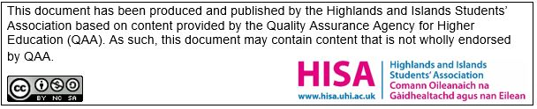
Thank you for listening
Any questions?

