Slide 1
Evidence for Enhancement:
Just enough? Why we need to question our assumptions about evidence
Stella Jones-Devitt and Alan Donnelly
Sheffield Hallam University
20 November 2018

Slide 2
Introductions and overview
Considering what counts as credible evidence
Exploring the use of hierarchies of evidence and why these should carry a health warning
Investigating the impact on decision-making and methodological approaches
Suggesting possible reconceptualisations concerning the valuing of types of evidence and the application within an enhancement context

Slide 3
'Evidence-informed' everything?
Types of evidence
Really depends on the nature of the question...
Evidence as facts or 50 shades of grey?
Your perspective may be determined from your vantage point
Evidence that fits
Many false inferences are drawn from assumptions
Evidence that suits
Much is made of scale and 'paralysis by analysis'

Slide 4
Activity
We often hear that data is either a) too granular to be meaningful, or b) too homogenous to act upon.
Some questions for you:
How much of an evidence-base is 'just enough'?
Can you think of examples in which there has been paralysis by analysis?
Are there any optimum circumstances relating specifically to enhancement processes?

Slide 5
Evidence-informed decision-making?
Evidence proxies
The methodological challenges of coping with NSS, TEF, etc.?
Empirical evidence rules, ok?
If we only capture what is seen, we might miss lots of important factors
Good news evidence
'What works' pressures can lead to under-reporting of lessons learned

Slide 6
The contested nature of evidence
'The conscientious, explicit and judicious integration of best available research on teaching technique and expertise within the context of student, department, college, university and community characteristics'
(Groccia & Buskist, 2011)
Do you agree or disagree with this definition of evidence-based practice?

Slide 7
The contested nature of evidence
Questions about evidence and practice in education (Cain, 2015)
Can the 'medical model' of evidence-based practice be applied to education?
What constitutes as 'evidence'?
Are the favoured research methods appropriate?
How will evidence translate into practice?
Who is responsible for its implementation?

Slide 8
Credibility of evidence-based practice?
Systematic Review and Meta-analysis
Evidence 'hierarchy'
Higher
RCT
Lower
Case control studies
Quality of evidence
Case studies
Risk of bias
Case reports
Lower
Higher
Ideas, editorials and opinions

Slide 9
Credibility of evidence-based practice?
Systematic Review and Meta-analysis
Evidence 'hierarchy'
Higher
RCT
Lower
Case control studies
Quality of evidence
Case studies
Risk of bias
Case reports
Lower
Higher
Ideas, editorials and opinions

Slide 10
Credibility of evidence-based practice?

Slide 11
Credibility of evidence-based practice?
Expose inaccurate claims of research and potential to reduce 'selection bias' (Haynes et al., 2012)

Slide 12
Credibility of evidence-based practice?
Encourage practice that is based on 'sound evidence' rather than tradition and intuition (Groccia & Buskist, 2011)

Slide 13
Credibility of evidence-based practice?
Evidence is reduced to narrow 'scientific' terms that avoids social context and values (Biesta, 2007)

Slide 14
Credibility of evidence-based practice?
Disengages inquiry from teaching and undermines professional judgement (Thomas, 2016)

Slide 15
Credibility of evidence-based practice?
Ethical implications?
?

Slide 16
Credibility of evidence
Professional judgement
System-level data
Research evidence
Classroom data
Nelson and Campbell (2017)

Slide 17
Credibility of evidence
Knowledge mobilisation?
Levin (2013)
Use
Production
Mediation

Slide 18
Activity
Would you challenge the 'pyramid' hierarchy of evidence?
If you had to construct a new order, what would it look like?

Slide 19
Reconceptualising Evidence
In order to engage, we might have to unlearn
Involves Bauhausian notion of “deschooling” to encourage looking at the
world anew
Evidencing the unintended
Only capturing the observable or traditionally measurable results in
missing or devaluing lots of useful 'stuff'
Requires evidence osmosis!
Moving from credibility to mobility....

Slide 20
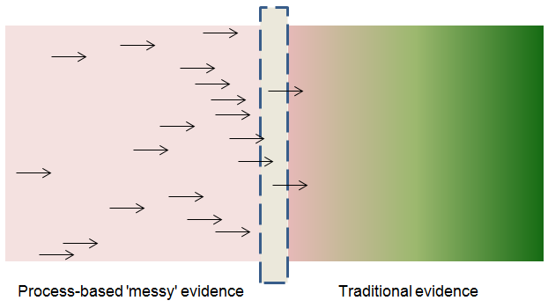
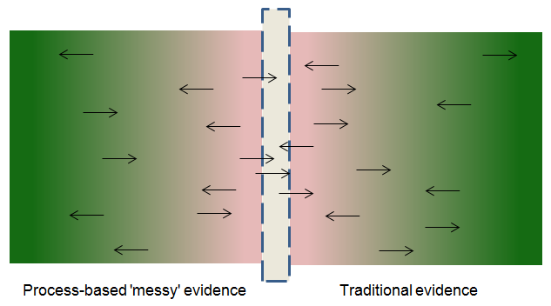
An Osmotic Evidence Base
The Norm
Limited routes for 'messy' evidence and one way flow
Minimal absorption into traditional approaches and practices
Very limited permeability between the traditional and process-based forms of evidence
Minimal changes to saturation levels, i.e. nothing changes or mobilises
The Future?
Fusion of process-based and traditional evidence approaches
Possible absorption and valuing of lots of approaches
Permeable on both sides
Equalising of saturation levels resulting in much learning, progress and knowledge mobilisation

Slide 21
Deliberations....?
What are the implications for your work concerning evidence for enhancement purposes?
What are the take away messages from this webinar?

Slide 22
Additional resources
Following on from this webinar, the following resources will be available:
A 'new order' evidence template, which you can apply to your own practice
An annotated bibliography of interesting sources

Slide 23

Evidence for Enhancement:
Asking Questions of Evidence email: s.jones-devitt@shu.ac.uk a.donnelly@shu.ac.uk
Twitter: @jonesdevitt
@alandonnelly90
@SHU_StEER
www.blogs.shu.ac.uk/steer

