Slide 1
How do we really record lectures?
Making the best use of multiple evidence sources in a large institutional evaluation project
Jill MacKay
jill.mackay@ed.ac.uk
17/12/2019, 12:30-13:15

Slide 2
Outline
Recordings
Evidence
Edinburgh
Resources
Chat
What do we know about lecture recording?
What do we know about evidence?
Edinburgh as a case study
Resources
Chat
  Expectation Setting:
  Please talk/questions in the chat – I’ll try to respond as we go and address a balance of questions

Slide 3


Recording transforms . . .
Recordings
Evidence…
Edinburgh
Resources
Chat

Slide 4
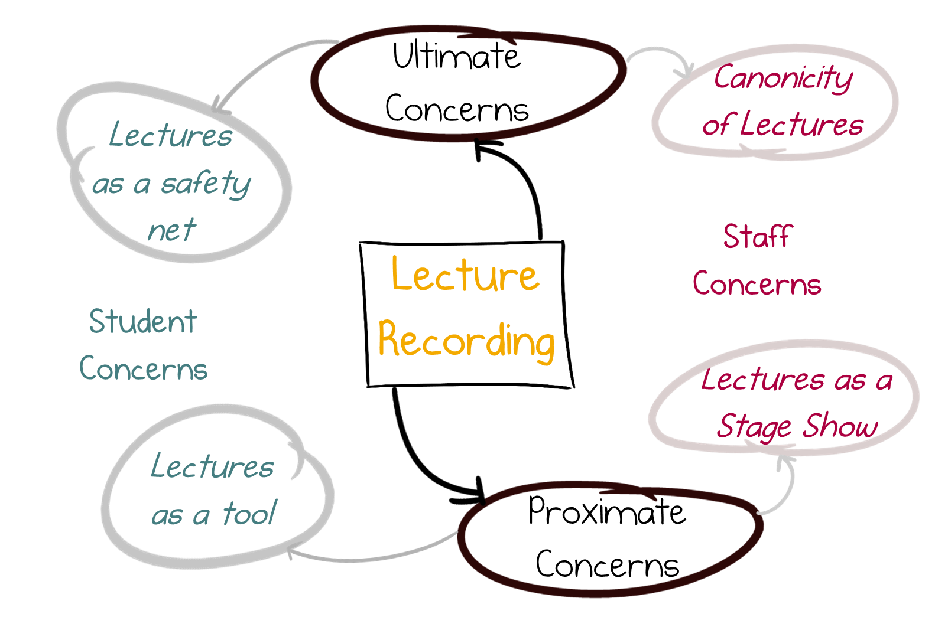
Recordings as a transformation
Recordings
Evidence…
Edinburgh
Resources
Chat
MacKay 2019, https://doi.org/10.1016/j.compedu.2019.05.019

Slide 5
Recordings as a transformation
Recordings
Evidence…
Edinburgh
Resources
Chat
But let’s talk business
MacKay 2019, https://doi.org/10.1016/j.compedu.2019.05.019

Slide 6










Data Analysis
Recordings
Evidence…
Edinburgh
Resources
Chat
Analyses condense information
(So that you don’t have to know the data in depth to make a decision)

Slide 7
Making Best Use of Evidence…
Recordings
Evidence…
Edinburgh
Resources
Chat
Quantitative Evidence
Sharing data/workflows
  https://www.ukdataservice.ac.uk/manage-data/plan/why-share.aspx
  https://ropensci.github.io/reproducibility-guide/sections/introduction/
Benchmarking / Exploring diffs
  Buckey (2019) Using statistical significance to interpret NSS results https://www.enhancementthemes.ac.uk/docs/ethemes/evidence-for-enhancement/using-statistical-significance-to-interpret-national-student-survey-results.docx?sfvrsn=fd59c581_8
Qualitative Evidence
Triangulation (Data, Methodology, Participant Checking, Theoretical Triangulation, Investigator Triangulation)
  Twining et al 2017 (https://doi.org/10.1016/j.compedu.2016.12.002)
Explore ways of sharing:
  MacKay 2019 (https://jpaap.napier.ac.uk/index.php/JPAAP/article/view/354)

Slide 8
Making Best Use of Evidence…
Recordings
Evidence…
Edinburgh
Resources
Chat
Evidence needs to be shared
Quantitative Evidence
Sharing data/workflows
  https://www.ukdataservice.ac.uk/manage-data/plan/why-share.aspx
  https://ropensci.github.io/reproducibility-guide/sections/introduction/
Benchmarking / Exploring diffs
  Buckey (2019) Using statistical significance to interpret NSS results https://www.enhancementthemes.ac.uk/docs/ethemes/evidence-for-enhancement/using-statistical-significance-to-interpret-national-student-survey-results.docx?sfvrsn=fd59c581_8
Qualitative Evidence
Triangulation (Data, Methodology, Participant Checking, Theoretical Triangulation, Investigator Triangulation)
  Twining et al 2017 (https://doi.org/10.1016/j.compedu.2016.12.002)
Explore ways of sharing:
  MacKay 2019 (https://jpaap.napier.ac.uk/index.php/JPAAP/article/view/354)

Slide 9

Edinburgh as a Case Study
Recordings
Evidence
Edinburgh
Resources
Chat
Education researcher seconded to Information Services Group
Tasked to explore “What is the value of lecture recording at the University of Edinburgh”
  Establish an evidence baseline of experiences at Edinburgh
  Provide guidance on future work

Slide 10
Edinburgh as a Case Study
Recordings
Evidence
Edinburgh
Resources
Chat
Late 2017
Identified need for evaluation of roll-out
Secondment post generated
Early 2018
Characterise Edinburgh story (Qual + Quant)
Generate report on outcomes
Late 2018
Extend secondment
Generate guidance in staff/student workshops
Early 2019
Write up guidance

Slide 11
Our Evaluation
Recordings
Evidence
Edinburgh
Resources
Chat
Triangulation
Data Triangulation
  ‘All is Data’ – compared with other sources
Methodology Triangulation
  Surveys, interviews, focus groups
Participant Checking
  Results checked with user groups. Focus Group checked some survey results
Theoretical Triangulation
  Not yet – mostly Grounded Theory so far
Investigator Triangulation
  PTAS projects
Unstructured Staff Interviews (n = 12)
Fully qualitative
Attitudes about
Student Survey (n = 295)
Attitudes
Self-reports of behaviour
Student Focus Group (n = 2)
Fully qualitative
Mostly quantitative, some qualitative
Self-reports of behaviour
Attitudes about
Self-reports of behaviour

Slide 12










Benefits of Internal Secondments
Recordings
Evidence
Edinburgh
Resources
Chat
Culture and oil tankers . . .

Slide 13
Benefits of Internal Secondments
Recordings
Evidence
Edinburgh
Resources
Chat
Institutional Memory
Culture and oil tankers . . .

Slide 14
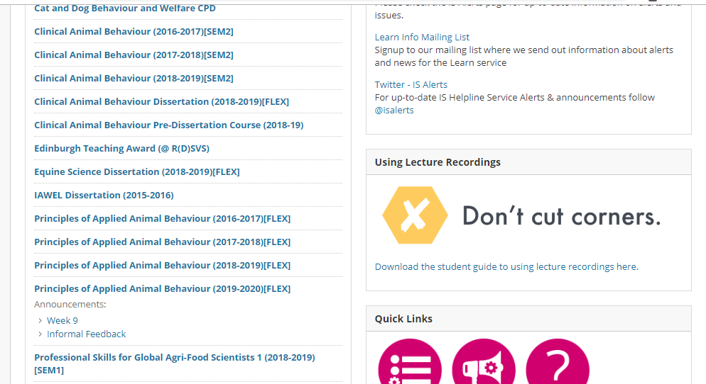
Result: Lectures as a tool
Recordings
Evidence
Edinburgh
Resources
Chat
How do we support students to use this tool?
Many people (ourselves included) use Nordmann et al guidance:
We’ve generated new CC-BY guidance too …

Slide 15
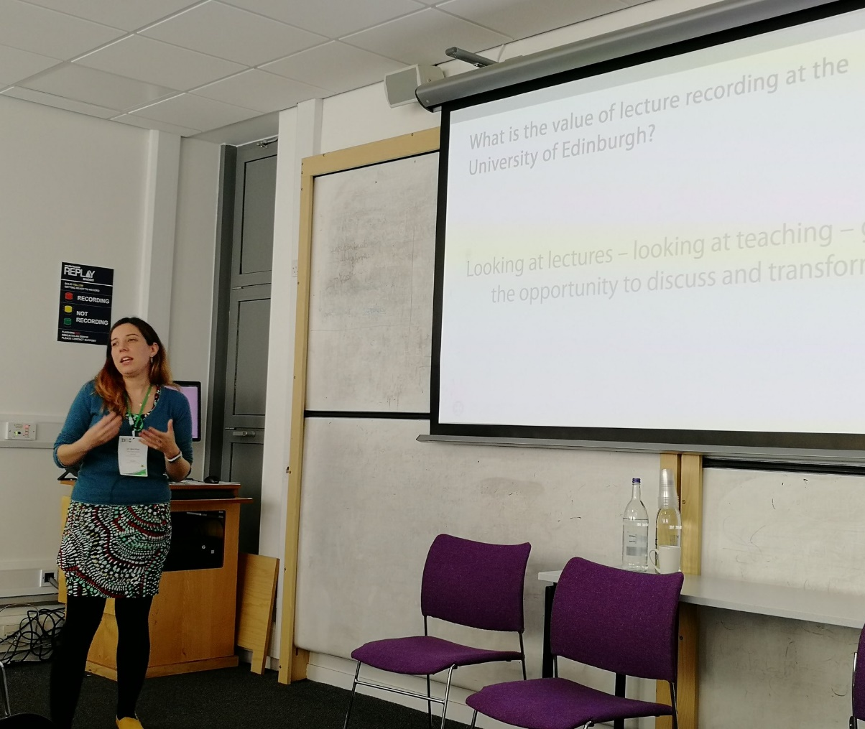
1st: Secondments
Recordings
Evidence
Edinburgh
Resources
Chat
My lessons learned . . .
Have confidence in your work
  We could have gone further
Recognise your limitations
  Industrial action has affected my work
Disseminate
  Events like this are key
Photograph: Alicia Owen @OwenMarie

Slide 16
1st: Secondments
Recordings
Evidence
Edinburgh
Resources
Chat
Resource 1:
UoE Lecture Recording Evaluation Outline
My lessons learned . . .
Have confidence in your work
  We could have gone further
Recognise your limitations
  Industrial action has affected my work
Disseminate
  Events like this are key
Photograph: Alicia Owen @OwenMarie

Slide 17

2nd: Starting Conversations
Recordings
Evidence
Edinburgh
Resources
Chat
To refine our guidance, we created a workshop
Staff and students come together to discuss complex lecture recording scenarios
From this we’ve generated our EngagEd Guide to Teaching with Lecture Recordings (2020)

Slide 18
2nd: Starting Conversations
Recordings
Evidence
Edinburgh
Resources
Chat
Resource 2:
Lecture Recording Workshop
To refine our guidance, we created a workshop
Staff and students come together to discuss complex lecture recording scenarios
From this we’ve generated our EngagEd Guide to Teaching with Lecture Recordings (2020)

Slide 19
3rd: Supporting Students
Recordings
Evidence
Edinburgh
Resources
Chat
We identified a gap in our own practice:
  If students see this as a tool – are we facilitating that?
  Do we spend too much time telling them how not to use it?
  We must support strategies – and ask students how they’re using it!

Slide 20
3rd: Supporting Students
Recordings
Evidence
Edinburgh
Resources
Chat
Resource 3:
Revising with Recordings
We identified a gap in our own practice:
  If students see this as a tool – are we facilitating that?
  Do we spend too much time telling them how not to use it?
  We must support strategies – and ask students how they’re using it!

Slide 21
Questions
Recordings
Evidence
Edinburgh
Resources
Chat
And other resources:
Edinburgh Story:
  https://www.ed.ac.uk/information-services/about/news/lecture-recording-publication
Edinburgh Evaluations:
  https://www.ed.ac.uk/information-services/learning-technology/media-hopper-replay/about-media-hopper-replay/evaluation-and-research
Edinburgh Evaluation Report (Includes survey):
  https://www.ed.ac.uk/information-services/learning-technology/media-hopper-replay/about-media-hopper-replay/evaluation-and-research/university-evaluation

