Slide 1
Evidence for Enhancement:
Improving the Student Experience
18th December 2018

Slide 2
Gathering Together: working alongside students in an evidence-critical environment
Dr Jill LeBihan
Sheffield Hallam University

Slide 3

Michael Ondaatje, In The Skin of a Lion
‘The first sentence of every novel should be: “Trust me, this will take time but there is order here, very faint, very human.” Meander if you want to get to town’ (1987, p.146).
Notes:
Image from the 1987 Secker and Warburg edition of Ondaatje’s novel. The jacket illustration is Hull Rivetting by Frederick B. Taylor, owned by the National Museums of Canada.
Refer back to Stella's osmosis model

Slide 4
Introductions and Explanations
This session is about:
Reflections on students working alongside staff
A critical eye on what counts as data from the perspective of the humanities
Thinking time
Notes:
Connections to other webinars in the series

Slide 5
Some questions
May I ask why you are here today?
Do your replies count as auditable evidence of engagement?
As ‘participant voice’?
Compliance?
Pity?

Slide 6
Staff, students and the rules of engagement
A personal tale from a teacher on the PG Certificate in Teaching and Learning in Higher Education
  ‘This is not data’
Speaking from these places:
  as practitioner
  as teacher
  out of the humanities

Slide 7
Evidence for teaching quality
Teaching, alongside healing and governing, is an 'impossible profession'.
We fall between Freud’s Scylla and Charybdis: we cannot allow complete liberty but repression causes damage. How can education ‘achieve the most and damage the least’? (Freud Standard Edition 22, p.149).
Stories and voices as data: genre (and the super-ego, and fear of management) influences what people can say.

Slide 8
TEF narratives and engagement
The script as a constraint
The script as an enabler

Slide 9
Students, colleagues and volunteers
Does your institution have a 'branded' students-as-partners scheme?
peer educators
ambassadors
mentors
colleagues
change agents
partners
SALTS
Notes:
What difference does the name make? And what about the student partnership agreement, if you have one? Constraints and requirements? Does compulsion make a difference?

Slide 10
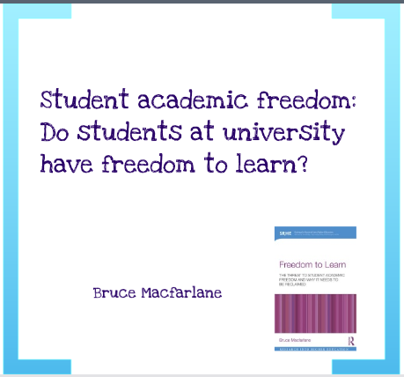
Against engagement
Macfarlane argues that the requirement to demonstrate ‘engagement’ can be at odds with the ideal of university as a place where students are free to develop their critical thinking and their resistance (Macfarlane 2018).
Notes:
Barriers to engagement from staff and students? Resistance to engagement (from staff and students)

Slide 11

Researching, Advancing and Inspiring Student Engagement
10th Anniversary Conference, Newcastle University, 4-6th September 2019
Conference theme: ‘exploring the impact of student engagement’
Organisations and journals supporting student engagement and partnership work: Lucy Mercer-Mapstone et al: A Systematic Literature Review of Students as Partners in Higher Education

Slide 12
Case Study: Student Peer Educators
Students in groups
The importance of paid training
Mutual support and the WhatsApp generation
Trusting them to do their own thing
Google form for hours and self-reflection
Mentoring relationships

Slide 13
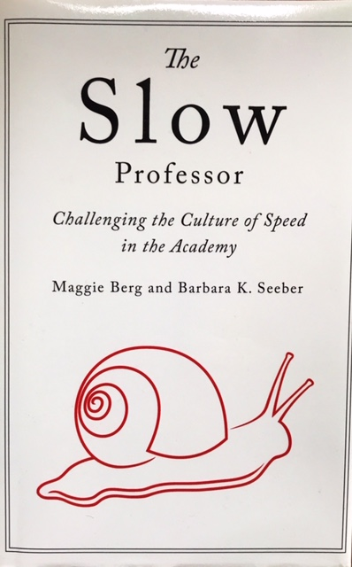
The Slow Professor
Teaching and relationships
  Pedagogy and pleasure
  'emotional investment and expression may be seen as a risky strategy' (Quinlan 2016, p.104)
Economy and exchange:
  students and staff teaching and learning together
  gathering around the subject
  Kathleen Quinlan (2016): 'creating self-directed learning groups is particularly important' -- but also it's hard to measure the success of a group if we are not part of it.
Notes:
evaluation (evaluating students and evaluating staff); affect and emotion, teaching and enjoyment -- what are the differences here between the traditional teacher and the student as partners model where you also have 'self-directed groups'

Slide 14



Representations of Teaching and Learning
Do you have a favourite role model or favourite representation of teaching from fiction or popular culture?

Slide 15
Implications
So what?
(Thinking and conversation)
(And reading)

Slide 16

Michael Ondaatje, In The Skin of a Lion
‘Only the best art can order the chaotic tumble of events. Only the best can realign chaos to suggest both the chaos and order it will become’ (p.146).
Notes:
Image owned by the Toronto Archives.

Slide 17
References
Berg, Maggie and Seeber, Barbara (2016) The Slow Professor. Toronto: University of Toronto Press.
LeBihan, Jill, Hughes, Christina and Taylor, Carol A. (2018) The Teaching Excellence Framework: Quality, Equality and Student Engagement in English Higher Education, in Jaimie Hoffman, Patrick Blessinger, Mandla Makhanya, (eds) Contexts for Diversity and Gender Identities in Higher Education: International Perspectives on Equity and Inclusion (Innovations in Higher Education Teaching and Learning, Volume 12) Emerald Publishing Limited, pp.141 - 154
LeBihan, Jill, Lowe, Tom and Marie, Jenny (forthcoming) Considerations of the challenges, conflicts and competitions when expanding student-staff partnerships across an institution: Perspectives from three UK Universities. Journal of Learning and Teaching in Higher Education.
Macfarlane, Bruce (2018) Student academic freedom: do students at university have freedom to learn. Prezi 2018. https://prezi.com/omp6-lfftqtw/do-students-at-university-have-the-freedom-to-learn/
Mercer-Mapstone, Lucy et al (2017) A systematic literature review of students as partners in higher education. International Journal for Students as Partners, Vol.1, Issue 1.
Ondaatje, Michael (1987) In the Skin of a Lion. London: Secker and Warburg.
Quinlan, Kathleen M. (2016) How emotion matters in four key relationships in teaching and learning in higher education. College Teaching, 64:3, p.101-111. DOI: 10.1080/87567555.2015.1088818

Slide 18

Evidence for Enhancement: working alongside students in an evidence-critical environment j.lebihan@shu.ac.uk
@drlb66 www.blogs.shu.ac.uk/steer
@SHU_StEER

