Slide 1
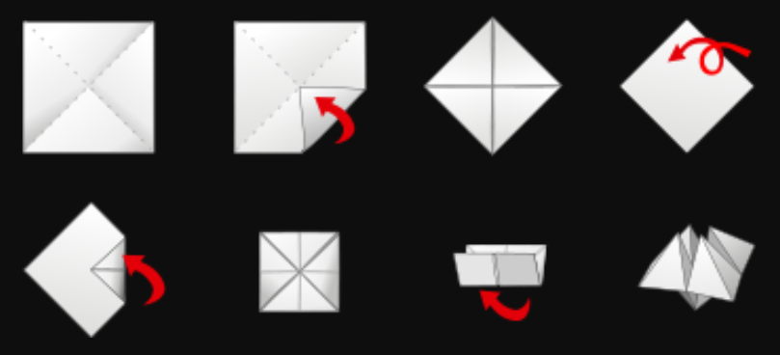
How to fold your Paku Paku
Start with the paper text-side-down; fold all four corners into the centre.
Turn the paper over; fold all four corners into the centre again.
Turn the paper over one last time; work your fingers into the four pockets.

Slide 2
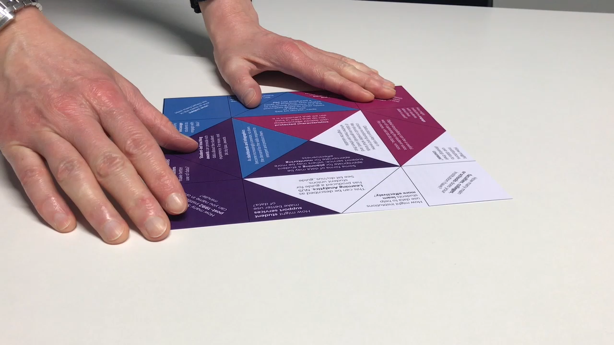
How to fold your Paku Paku: Step 1

Slide 3
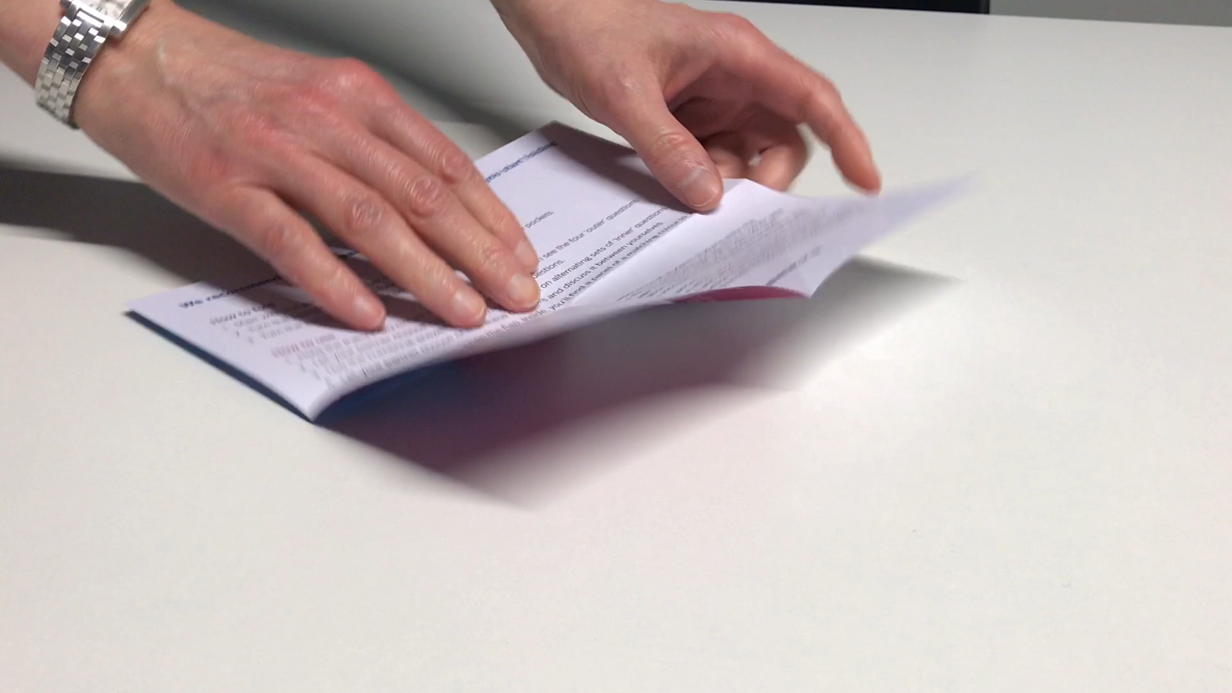
How to fold your Paku Paku: Step 2

Slide 4
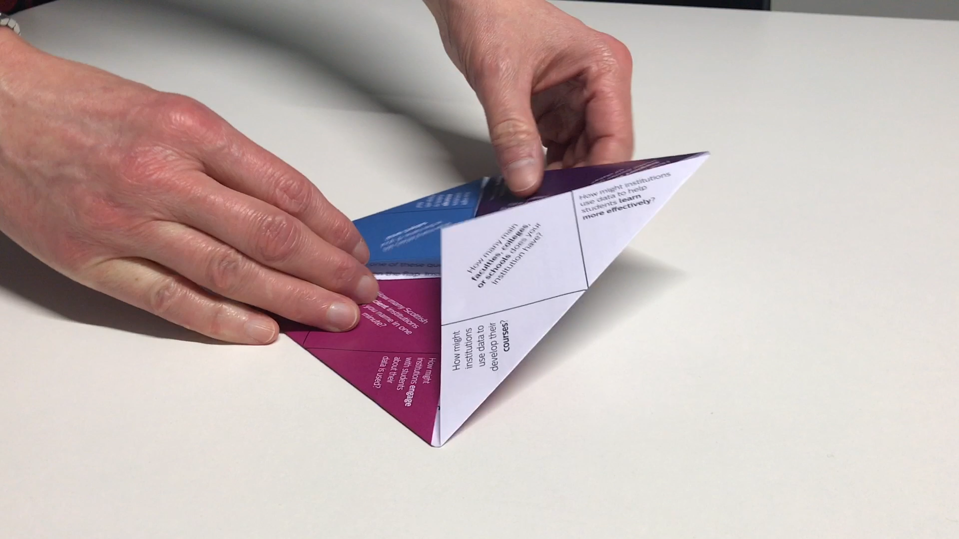
How to fold your Paku Paku: Step 3

Slide 5
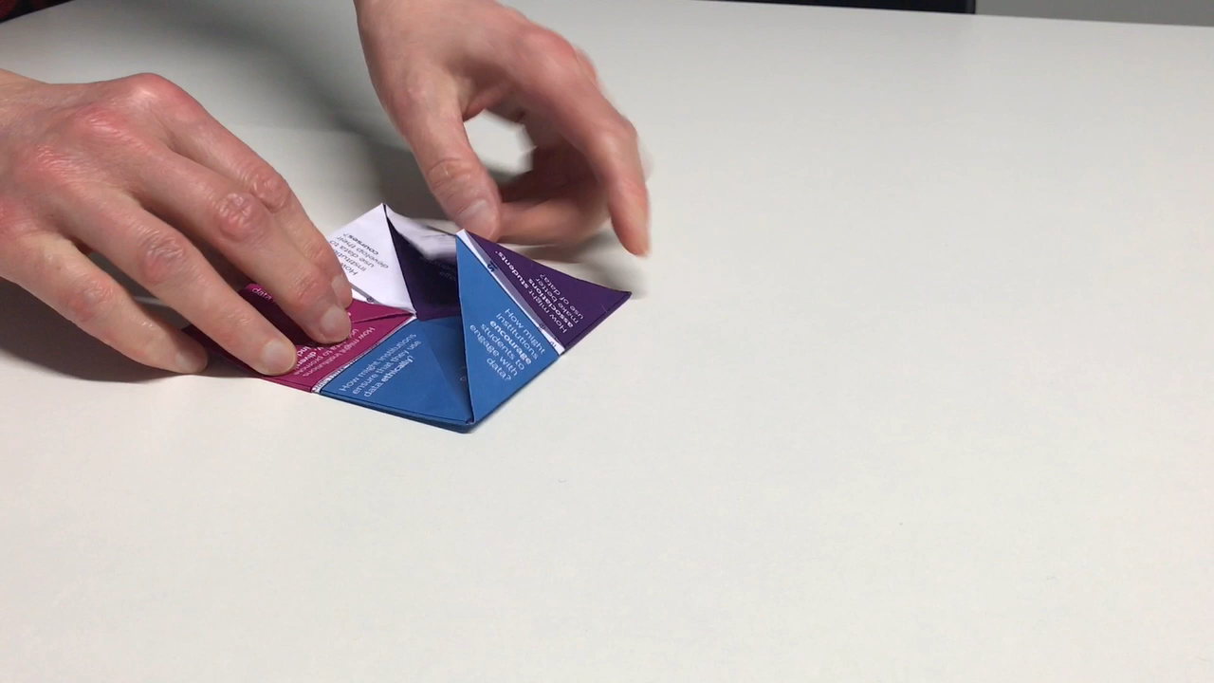
How to fold your Paku Paku: Step 4

Slide 6
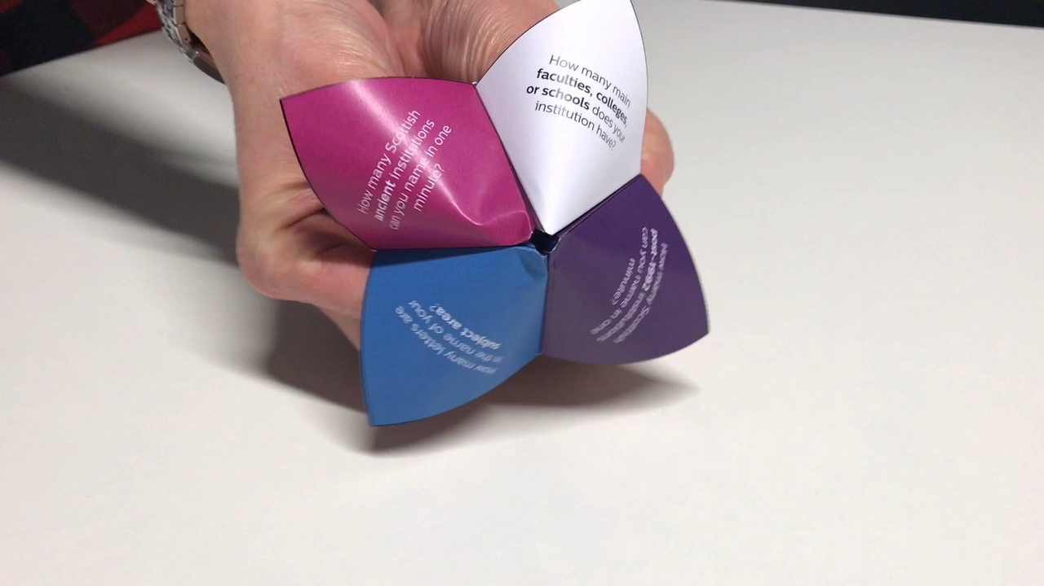
How to fold your Paku Paku: Step 5

Slide 7
How to use your Paku Paku
Hold it closed so your discussion partner can see the four ‘outer’ questions.
Let your partner choose and answer one of these questions.
Use the numerical answer to open the Paku Paku on alternating sets of ‘inner’ questions.
Let your partner choose one of these questions and discuss it between yourselves.
After five minutes, open the flap. Inside, you’ll find a panel of colour that matches your question, with signposts to further information.
Swap and repeat!

Slide 8
Answers to the ‘outer’ questions
Question 1:
Answer 1:
Question 2:
Answer 2:
Question 3:
Answer 3:
Question 4:
Answer 4:

