Slide 1
Creating Cultures of Enhancement, Supporting Programme Leadership
Professor Martha Caddell (Heriot-Watt University)
Dr Christine Haddow (Edinburgh Napier University)
19th November 2019

Slide 2

Exploring the Evidence for Enhancement Landscape

Slide 3
Exploring the Evidence for Enhancement Landscape
Identifying the Programme Leadership terrain
Dominant features … and hidden voices
Focal points that influence direction
Empowered to make decisions about course
Programme Leadership as pivotal role that needs to be brought into focus.

Slide 4

Outline of the Session
Insights from the PL Cluster
Spheres of influence, Cultures of Enhancement
Navigating alternative pathways
… and a tool to guide conversations on the way.
-------------------------------------------------
And in the chat space:
Sharing institutional experiences and exemplars.
Introducing resources and insights from the Collaborative Cluster.

Slide 5

Programme Leadership in Context
Programme Leadership in the Evidence Landscape
What does the evidence landscape look like from the programme perspective?
How can we best support programme-level enhancement?
How can programme leaders be better supported to use evidence to enhance the student experience?
How can we use the evidence we have about programme leadership to enhance support for people in such roles?

Slide 6
Programme Leadership in Context
Evidence for Enhancement Cluster
Resources and Outputs
Enhancing Programme Leadership
Navigating the Data Landscape
Engaging with Student Voices
Creating Cultures of Enhancement in Programme Teams
Developing the PL role
Discussion Symposia
Peer Sharing & External Input
Virtual networks
PL Forum
Institutional PL support
Think Pieces and Institutional Insights
Discussion Themes
https://www.enhancementthemes.ac.uk/current-enhancement-theme/optimising-existing-evidence/enhancing-programme-leadership

Slide 7

PLs and the Evidence ‘Funnel’
Measurement, management and making a difference
The student satisfaction questions which best predict overall satisfaction are those concerning teaching quality and management of the programme, not assessment and feedback (Burgess, Senior and Moores, 2018).
The quality of teaching, students feeling part of a learning community, and especially programme management are experienced by students primarily at the programme level.
This places significant responsibility on the figureheads of these programmes as interpreters and creators of evidence for enhancement.
The critical interface between ‘keystone’ metrics, diverse student & staff voices, and calls for action.

Slide 8

PLs and the Evidence ‘Funnel’
On Measurement and Hidden Voices
Programme leaders as navigators of a complex, diverse evidence landscape.
Dominant features and the ‘hidden transcripts’ that frame action and shape change.
Structures and systems (and people) to engage with.
Skills, capabilities and time needed in this role.
Valuing Programme Leadership
Prestige – Visibility – Connections
Recognition – Intrinsic Reward

Slide 9
The (ever-expanding) Programme Leader Role
Breadth and depth of Programme Leadership role.
Support is vital.
Visibility, recognition and spaces for collaboration
Within & beyond institutions.
Making PL time count.
Temporality and rhythm vital not just time.

Slide 10
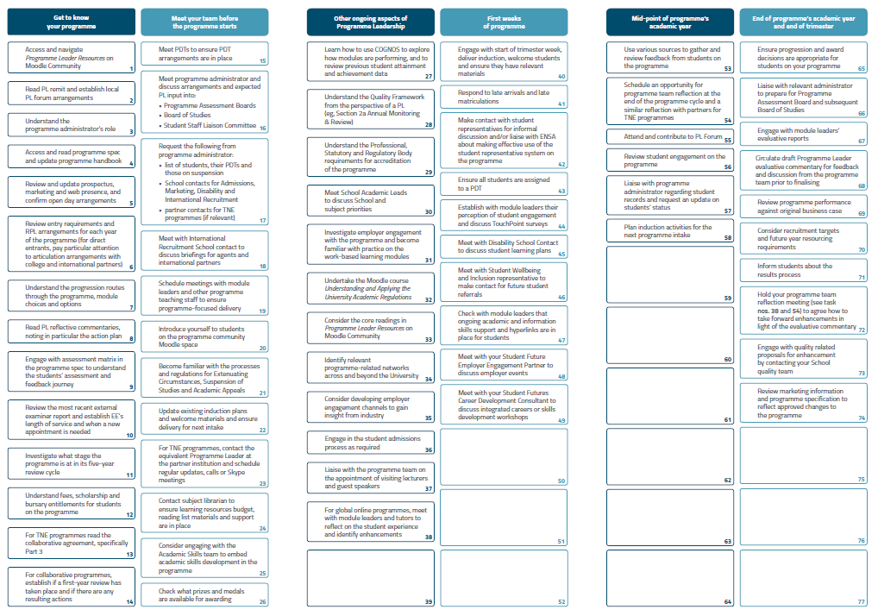

Slide 11
The (ever-expanding) Programme Leader Role
Breadth and depth of Programme Leadership role.
Support is vital.
Visibility, recognition and spaces for collaboration
Within & beyond institutions.
Making PL time count.
Temporality and rhythm vital not just time.

Slide 12
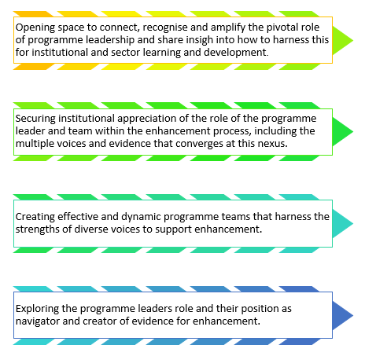
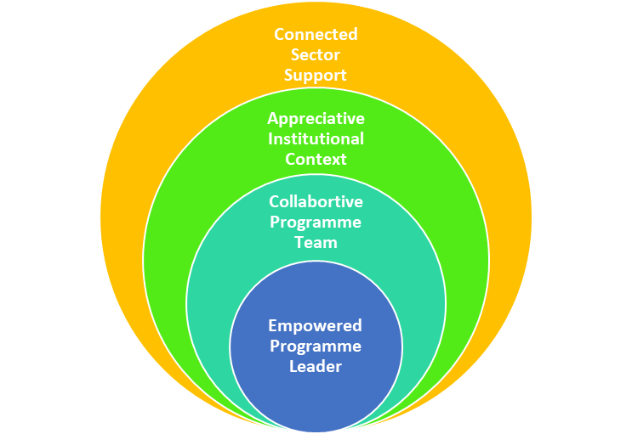
Programme Leadership in Context
Spheres of influence and action

Slide 13
Examples of Practice
Strengthening Programme Teams
Beyond real and pseudo teams.
Practical tools to support engagement.
-Global Teams
-Student voice
Shared approach to E4E
Creating an Appreciative Institutional Context
Creating space for collaboration and sharing of practice.
Time to develop skills and leadership capabilities.
Reward and Recognition.
Reorienting of institutional structure and focus.
Connected Sector Learning and Support
Spaces and time to enhance visibility.
Legitimising collaboration.
Opportunities for SoTL / SoEL.

Slide 14
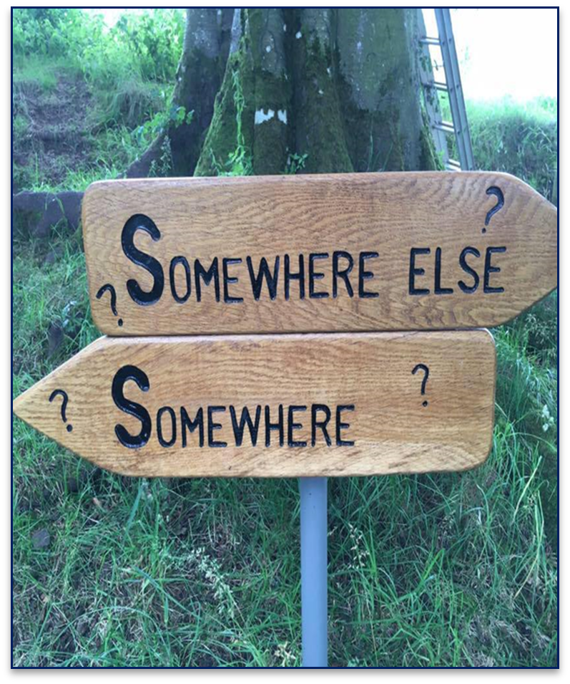
Programme Leadership: Navigating alternative pathways
Whole institution reorientation required to recognise programme leadership as central to the enhancement landscape.
Beyond management and data processing.
Pathway that is creative, action-oriented and founded on academic leadership.
Skills and capabilities required to navigate evidence for enhancement need support.
Creating a culture of enhancement that truly empowers programme leadership.

Slide 15
Programme Leadership in Context
Spheres of influence and action

Slide 16
Themes and Questions to Guide Enhancement Conversations
Empowering Programme Leaders
* How is the programme leadership role constituted? What does the job description cover?
* How is the temporality of the role recognised in workload models?
* What data sources and evidence are PLs expected and able to access as part of their role?
* To what extent are PLs empowered to lead enhancements in to the programme?
Strengthening Programme Teams
* What is the expected membership and remit of a programme team? How are staff, students and other stakeholders involved in enhancement activity?
* To what extent is the PL expected to lead or to manage the team?
* What opportunities exist for shared exploration and / or co-production of evidence for enhancement across the programme team?
Creating an Appreciative Institutional Context
* How is programme leadership recognised, supported and rewarded within the institution?
* How are programme level reports, evidence and voices engaged with and responded to?
* How is programme success celebrated and learning across programme teams shared and amplified?
Connected Sector Learning and Support
* How is strategy and practice in relation to programme leadership shared and developed at sector level?
* How could opportunities for programme leaders to share practice and exchange learning beyond their own institutional context be supported?
* How would we know that efforts to enhance programme leadership had been successful? What indicators could be useful?

Slide 17
References and Useful Resources
Bennet, R. and Kane, S. (2014). Students’ interpretations of the meanings of questionnaire items in the National Student Survey. Quality in Higher Education, 20(2), 129-146.
Burgess, A., Senior, C. and Moores, E. (2018). A 10-year case study on the changing determinants of university student satisfaction in the UK. PLoS ONE, 13(2), 1-15.
Cahill, J. Bowyer, J. Rendell, C., Hammond, A. and Korek, S. (2015). An exploration of how programme leaders in higher education can be prepared and supported to discharge their roles and responsibilities effectively. Educational Research, 57 (3), 272-286.
Cunningham, C. and Wilder, K. (2019). Programme Leaders as Invisible Superheroes of Learning and Teaching. Enhancing Programme Leadership: Project Outcomes. Available online at: https://www.enhancementthemes.ac.uk/docs/ethemes/evidence-for-enhancement/programme-leaders-as-invisible-superheroes-of-learning-and-teaching.pdf?sfvrsn=e862c381_8
Ellis, S. (2019). Programme Leadership: A Review of Evidence and an Agenda for Action. Enhancing Programme Leadership: Project Outcomes. Available online at: https://www.enhancementthemes.ac.uk/docs/ethemes/evidence-for-enhancement/programme-leadership---a-review-of-evidence.pdf?sfvrsn=97f4c381_6
Ellis, S. and Nimmo, A. (2018). Opening eyes and changing mind-sets: professional development for programme leaders. In Lawrence, J. and Ellis, S. (Eds), Supporting Programme Leaders and Programme Leadership (London: Staff and Educational Development Association), SEDA Special 39, 35-39.
Fotheringham, H. (2019). Engaging Staff and Students with Data. Enhancing Programme Leadership: Project Outcomes. Available online at: https://www.enhancementthemes.ac.uk/docs/ethemes/evidence-for-enhancement/engaging-staff-and-students-with-data.pdf?sfvrsn=e392c781_8
Haddow, C. (2019). Exploring the Data Landscape from the Programme Leaders’ Perspective. Enhancing Programme Leadership: Project Outcomes. Available online at: https://www.enhancementthemes.ac.uk/docs/ethemes/evidence-for-enhancement/exploring-the-data-landscape-from-the-programme-leaders-perspective.pdf?sfvrsn=f162c381_6
King, M. (2019). Student Surveys – Process to Enhancement. Enhancing Programme Leadership: Project Outcomes. Available online at: https://www.enhancementthemes.ac.uk/docs/ethemes/evidence-for-enhancement/student-surveys---process-to-enhancement.pdf?sfvrsn=f062c381_8
Malone, E. (2019). Top Tips for Programme Leaders. Enhancing Programme Leadership: Project Outcomes. Available online at: https://www.enhancementthemes.ac.uk/docs/ethemes/evidence-for-enhancement/top-tips-for-programme-leaders.pdf?sfvrsn=fb92c781_8
Voorhees, R.A. and Cooper, J.D. (2014). Opportunities and Barriers to Effective Planning in Higher Education. In Menon, M.E. et al. (Eds), Using Data to Improve Higher Education. Rotterdam: SensePublishers.

