Slide 1
Evidence for Enhancement:
Building an evidence based approach to widening access: Scotland’s Framework for Fair Access
Dr Stephanie Mckendry (University of Strathclyde and Office of the Commissioner for Fair Access)
23 March 2019

Slide 2



‘Fair Access’ to Higher Education
Thriving body of activity, research and theory focused on improving access to HE for under-represented or disadvantaged people:
  Institutional activity (summer schools, taster programmes, mentoring, tutoring)
  Regional, Scottish Funding Council-funded access programmes (SHEP, AHD)
  Third sector organisations (Robertson Trust, Children’s University, Brilliant Club)
Most HEIs have widening participation/ widening access staff who engage in outreach/engagement and access policy;
Access has been an element of Outcome Agreements for a number of years and the Post-16 Education Act (Scotland) 2013 introduced a regulatory framework on access
BUT progress has been slow

Slide 3
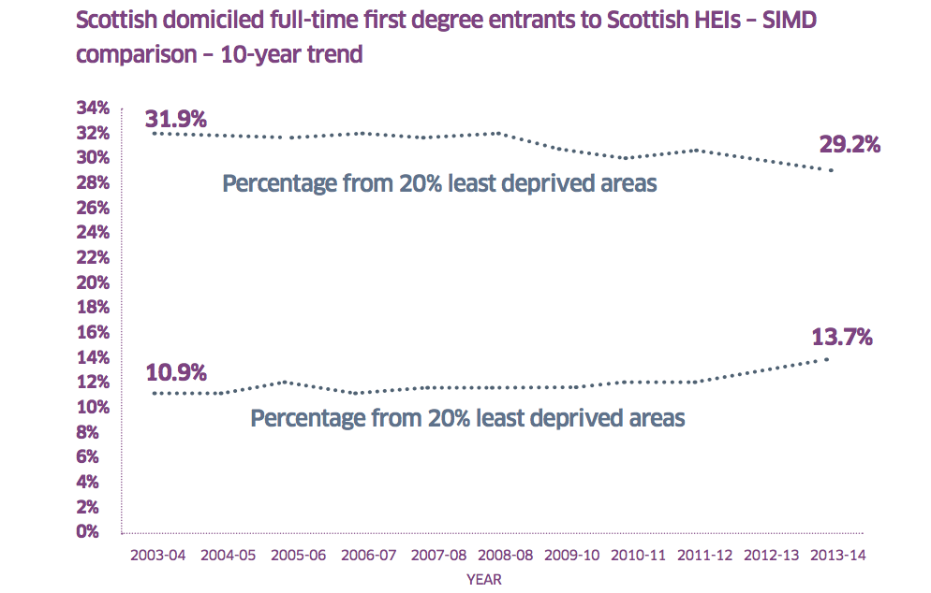
‘Fair Access’ to Higher Education
Source: Commission on Widening Access, interim report
SIMD – Scottish Index of Multiple Deprivation
Percentage from 20% least deprived areas
Percentage from 20% most deprived areas

Slide 4
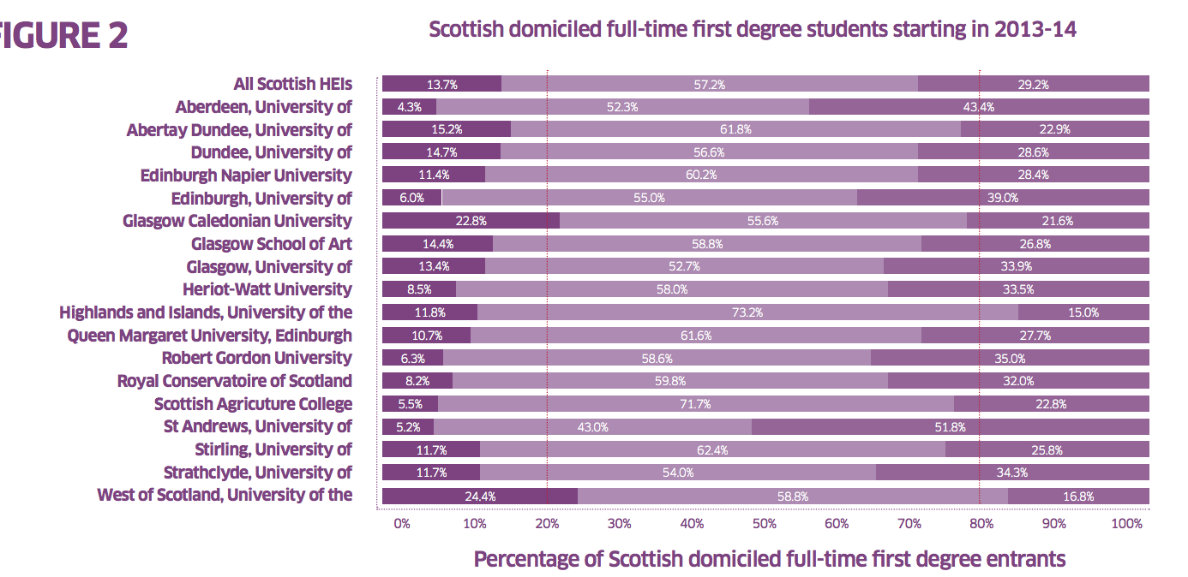
‘Fair access’ to Higher Education
Source: Commission on Widening Access, interim report
SIMD – Scottish Index of Multiple Deprivation

Slide 5
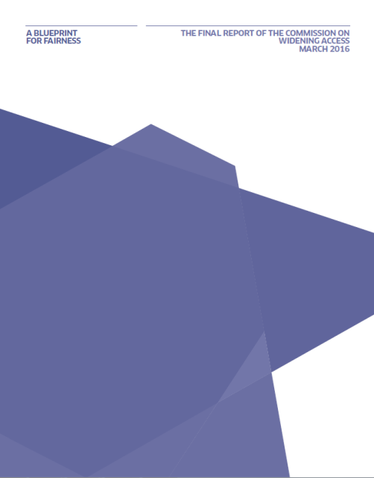
Commission on Widening Access
Announced in First Minister’s Programme for Government in November 2014.
Chaired by Dame Ruth Silver, met from April 2015 with final report, Blueprint for Fairness published in March 2016.
Consciously focused on fair access to f/t first degree study for those from socioeconomically deprived backgrounds or those with care experience.
Acknowledged areas left unconsidered e.g. additional barriers faced by people with protected characteristics.
33 Recommendations for Scottish Government, Scottish Funding Council, Universities and other stakeholders;
All accepted;

Slide 6
Commission on Widening Access
Access targets
By 2030, students from 20% most deprived backgrounds should represent 20% entrants to higher education. Equality of access should be seen in both the college and university sectors
  By 2021, students from 20% most deprived backgrounds should represent at least 16% of f/t, 1st degree entrants to Scottish HEIs
  By 2021, students from the 20% most deprived backgrounds should represent at least 10% of f/t, 1st degree entrants to every individual institution.
  In 2022, the target of 10% for individual Scottish institutions should be reviewed, and a higher target should be considered for subsequent years.
  By 2026, students from the 20% most deprived backgrounds should represent at least 18% of full-time first degree entrants to Scottish universities as a whole
  Scottish Index of Multiple Deprivation (SIMD) used as a measure.

Slide 7
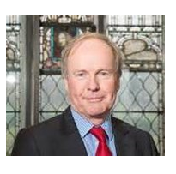
Commissioner for Fair Access
Professor Sir Peter Scott appointed first Commissioner in December 2016 to lead system wide effort to deliver fair access in an independent, non-statutory role.
Functions:
Lead cohesive efforts; acting as advocate for disadvantaged learners and holding to account those with role in achieving access (inc. Ministers and SFC);
Coordinate and prioritise development of more substantial evidence base, including commissioning and publication of independent research and development of Framework for Fair Access;
Publish, annually, a report to Ministers outlining Commissioner’s views on progress towards equal access to inform development of effective policy at national, regional and institutional level.

Slide 8
Commission on Widening Access – evidence of impact
The lack of robust, quantitative, research based evidence on the success of access programmes is a particularly frustrating problem. It is presently almost impossible to judge with precision which programmes deliver meaningful impact, and consequently, where best to target the substantial public and institutional resource that is invested in access.
Yet the solution is straightforward. At the heart of all access programmes should be rigorous arrangements for monitoring and evaluation, based on sound research methodology. Over
time, sharing the robust data yielded from these processes across the whole education system will contribute to the development of a more substantial and reliable national evidence base.
Blueprint for Fairness, p. 23

Slide 9
Commission on Widening Access – evidence of impact
Does that summary ring true?
Is it similar to other elements of the HE sector?
What might explain it?

Slide 10
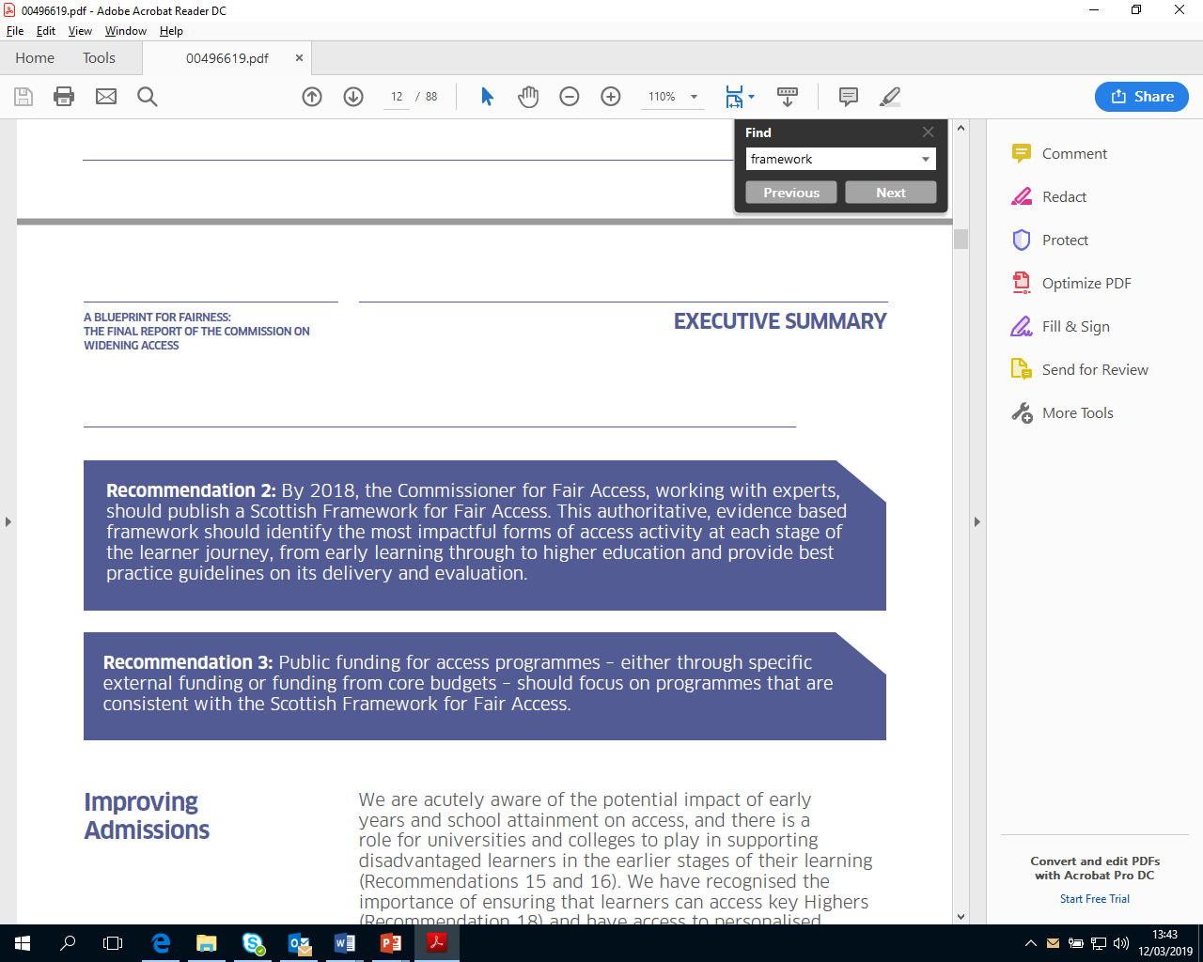
Framework for Fair Access
Notes:
‘...there is very little evidence of the relative effectiveness of different access initiatives. This lack of robust evidence has presented the Commission with challenges in identifying the interventions that deliver most impact. Considerable sums of public money are invested in access initiatives both by the Scottish Funding Council and institutions themselves and it is vital that this is spent to best effect.’
Blueprint for Fairness, p. 9, https://www.gov.scot/publications/blueprint-fairness-final-report-commission-widening-access/

Slide 11

The two pillars of the Framework for Fair Access
SCAPP (Scotland’s Community of Access and Participation Practitioners)
Community of Practice for all involved in access;
Development Coordinator role to develop activities and network and move to sustainable funding model;
Professional accreditation and training provision;
Link developed between researchers and practitioners to improve evidence base
Online toolkit
Summarises evidence on impact of interventions/ activities across learner journey and with full range of target participants;
Toolkit has capacity to include evidence on impact by equality groups and to search for interventions by learner groups though there is insufficient robust evidence at present;
Identifies gaps in evidence
Includes example of promising Scottish practice

Slide 12
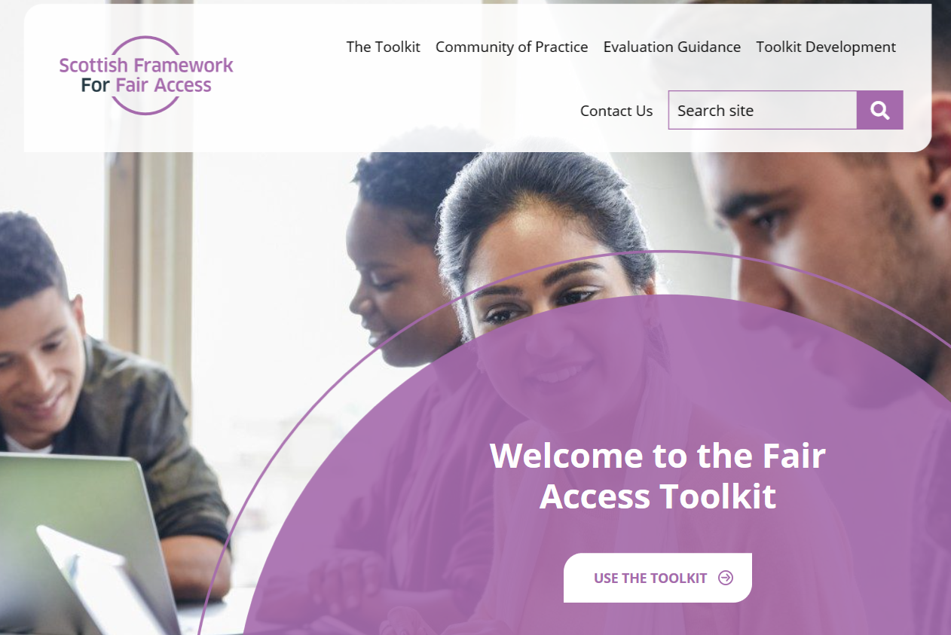


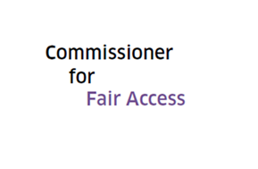
Framework for Fair Access

Slide 13
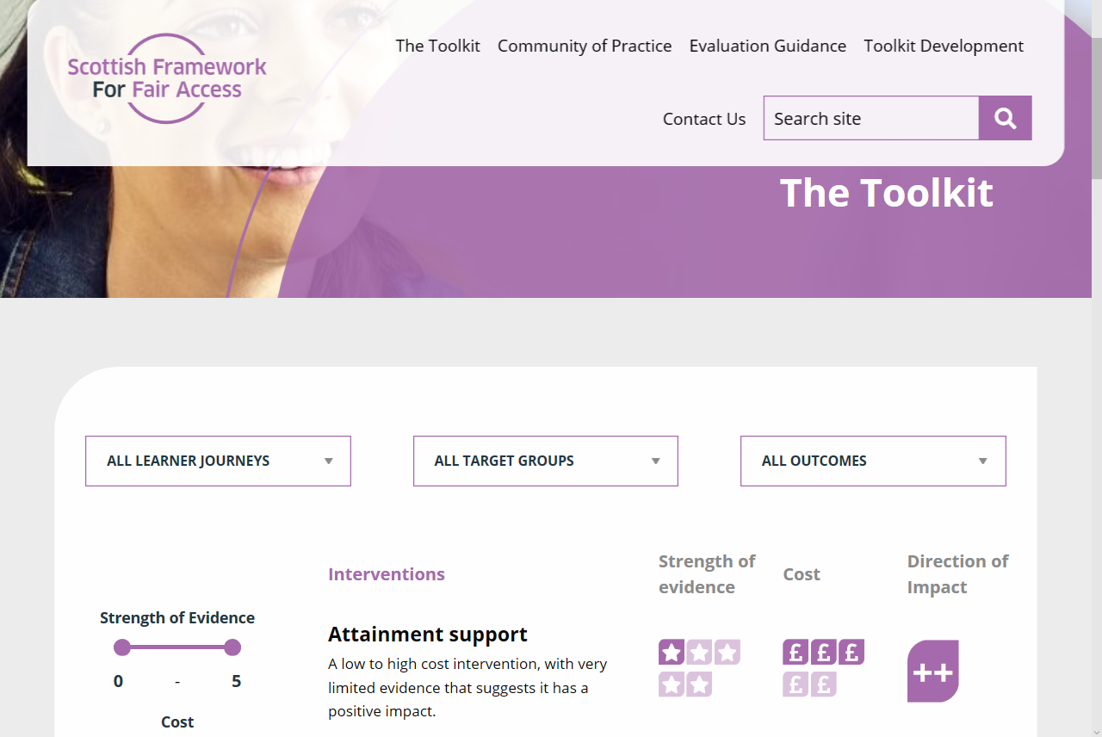
Framework for Fair Access
Evidence underpinning interventions is assessed at Level 1 (evidence of change/impact), Level 2 (evidence of comparative impact) and Level 3 (evidence of causal impact)
Indication of cost, effectiveness and credibility of supporting evidence for each intervention

Slide 14
Framework for Fair Access
Explores interventions across the learner journey
Access to HE
Participation in HE
Post-HE
Outcomes include:
Application to HE
Enrolment in HE
Attainment
Completion
Employability

Slide 15
Framework for Fair Access – getting the balance right
Providing useful evidence on what works
Identifying gaps in understanding or activity
Seeking ambitious approach to evaluation, joined up activity and engagement of practitioners
No intention to stifle creativity of activities or evaluation methods
Perhaps inevitable volume of evidence from quantitative approaches but no privileging of particular methods
There are improvements that are best achieved collaboratively – longitudinal tracking of learners, professional development activities
Would it be useful to have a standardised evaluation framework for similar types of interventions? How can we avoid reductive approaches or understanding when launching the Framework?

Slide 16
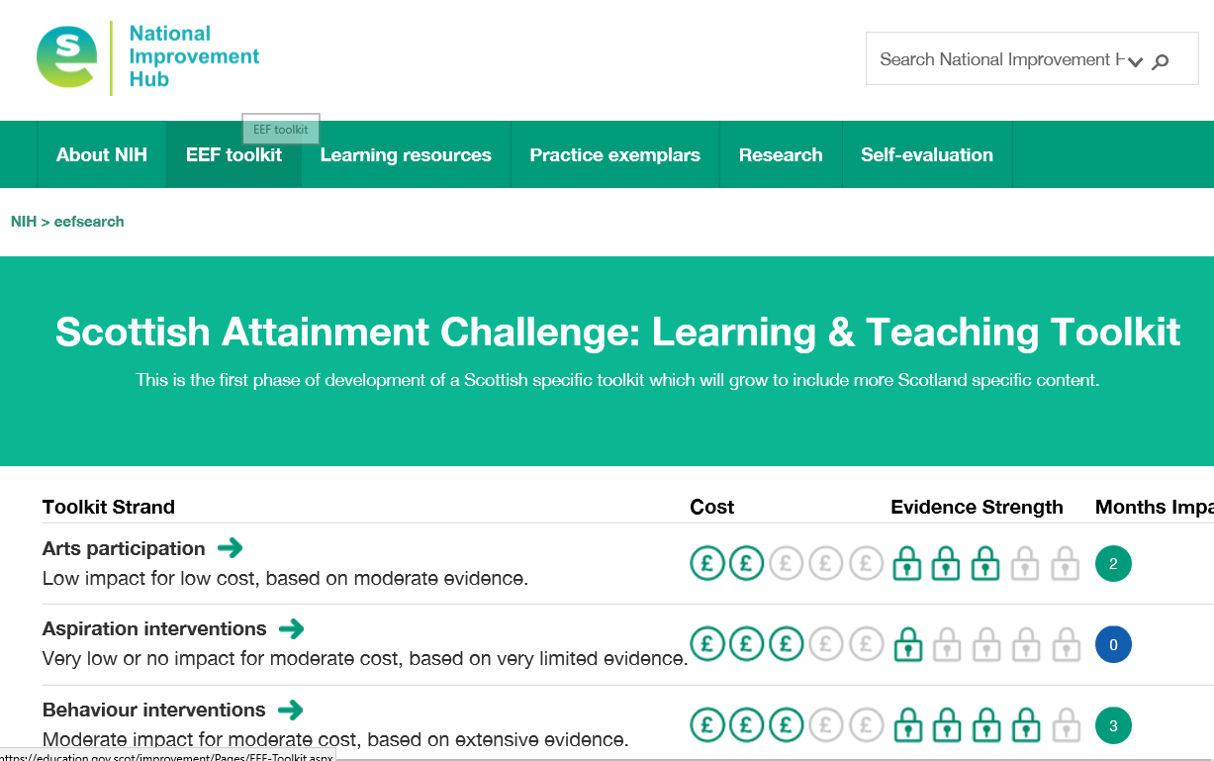
Framework for Fair Access – learning from others
Education Endowment Fund’s work on learning and teaching in schools
QAA Enhancement Themes e.g. Transitions Map
Office for Students’ Evidence and Impact Exchange
Should we be linking to other work?

Slide 17
Framework for Fair Access – bringing researchers and practitioners together
We believe the combination of toolkit and community of practice is key – with each reinforcing the value and activities of the other
Planned series of events to explore different forms of evaluation/methodologies for practitioners
Framework Governance Group provides strategic oversight to both pillars – Chaired by Commissioner for Fair Access with representatives from SFC, third sector, HE, FE, schools, researchers

Slide 18
Framework for Fair Access – the launch is the first stage in the process
Need to manage expectations and clarify what the Framework, and toolkit, can do and what it cannot.
CFE Research will provide update of evidence in summer 2019 and 2020
Community should support further development of toolkit – collation of evidence, development of best practice guidance…

Slide 19
Framework for Fair Access – the launch
Official public launch planned for Tuesday 7th May 2019
Online toolkit will be published
SCAPP will be launched
Booking details will be advertised shortly

Slide 20

Thank you for listening

