Slide 1
Evidence for Enhancement:
Improving the Student Experience
15th October 2019

Slide 2
Beyond the Metrics: Charting the Intangible Aspects of Enhancement
Dr. Alastair Robertson, Abertay University alastair.robertson@abertay.ac.uk
Prof. Elizabeth Cleaver, UWE Bristol elizabeth.cleaver@uwe.ac.uk
Dr Fiona Smart, Edinburgh Napier University f.smart@napier.ac.uk

Slide 3
Introduction to the project
The ‘wicked problem’ (Rittel & Webber, 1973) of measuring things that can’t be counted
Encountering the McNamara Fallacy (Yankelovich,1972; cited in O’Mahony, 2017)
Haskell & Westlake (2017) – the rise of the intangible economy
  ‘we are now trying to measure capitalism without counting all of the capital’ (p.7)
Key Question:
In an educational world increasingly dominated by metrics and data, how can we ensure that we don’t fall in to the trap of measuring educational excellence or value, without counting all of the education?
Notes:
Alastair

Slide 4

Our Aim
To provide a renewed understanding of contributory aspects to the success of higher education that are deemed to be important yet not easily measurable or quantifiable: our so-called 'intangible assets'.
Notes:
Alastair

Slide 5
Identifying and Mapping Intangible Assets
draws on cultural mapping literature and approaches
a practical and participatory planning and development tool
to identify aspects of place or culture that build a sense of identity or place but are not easily quantified.
prioritises a community’s intellectual capacity and its ability to define its own meaningful resources
  Methodologically if one accepts that the intangible, the subjective and the immaterial are important to what culture is as an object of study, then quantitative methods alone are inadequate. This interest in making the intangible visible heightens the importance of drawing on cultural research traditions that are primarily qualitative in nature
  (Duxbury, Garrett-Petts & MacLennan, 2015 p.18)
Notes:
Alastair

Slide 6
Identifying and Mapping Intangible Assets
Based on cultural mapping methodology - focused on 3 key steps:
Step 1: What are the most important IAs for us and our stakeholders and why are they important?
Step 2: How do we know that we value the IA – can we map it?
Step 3: Now we know what is important and where we invest in it, is this making a difference - and for whom?
Notes:
Alastair

Slide 7
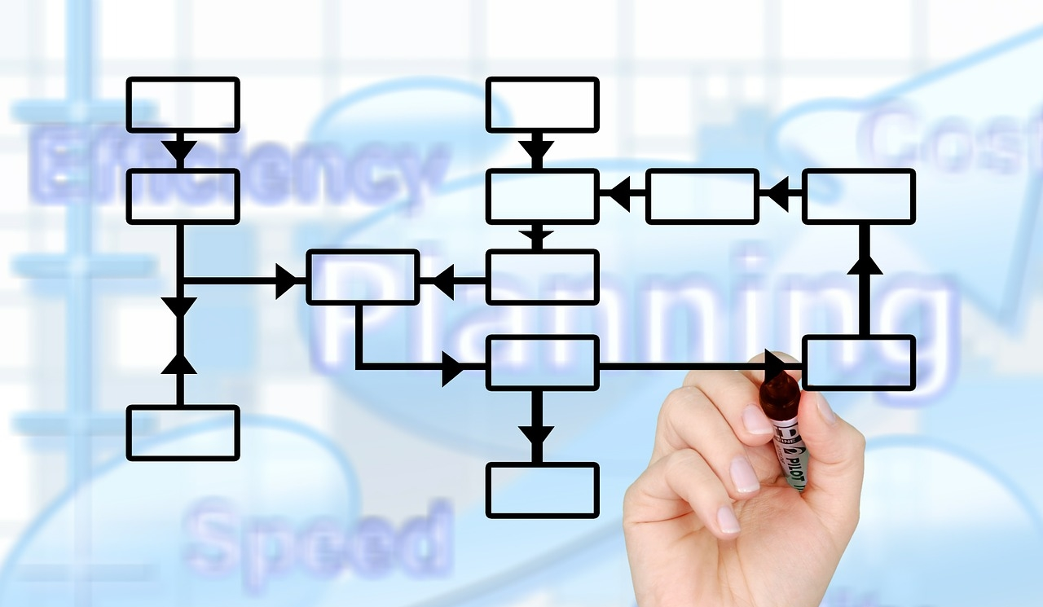
Step One
We engaged in conversations across the sector
Nine workshops
  England
  Scotland
147 participants
Notes:
Fiona

Slide 8
Step 1: Our evidencing value grid
What is important to your education experience which you can’t easily measure? |  | Why does this intangible aspect of your experience matter to you? Why does it have value to you?
If you dared to dream, how might your intangible be recognised as being of importance/ value in your institution? |  | At the moment, do you have a proxy measure for this intangible?
Notes:
Fiona

Slide 9
Our findings
Priority assets
  Sense of belonging/academic community belonging
  Relationships between staff members and staff and students
  The transformative impact of higher education
  The wellbeing of staff and students
  Student engagement and participation
Notes:
Fiona

Slide 10
Step Two: Mapping the Intangibles #1
To support the mapping of the intangible assets and to showcase evidence of investment, gaps and over investments we developed our Evidencing Value Organisational Framework
Based on:
  organisational design and effectiveness literature
  evidence and insight gathered through this study
Notes:
Liz

Slide 11
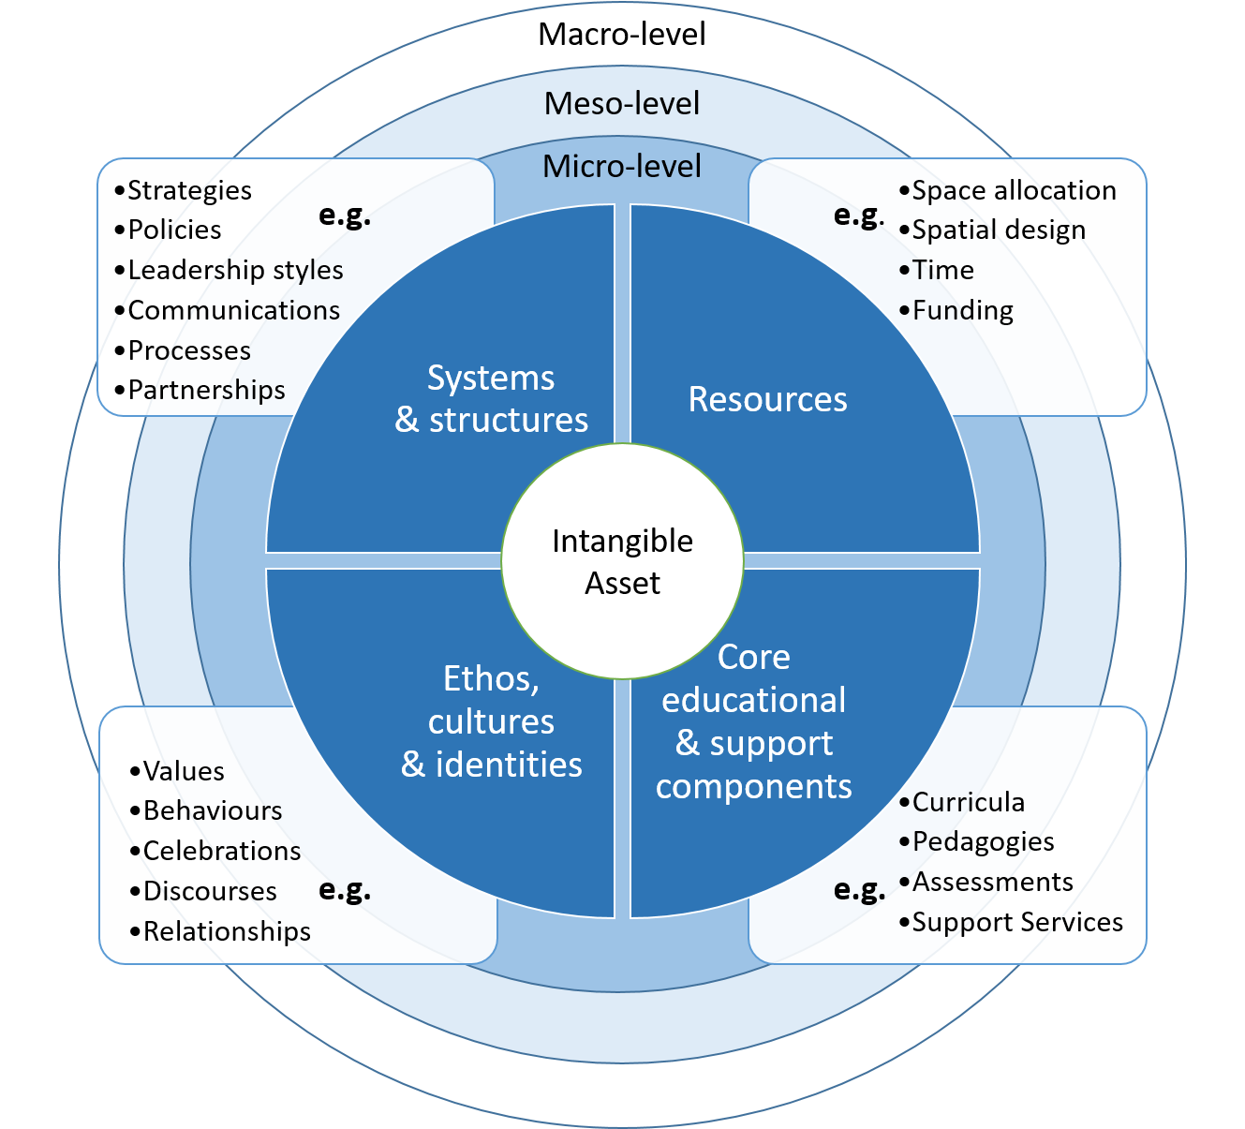
Mapping the Big Picture: the Evidencing Value Framework
Notes:
Liz

Slide 12
Step 2: Mapping the Intangibles #2
Are your most important IAs adequately captured and evidenced?
Are there any opportunities for additional/new value creation and capture?
Are there areas of over-valuation to the disadvantage of others?
How do you know your activities are enhancing the intangible asset? Are you spending your time effectively?
Notes:
Liz

Slide 13
Step 3: Evidencing Value through Narrative, Affirmation and Evaluation
How does your evidence help you to ‘map’ your intangibles through words and stories?
Do current communications reflect and affirm value of each intangible asset for the greatest impact?
Are existing evaluation activities targeted in the right areas and asking the right questions?
Are there opportunities to collect more nuanced and focused evidence of impact and case studies?
Notes:
Liz

Slide 14

‘Testing our thinking’ workshops
Notes:
Alastair

Slide 15

Any questions, next steps and get in touch
Subject Level TEF at UWE
T&L strategy development
Curriculum Reform
Services review
Internal quality review
ELIR
If you would like us to run workshops at your institutions, then please get in touch.
Notes:
Alastair

Slide 16
References
Duxbury, N., Garrett-Petts W.F. & MacLennan, D. (2015) Cultural Mapping as Cultural Inquiry. New York: Routledge.
Haskel, J. & Westlake, S. (2017). Capitalism without Capital: the Rise of the Intangible Economy. Princeton: Princeton University Press.
O’Mahony, S. (2017) Medicine and the McNamara fallacy. Journal of the Royal College of Physicians Edinburgh. 47, pp. 281–7.Available: https://doi.org/10.4997/JRCPE.2017.315
Rittel, H. & Webber, M. (1973) Dilemmas in a general theory of planning. Policy Sciences. 4 (2), pp.155-69.
Yankelovich, D. (1972). Corporate priorities: A continuing study of the new demands on business. Yankelovich Inc., Stamford, CT.

Slide 17
Beyond the Metrics: Charting the Intangible Aspects of Enhancement

